Slide 1
Electron Configurations and PERIODIC TRENDS

Slide 3
Atomic Radius
Atomic Radius (size) is determined by 2 things:
1. n – as n increases, electrons are farther from the nucleus
size INCREASES as you go DOWN the table
2. Effective Nuclear Charge (Z_{eff})– net force of attraction between electrons and the nucleus
Ex: B C N
Size DECREASES as you go to from RIGHT (more protons, bigger Z_{eff})

Slide 4
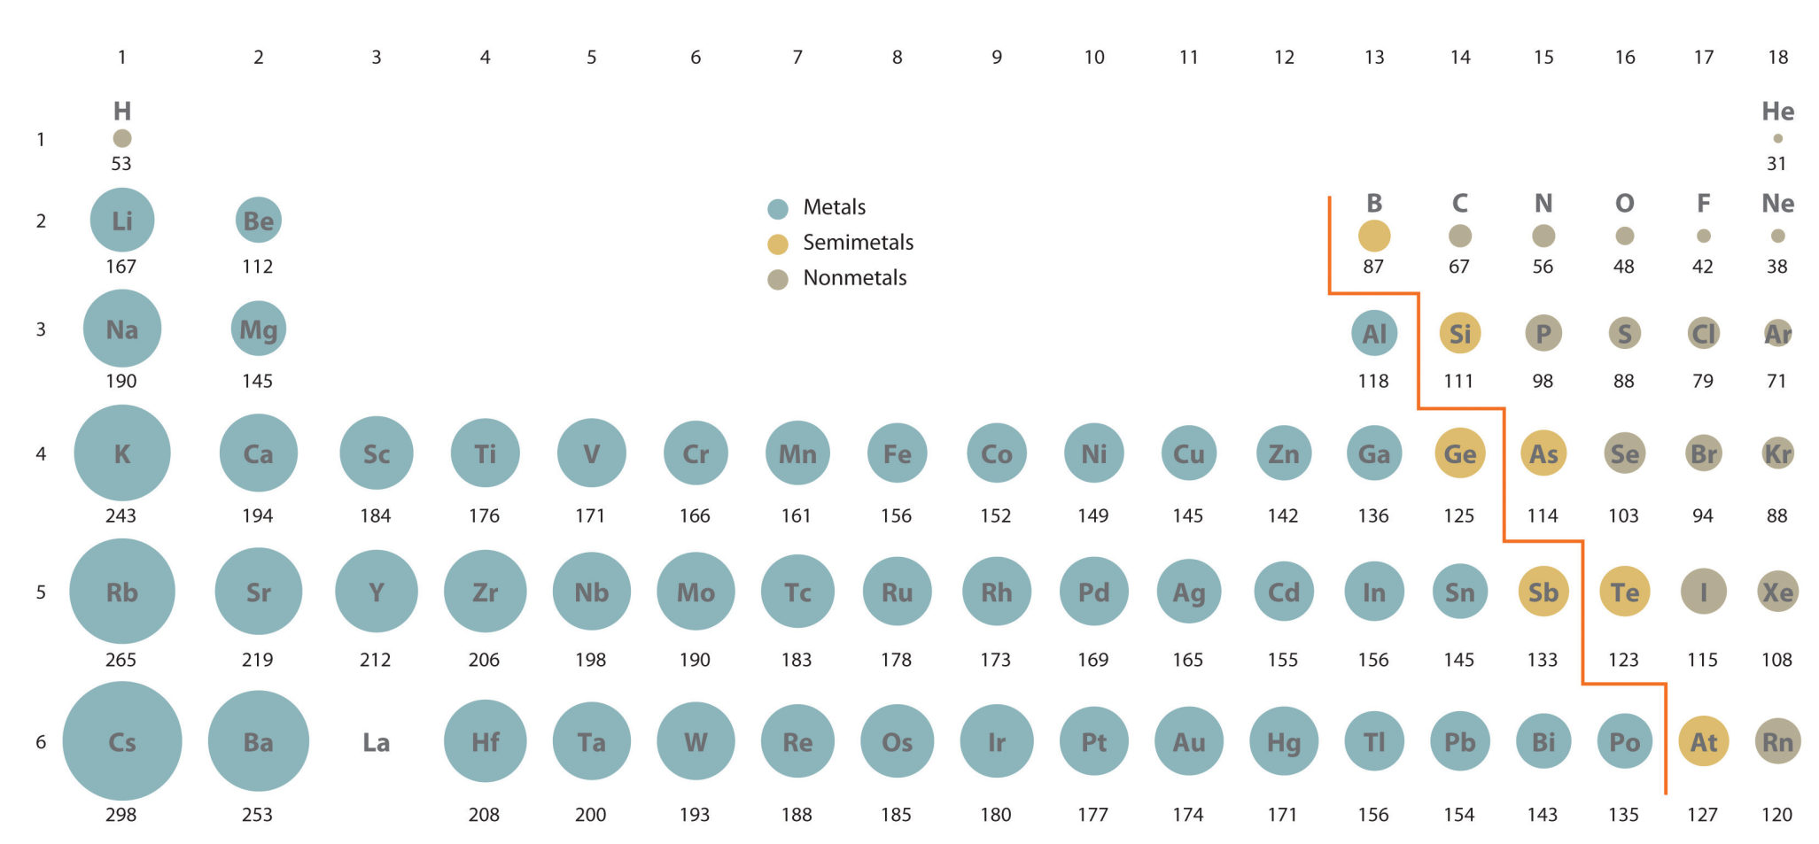
Atomic Radius

Slide 5
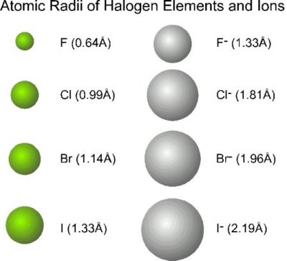
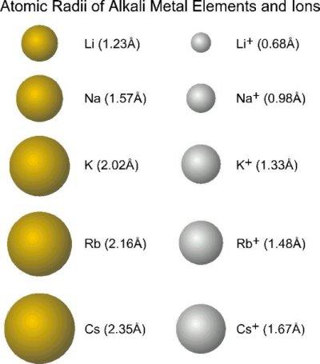
Atomic Radius of Ions
Anions (negative) Cations (positive)
-adding electron - removing electron
-size increases - size decreases

Slide 6
Ionization Energy (IE)
The energy needed to remove an electron from a ground state atom (to overcome attraction between e- and p+)
Easier to remove → smaller IE
Atoms with multiple electrons have multiple ionization energies
1st IE < 2nd IE < 3rd IE…
As Z_{eff} increases (and size decreases), electrons are harder to remove so ionization energy increases
Ionization energy decreases going down and increases going right

Slide 7
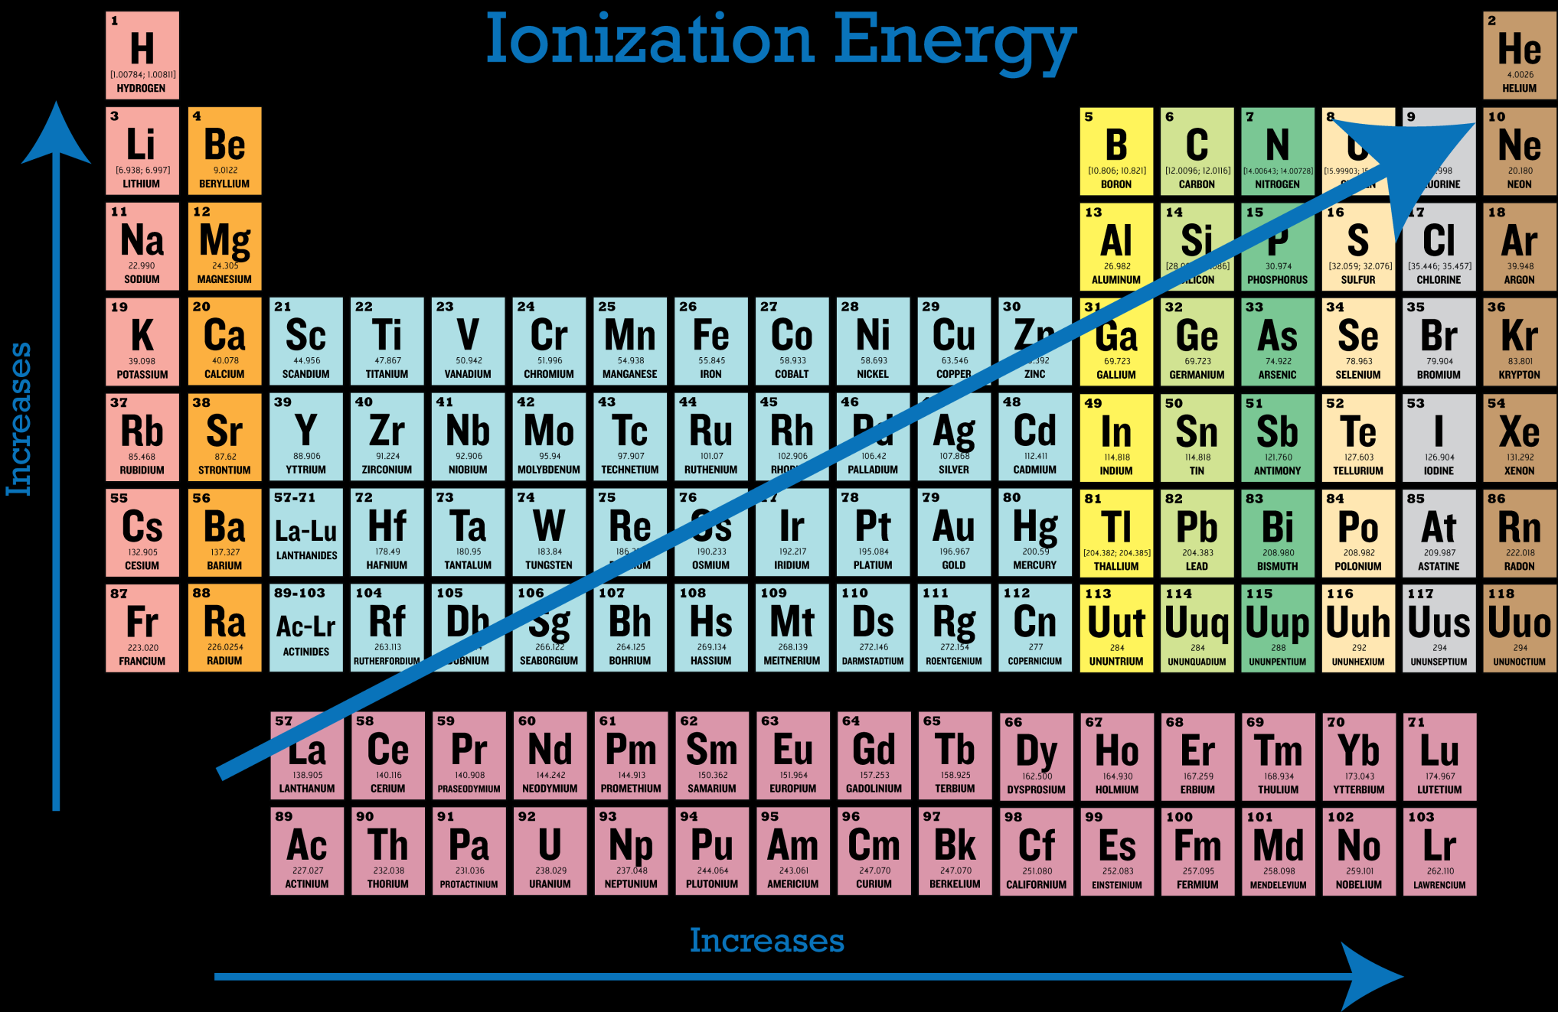

Slide 8
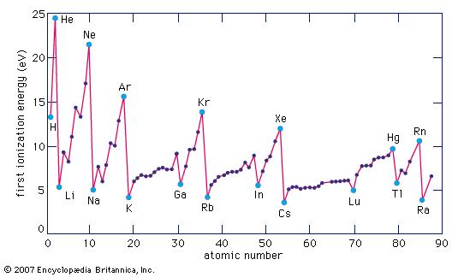
Why the blips?

Slide 9
Electron Affinity (EA)
The change in energy that occurs when an electron is added to a gaseous atom
AKA the ability of an atom to accept electrons
The easier it is to add an electron, the higher the EA (or larger negative number)
Electron Affinity decreases as you add more electrons
1st EA > 2nd EA > 3rd EA…
EA decreases down a group, and increases to the right

Slide 10
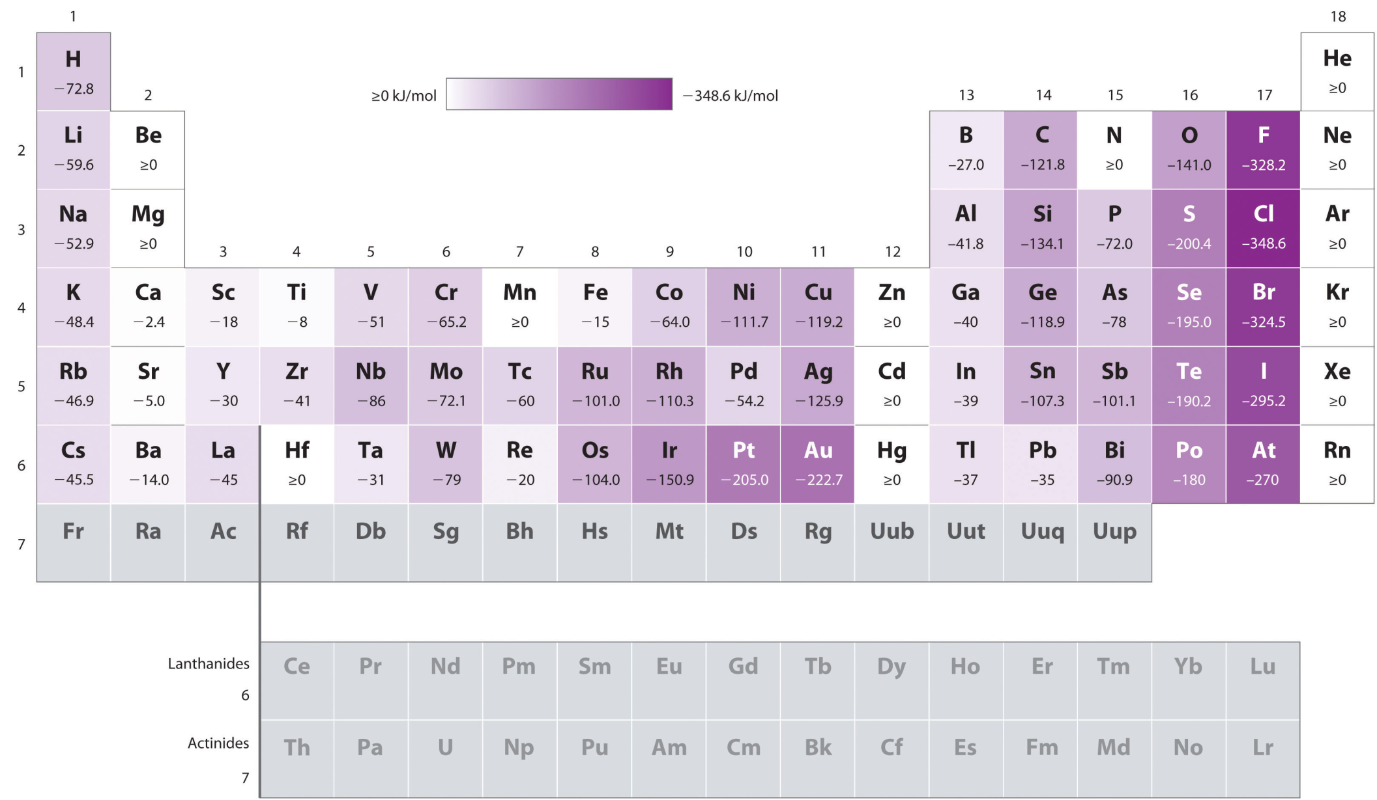

Slide 11
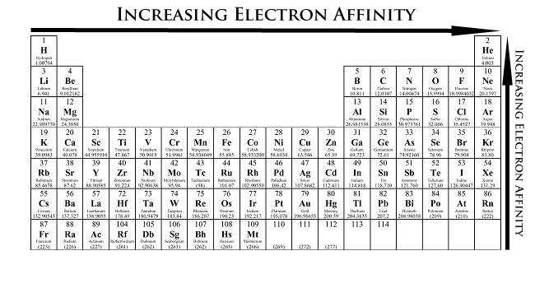

Slide 12
Electronegativity
The atom of an atom for electrons in a chemical bond
Higher EN → greating attraction for bonding e-
Strong EN → polar molecules (uneven distribution of charge)
EN decreases down and increases to the right (due to size and Z_{eff})

Slide 13
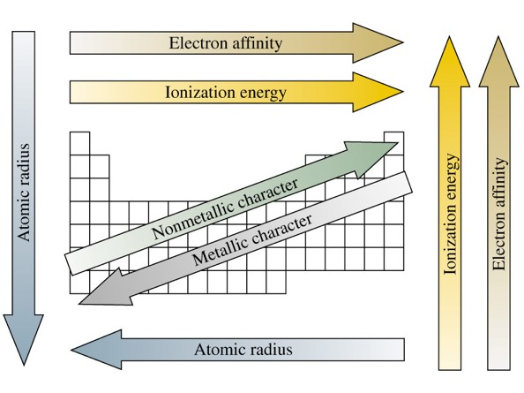
Summary

