Slide 1
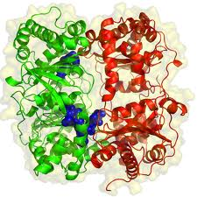
Enzymes

Slide 2
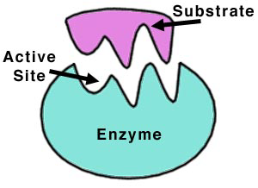
What is an Enzyme
Protein catalysts
Exhibits substrate specificity
Speeds up chemical reactions by lowering the activation energy
Not consumed during a reaction

Slide 3
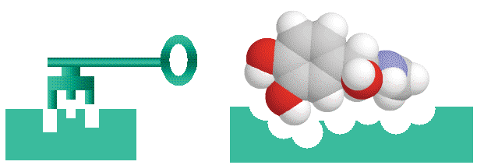
Lock and Key Model
Enzymes are specific to their substrate(s)
1 Substrate for each enzyme

Slide 4
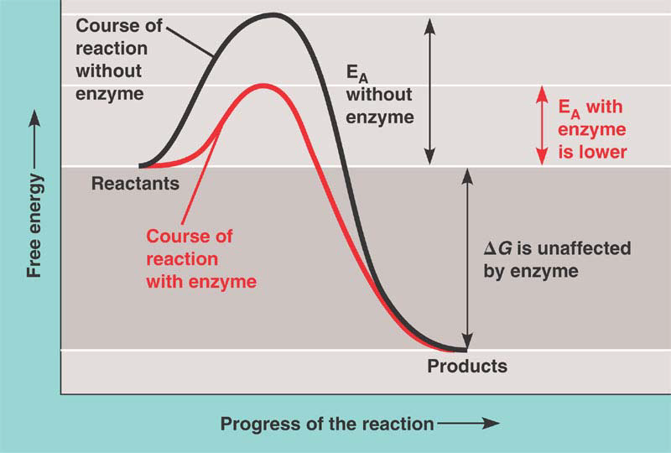
What Do Enzymes Do?
Lowers the Activation Energy required for a reaction to take place

Slide 5
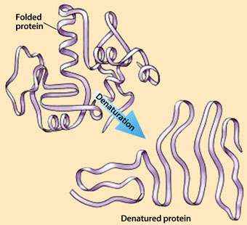
Why use Enzymes?
Heat usually speeds up reactions
Proteins are denatured at high temperatures and lose their function
Body cannot rely in increased temperatures to speed up reactions

Slide 6
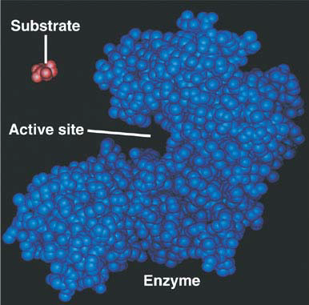
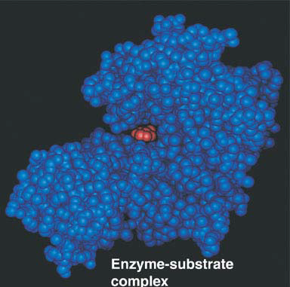
Enzyme-Substrate Complex
Substrates bind to an active site to form an enzyme-substrate complex
Active site undergoes a conformation change to better accommodate the substrate – Induced Fit Model

Slide 7
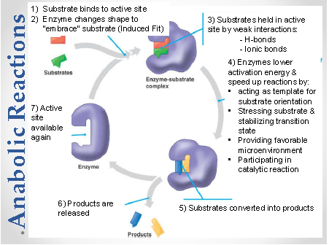

Slide 8
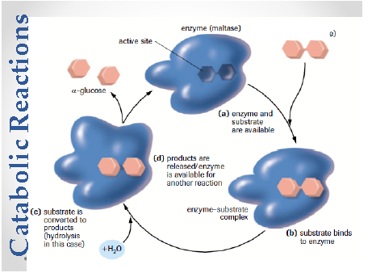

Slide 9
Factors that Affect Enzyme Activity

Slide 10
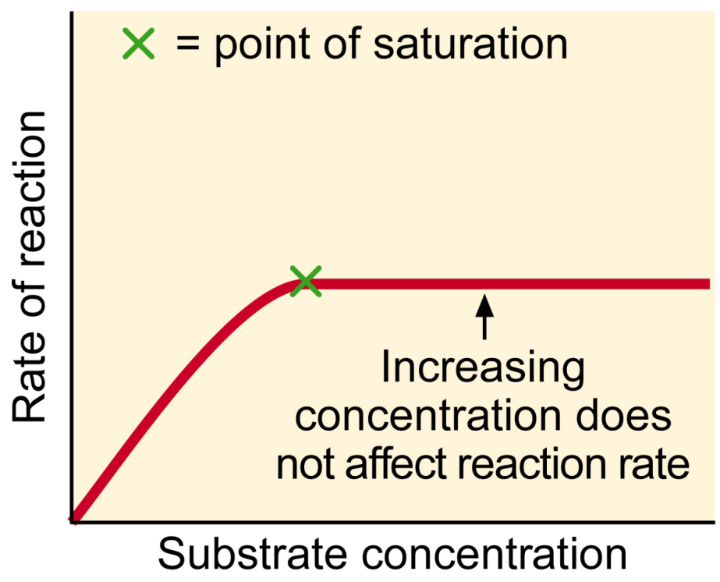
Substrate Concentration
Increasing substrate concentration increases the rate of reaction until the enzymes are fully utilized
Once enzymes are saturated then increasing substrate concentration does not affect reaction rate

Slide 11
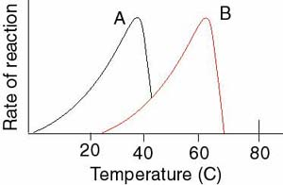
Temperature
Each enzyme has its own optimal temperature

Slide 12
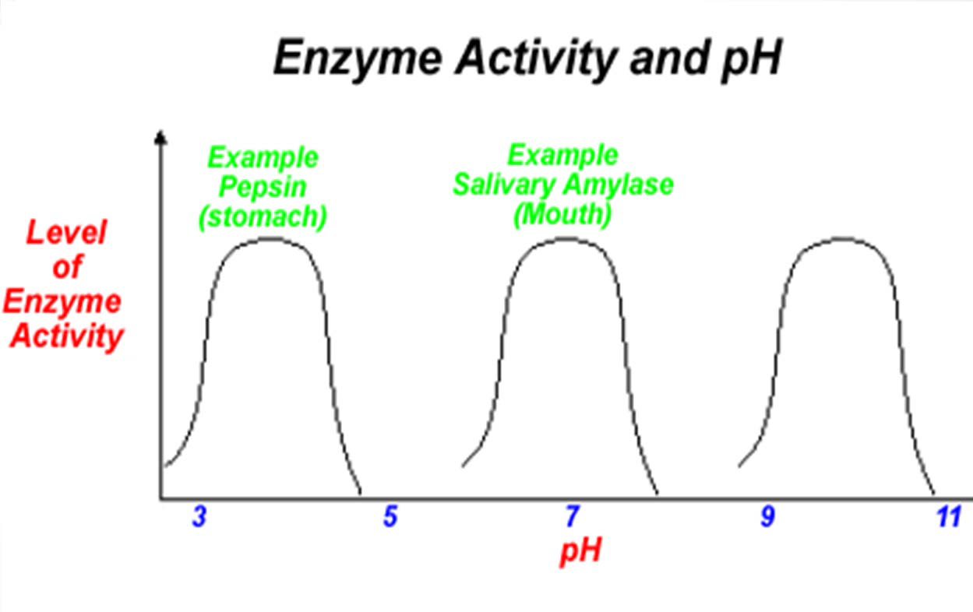
pH
Each enzyme has its own optimal pH level

Slide 13
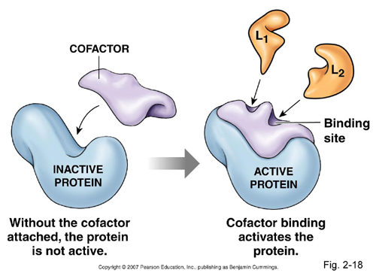
Enzyme Cofactors
Non-proteins – minerals or vitamins
Needed for some enzymes to function
Examples: zinc, iron

Slide 14
Allosteric Regulation
Cells control enzyme activity to coordinate cellular activities
A substance binds to an allosteric sit, causing a conformational change
Allosteric Activators stabilize the active form of the enzyme
Allosteric Inhibitors stabilize the inactive form of the enzyme

Slide 15
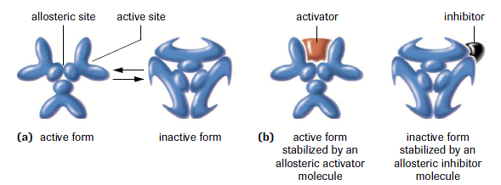

Slide 16
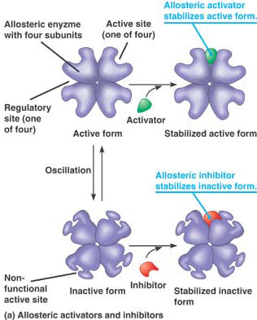

Slide 17
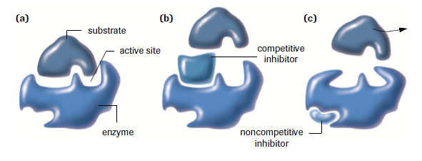
Competitive Inhibitors
Similar to substrate
Binds to the active site and blocks the normal substrate

Slide 18
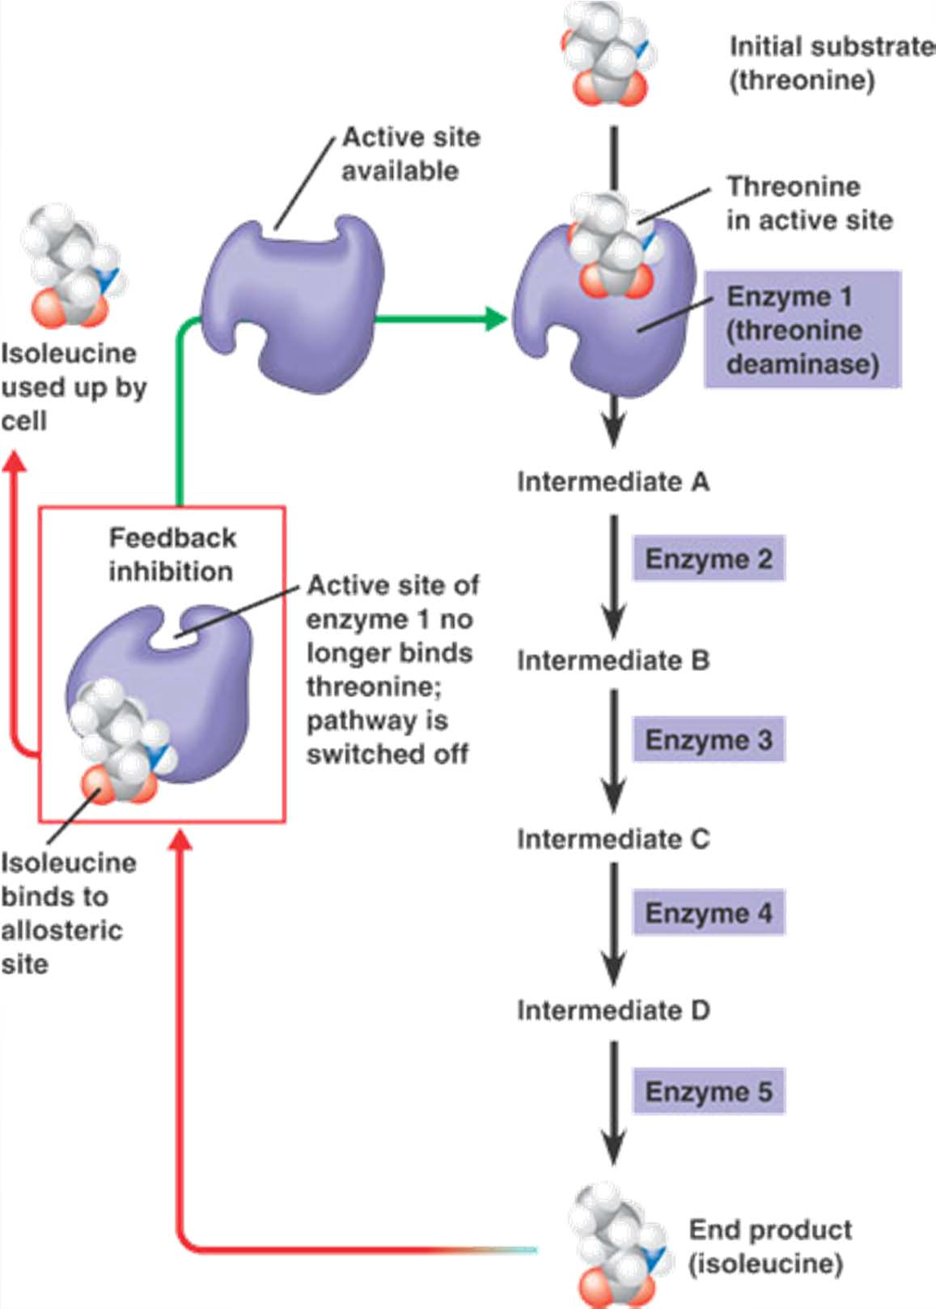
Feedback Inhibition

