Slide 1
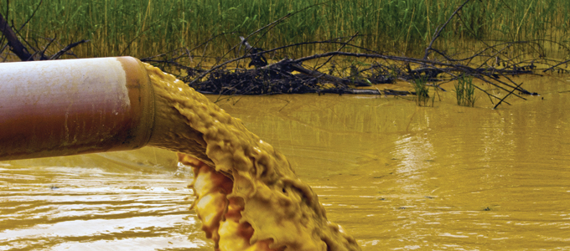
Effects of human activity on soil, water, and air
1.2

Slide 2
The composition of soil, water, and air usually changes very slowly over thousands of years. Human activities, however, can change soil, water, and air quality in just decades or days.

Slide 3
These changes can have long-lasting effects on living things, environments, and climate patterns. The effects also impact on our societies and quality of life. They can become permanent before we fully understand the dangers that they pose.

Slide 4
Soil
As Earth’s population gets bigger, so does our demand on its resources. Not all soils are suitable for growing crops or raising livestock.

Slide 5
Crops can be grown on only about 12% of the land on Earth. Livestock can be raised on only about 26% of the land on Earth (see Figure 1.11). In Canada, we can only grow food or raise livestock on 9% of our land.

Slide 6
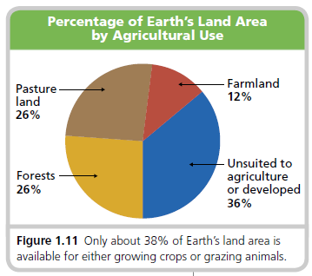

Slide 7
A bigger population means more people looking for places to live and work. We often build those places on soils that can support crops and pasture.

Slide 8
These soils may have taken thousands of years to form. Then we dig up these soils for new buildings and utilities. We pave over them for roads and sidewalks. This makes them useless for crop and livestock production.

Slide 9
Topsoil is the most fertile part of a soil, found just under its surface. When we develop land it should be removed to be used somewhere else. If it is not, it will be mixed up with other soil components and lost.

Slide 10
When soils that are good for agriculture are ruined like this, local people lose jobs. And we all become more dependent on food grown farther away from where we live.

Slide 11
In recent decades, farmers have increased their how much they are growing. They have done this by using chemical fertilizers instead of manure. They have also used synthetic pesticides instead of natural pest control methods.

Slide 12
However, using chemical fertilizers on soil for a long time can reduce the organic matter in soil. Then the soil becomes less productive for growing crops. Pesticides may make the pests and weeds that survive resistant to those pesticides.

Slide 13
How farmers plant their fields can either hurt or help soils. Erosion happens when wind and water blow and wash topsoil away.

Slide 14
Farmers can help prevent erosion by planting rows of trees between fields to act as windbreaks. They can also plough their fields at right angles (90°) to the slope of the land to help prevent water erosion (see Figure 1.13).

Slide 15
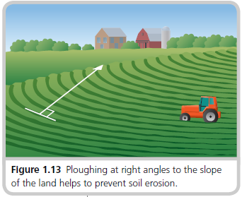

Slide 16
Cutting trees for lumber and pulp, and mining for ores and fossil fuels are activities that we rely on to support our way of life. These activities give us the wood, paper, metals, petroleum, and other products that we use.

Slide 17
Unfortunately, these activities also damage soils. Forests, for example, can be either clear-cut or selective-cut. When selective-cutting, loggers only cut down some of the trees in the area being logged. They leave most of the forest intact.

Slide 18
When clear-cutting, loggers cut down all of the trees in the area being logged. The topsoil in the forest is severely disturbed. It dries out, heats up, and cools down faster than before. Many living things that made the forest their home die or are forced to leave.

Slide 19
Although loggers may replant trees in the area, they often plant just one or two kinds of trees that they prefer. The area becomes like a farm. It may never again support the forest community that once lived there.

Slide 20
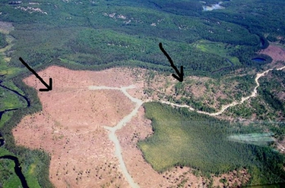

Slide 21
Mining, papermaking, manufacturing, and other industries use or release chemicals. If not carefully handled and contained, toxic substances like arsenic, cyanide, sulphuric acid, lead, and mercury may be spilled.

Slide 22
These and other chemical spills create serious human and environmental health hazards. The soils around Domtar in Cornwall, for example, are heavily polluted from many years of industrial use. Cleaning up this soil has so far proven very expensive to do. As a result, the lands remain abandoned.

Slide 23
With proper planning and action, we can lessen these damages. Cut forests can be reseeded with fast-growing plants that hold the soil in place until the forest can regrow.

Slide 24
Mines can be filled in, covered with topsoil, and reclaimed. Polluted soils can, where feasible, be removed or treated to neutralize toxic chemicals.

Slide 25
Water
The same activities that affect soils can also affect our water. Water can be polluted as a result of chemicals from mining and pulp mills, leaking dump sites, and industrial activities. The water may become unsafe for swimming or drinking.

Slide 26
Human structures and water-based activities like boating also affect water quality. Dams create barriers to fish spawning areas and slow down the flow of water.

Slide 27
Silt (small particles of dirt or pollutants) suspended in this water then falls out onto upstream riverbeds above the dams, causing siltation. This silt can also destroy spawning areas.

Slide 28
When people deepen harbours and water channels and drain wetlands, they also destroy habitats and breeding areas for many aquatic creatures.

Slide 29
Chlorine added to city drinking water kills bacteria that can cause disease. However, chlorine can react with hydrocarbons, which are chemical compounds formed from hydrogen and carbon in the water supply. This can create dangerous chemical compounds, some of which believed to cause cancer.

Slide 30
Cities and towns have lots of pavement, concrete, and storm drains. When it rains, gasoline, oil, road salt, and other dangerous substances are washed into the drains.

Slide 31
This contaminated water ends up in the closest body of water. This is also often the area’s water supply. Figure 1.16 shows ways in which our activities can affect water resources.

Slide 33
Check your understanding
What percentage of Earth’s land is available for growing crops?
Using Figure 1.11, determine what percentage of agriculture land is used for forest and woodland.
Continued...

Slide 34
Describe an action that could occur at school or home that could potentially lead to water pollution.
4. Using Figure 1.16, describe how fertilizer can get to the ocean. Be sure to list all the “steps” or pathways!

Slide 35
Air
Human activities can also have bad effects on air. Many of these activities, such as driving cars and heating buildings, rely heavily on fuels like natural gas, propane, gasoline, diesel oil, heating oil, and coal. These are fossil fuels, which means they formed in the earth from decaying organic matter over millions of years.

Slide 36
When fossil fuels are burned, they release gases and toxic metals like mercury (Hg) into the air. The major gases that are released are carbon monoxide (CO), carbon dioxide (CO₂), and water vapour (H₂O).

Slide 37
Nitrogen oxides (NO, NO₂, and NO₃, or NO_{X} ), sulphur dioxide (SO₂), and hydrocarbons are also released. Methane (CH₄) is a component of natural gas that is also produced by decaying plants. It escapes during fossil fuel drilling and processing.

Slide 38
Air naturally contains some of these gases. However, the burning or combustion of fossil fuels has meant that much larger amounts of these gases have gone into the air. The result is serious problems, such as smog and acid precipitation.

Slide 39
Smog is a type of air pollution. It is mainly made up of ground-level ozone (O₃ ). Groundlevel ozone is produced by the heat from sunlight acting on hydrocarbon and NO_{X} gases (see Figure 1.17). Smog causes headaches and breathing difficulties. It can also damage crops and forests.

Slide 40
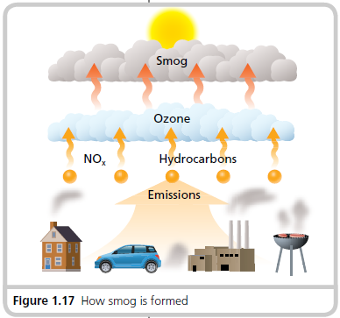

Slide 41
Acid precipitation is rain and snow that has pH values below 5.6 (see Figure 1.16). When SO₂ and NO_{X} rise in the air they may dissolve, along with CO₂, in the water vapour we see as clouds. This action forms sulphuric and nitric acids.

Slide 42
Acid precipitation can lower the pH of lakes, rivers, and soils with very negative effects. Clams, crayfish, and fish cannot survive in water that is too acidic. Soils may lose important nutrients, which can make it hard for trees and plants to grow.

Slide 43
Global warming is the average annual increase in global temperatures that has occurred since around 1850. At this time, factories started up, and fossil fuel use increased rapidly. Fossil fuel use has, on average, continued to increase every year since then.

Slide 44
Greenhouse gases (GHGs) are gases that absorb the heat of the sun in Earth’s atmosphere. Acting like a greenhouse, or a blanket, they allow solar radiation to heat Earth but keep part of the heat reflected off its surface from leaving (see Figure 1.20).

Slide 46
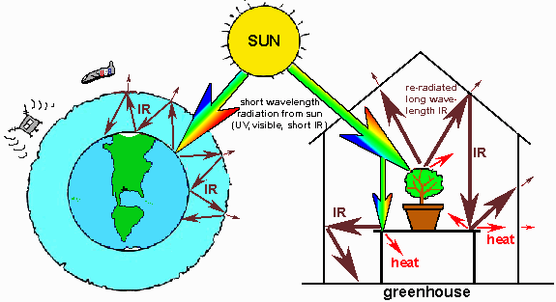

Slide 47
The main, naturally occurring GHGs are water vapour, methane, and carbon dioxide. Without these gases, Earth’s climate would be too cold to support life. However, large amounts of these and other gases are added to the atmosphere by burning fossil fuels.

Slide 48
Most scientists think that the global warming that has happened since 1850 is because of these additional gases. Global warming is a cause of climate change. Climate change is any change or difference in Earth’s normal, average weather conditions.

Slide 49
Droughts, floods, famines, and melting polar ice caps are some of the serious dangers posed by global warming and climate change.

Slide 50
Using the Venn diagram below, place the following terms in the appropriate location. You may use each term more than once.
water vapour carbon monoxide
methane ozone
carbon dioxide
NOx

Slide 51
naturally
occurring
GHG
burning fossil fuels
GHG
methane
water vapour
carbon monoxide
ozone
carbon dioxide
NO_{X}

Slide 52
Check your understanding
Explain the difference between regular precipitation and acid precipitation.
What chemicals may be present in acid precipitation?
How do greenhouse gases contribute to increasing the average global temperature?

