Slide 1
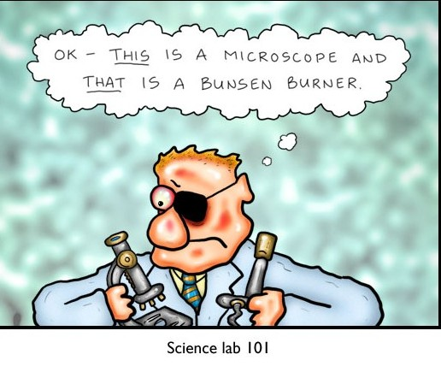
Science Safety
SNC2P

Slide 2
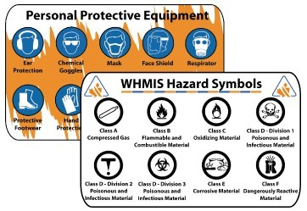
WHMIS
WHMIS
(the Workplace
Hazardous Materials Information System)
is the law throughout Canada.

Slide 3
WHMIS
As applied to high school labs:
1. There is to be no eating or drinking.

Slide 4
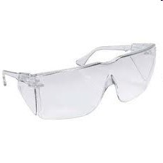
WHMIS
As applied to high school labs:
There is to be no eating or drinking.
Personal Protective Equipment (PPE) must be worn as directed.

Slide 5
WHMIS
As applied to high school labs:
There is to be no eating or drinking.
Personal Protective Equipment (PPE) must be worn as directed.
Students must follow all instructions of their teacher.

Slide 6
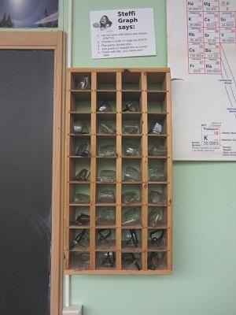
Some of those instructions
Re: safety glasses Do not collect your
safety glasses until instructed to do so, and return your safety glasses after the lab is complete.

Slide 7
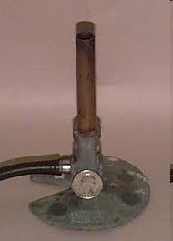
Some of those instructions
Re: safety glasses They must be worn
the entire time Bunsen burners or chemicals are used
at your desk or an adjacent desk

Slide 8
Some of those instructions
Re: safety glasses They must be worn
the entire time Bunsen burners or chemicals are used at your desk or an adjacent desk, and they must be worn over the eyes, not on the forehead.

Slide 9
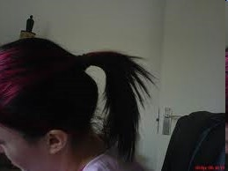
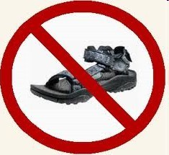
Some of those instructions
Re: other attire
Long hair should be tied back, dangling jewelry removed, drawstrings tucked in, and long sleeves rolled up.
Open-toed footwear should not be worn.

Slide 10
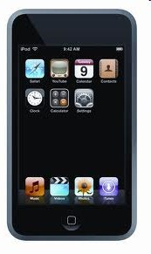
Some of those instructions
Re: valuables
All valuables, especially electronics (cell phones, iPods, etc.) should not be anywhere near the lab.

Slide 11
Some of those instructions
Re: injury prevention
Lab benches and the floor must be clear of clutter.

Slide 12
Some of those instructions
Re: injury prevention
Be aware of other students at desks around yours!

Slide 13
Some of those instructions
Re: injury prevention
Labs should be done standing up. Stools should be pushed under the benches. If you need to observe a reaction at eye level, crouch down.

Slide 14
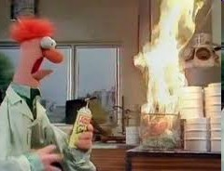
Alerts
All accidents (fire, spills, broken glass, etc.) must be reported to the teacher immediately.

Slide 15
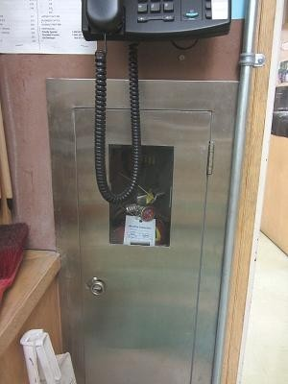
Alerts
Note the location of the:
Two exits. Exit through the science office only if the main exit is blocked by fire.
Fire extinguisher. Located between the teacher’s bench and the door to the science office.

Slide 16
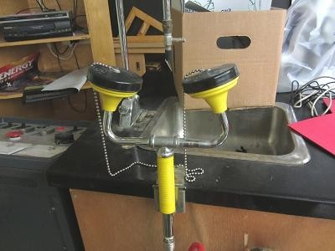
Alerts
Note the location of the:
Eye wash station. Open both eyes while the water is running into your eyes.

Slide 17
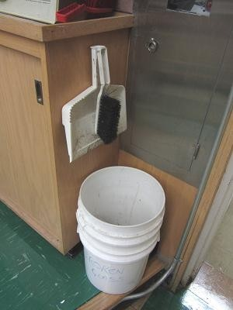
Alerts
Note the location of the:
Broken glass disposal. Do not touch broken glass with your hands, especially if the glass contained chemicals.

Slide 18
Alerts
Chemical spills (especially acid or base spills) should not just be wiped up with a paper towel. Always ask your teacher for the correct procedure.

Slide 19
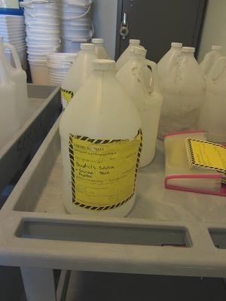
Chemical Disposal
All chemicals and the first rinse of any glassware should be disposed of in the labelled container indicated by your teacher.
Solid materials should be placed in a separate disposal bucket.

Slide 20
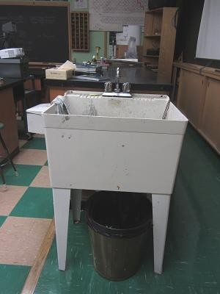
And Lastly. . .
Wash your hands thoroughly after completing every lab.

Slide 21
Never
Never perform any experiment that has not been explicitly authorized by the teacher.
Never perform an experiment if you do not understand a direction or part of a procedure.
ASK YOUR TEACHER BEFORE PROCEEDING.

Slide 22
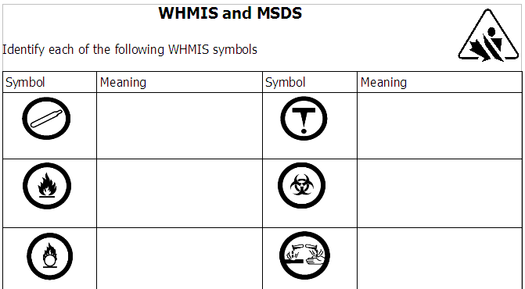
More on WHMIS
Please take a moment now to review WHMIS, HHPS symbols, and the MSDS.
This information is in your textbook. (Where?)

