Slide 1
Lab Equipment
SNC2P

Slide 2
A
is used for reacting small
quantities of reactants.

Slide 3
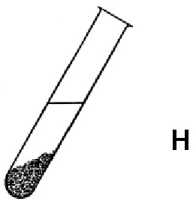
A test tube is used for reacting small quantities of reactants.

Slide 4
Test tubes are always placed in a
when reactions are occurring in
them.

Slide 5
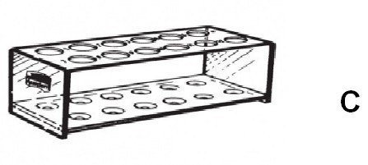
Test tubes are always placed in a test tube rack when reactions are occurring in them.

Slide 6
may be used to pick up small containers such as evaporating dishes and test tubes.

Slide 7
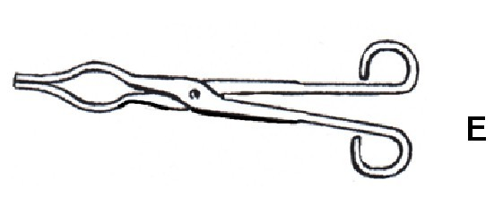
Crucible tongs may be used to pick up small containers such as evaporating dishes and test tubes.

Slide 8
Reactions of quantities too large to be placed in a test tube are done in a
.

Slide 9
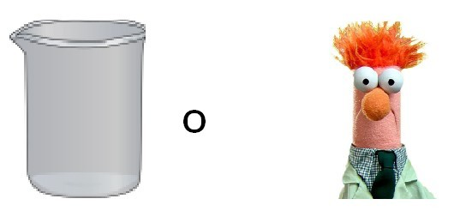
Reactions of quantities too large to be placed in a test tube are done in a beaker.

Slide 10
are used to safely handle hot
beakers.

Slide 11
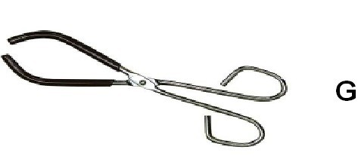
Beaker tongs are used to safely handle hot beakers.

Slide 12
A has fine gradations to precisely measure volumes of liquid.

Slide 13
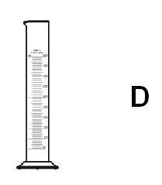
A graduated cylinder has fine gradations to precisely measure volumes of liquid.

Slide 14
An
may be used to swirl
liquids without fear of spilling.

Slide 15
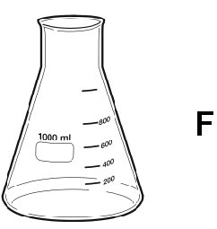
An Erlenmeyer flask may be used to swirl liquids without fear of spilling.

Slide 16
A
is used to direct the flow of liquid
into a test tube or flask.

Slide 17
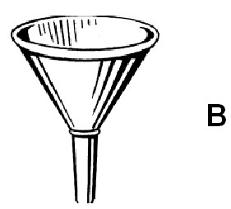
A funnel is used to direct the flow of liquid into a test tube or flask.

Slide 18
A is used to pick up small quantities of powdered chemicals.

Slide 19
A scoopula is used to pick up small quantities of powdered chemicals.

Slide 20
may be used to pick up small objects such as metal strips.

Slide 21
Forceps may be used to pick up small objects such as metal strips.

Slide 22
Most heating of chemicals in a science lab is done using a .

Slide 23
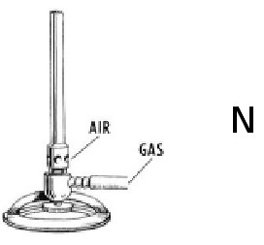
Most heating of chemicals in a science lab is done using a Bunsen burner .

Slide 24
A
is used to safely light
Bunsen burners.

Slide 25
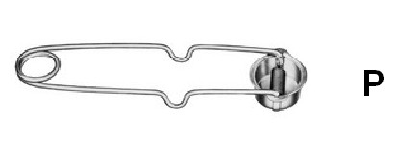
A flint lighter is used to safely light Bunsen burners.

Slide 26
A
is used to support test tubes
and beakers over a Bunsen burner.

Slide 27
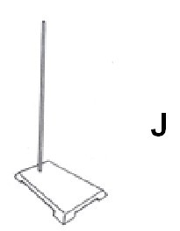
A retort stand is used to support test tubes and beakers over a Bunsen burner.

Slide 28
A
may be used to attach
test tubes to a retort stand.

Slide 29
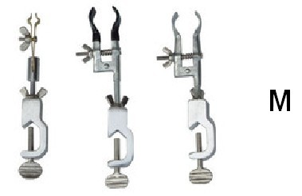
A test tube clamp may be used to attach test tubes to a retort stand.

Slide 30
A large is placed around a beaker to prevent it being knocked over when the beaker is supported over a Bunsen burner.

Slide 31
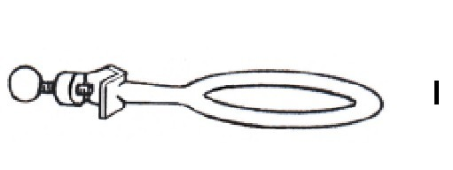
A large iron ring is placed around a beaker to prevent it being knocked over when the beaker is supported over a Bunsen burner.

Slide 32
A is placed under a beaker when a beaker is placed on an iron ring to be heated over a Bunsen burner.

Slide 33
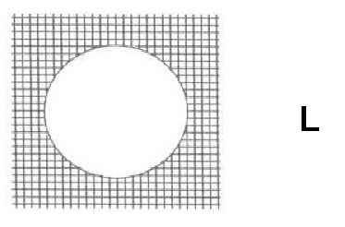
A wire gauze is placed under a beaker when a beaker is placed on an iron ring to be heated over a Bunsen burner.

