Slide 1
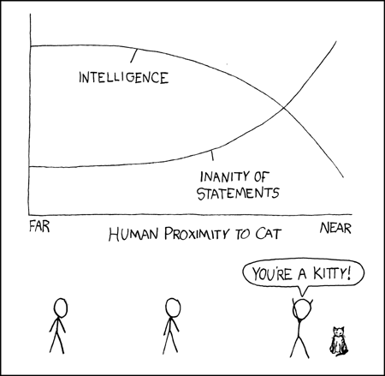
Graphing in Science
SNC2P

Slide 2
Qualitative vs. Quantitative
Qualitative observations are descriptive:
“The amplitude of the pendulum decreased.”
Quantitative observations contain numerical measurements:
“The mass of the pendulum was 150 g.”

Slide 3
Quantitative Data
Quantitative data should contain all the digits that were measured.
For example, if lengths are measured to the nearest mm, write 10.0 cm (NOT 10 cm).

Slide 4
Tables
Both qualitative and quantitative data can be recorded and presented in tables.
For example,

Slide 5
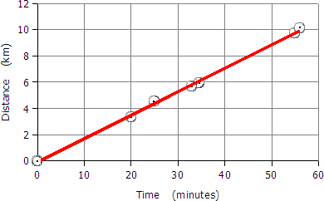
Graphs
Quantitative data may be presented and analyzed using graphs.
For example,
Graph 1: Distance-time information for a cart travelling along a track

Slide 6
Graphs
Rules for graphing:
You must use a ruler and graph paper.

Slide 7
Graphs
Rules for graphing:
You must use a ruler and graph paper.
Graphs must be numbered and titled.

Slide 8
Graphs
Rules for graphing:
You must use a ruler and graph paper.
Graphs must be numbered and titled.
A graph must take up an entire page.
(The axes should be about 2 cm from the edge of the page.)

Slide 9
Graphs
Rules for graphing:
You must use a ruler and graph paper.
Graphs must be numbered and titled.
A graph must take up an entire page.
(The axes should be about 2 cm from the edge of the page.)
The axes must be labeled with the variables (including units).

Slide 10
Graphs
More rules for graphing:
The scale on each axis should start at 0 and go up to just beyond the last data point in steps of 1, 2, 5, 10, 20, 50, or etc.

Slide 11
Graphs
More rules for graphing:
The scale on each axis should start at 0 and go up to just beyond the last data point in steps of 1, 2, 5, 10, 20, 50, or etc.
Points are plotted in pencil with a circle around each sharp dot.

Slide 12
Graphs
More rules for graphing:
The scale on each axis should start at 0 and go up to just beyond the last data point in steps of 1, 2, 5, 10, 20, 50, or etc.
Points are plotted in pencil with a circle around each sharp dot.
A straight line or smooth curve of best fit is drawn through the points. (Do NOT connect the dots.)

Slide 13
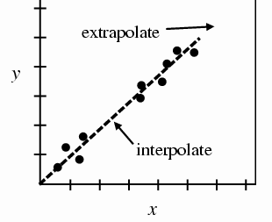
The Line/Curve of Best Fit
The line should extend past your points so that you can extrapolate (estimate values outside your data set).

Slide 14
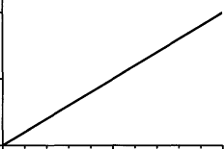
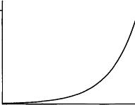
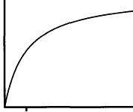
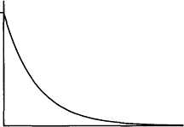
Trends in Graphs
The line or curve shows you the trend in the data.

Slide 15
Linear Increase
This graph shows a linear increase:
as the one variable increases, the other increases linearly.

Slide 16
Increase at an increasing rate
Here, as one variable increases, the other increases at an increasing rate.
(This is not necessarily an exponential increase. It could be a quadratic increase. The two are not the same!)

Slide 17
Increase at an decreasing rate
Here, as one variable increases, the other increases at an decreasing rate.

Slide 18
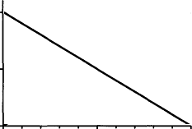
Linear Decrease
Linear decreases are rare.
If you get this, you’ve probably made a mistake.

Slide 19
Decrease at an decreasing rate
You are more likely to see this:
As one variable increases, the other decreases at a decreasing rate.

Slide 20
No Relationship
This graph shows NO RELATIONSHIP between the independent and dependent variables.

