Slide 1
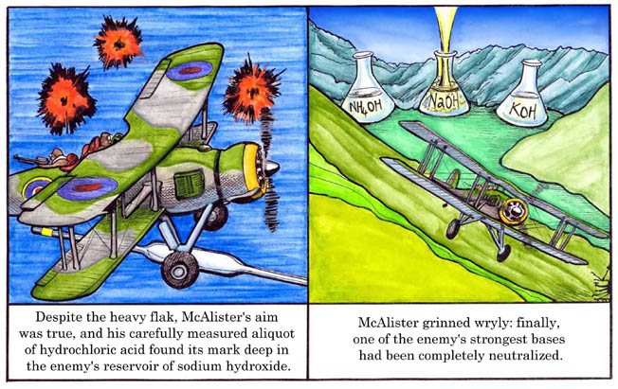
ACIDS AND BASES
www.lab-initio.com

Slide 2
Properties of Acids
Acids are proton (hydrogen ion, H⁺) donors
Acids have a pH lower than 7
Acids taste sour
Acids effect indicators
Blue litmus turns red
Methyl orange turns red
Acids react with active metals, producing H₂
Acids react with carbonates
Acids neutralize bases

Slide 3
Acids are Proton (H⁺ ion) Donors
Strong acids are assumed to be 100% ionized in solution (good H⁺ donors).
HCl
H₂SO₄
HNO₃
Weak acids are usually less than 5% ionized in solution (poor H⁺ donors).
H₃PO₄
HC₂H₃O₂
Organic acids

Slide 4
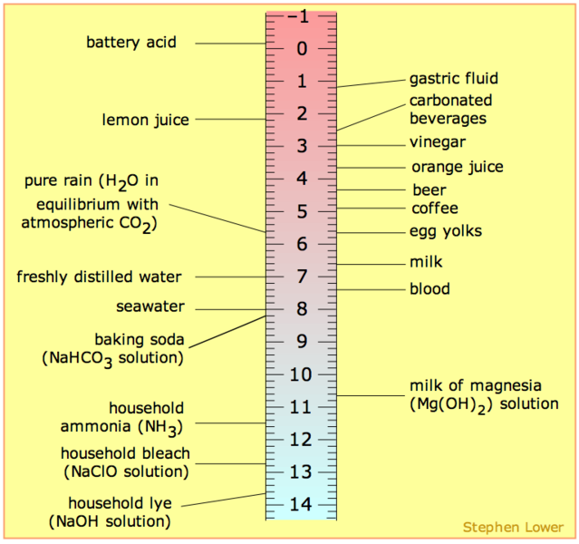
Acids Have a pH less than 7

Slide 5
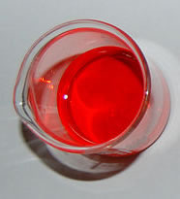
Acids Effect Indicators
Blue litmus paper turns red in contact with an acid.
Methyl orange turns red with addition of an acid

Slide 6
Acids React with Active Metals
Acids react with active metals to form salts and hydrogen gas.
Mg + 2HCl → MgCl₂ + H₂(g)
Zn + 2HCl → ZnCl₂ + H₂(g)
Mg + H₂SO₄ → MgSO₄ + H₂(g)

Slide 7
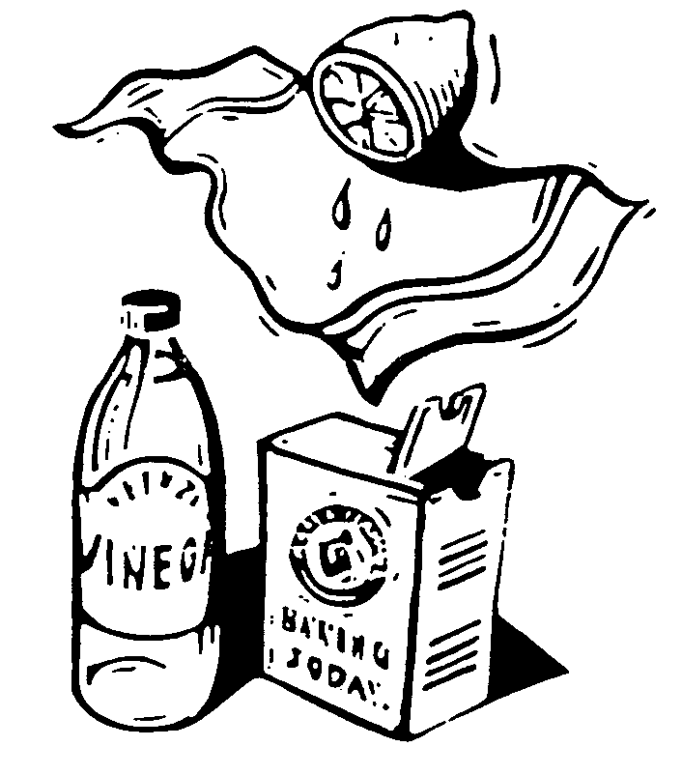
Acids React with Carbonates
2HC₂H₃O₂ + Na₂CO₃
2 NaC₂H₃O₂ + H₂O + CO₂

Slide 8
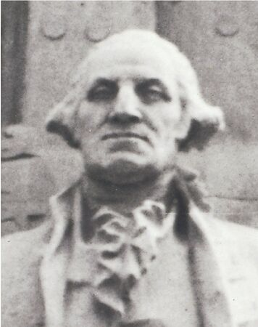
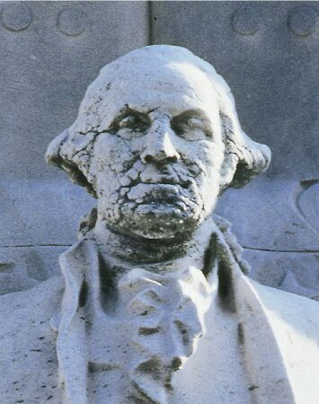
Effects of Acid Rain on Marble (calcium carbonate)
George Washington:
BEFORE
George Washington:
AFTER

Slide 9
Acids Neutralize Bases
Neutralization reactions ALWAYS produce a salt and water.
HCl + NaOH → NaCl + H₂O
H₂SO₄ + 2NaOH → Na₂SO₄ + 2H₂O
2HNO₃ + Mg(OH)₂ → Mg(NO₃)₂ + 2H₂O

Slide 10
Properties of Bases
Bases are proton (hydrogen ion, H⁺) acceptors
Bases have a pH greater than 7
Bases taste bitter
Bases effect indicators
Red litmus turns blue
Phenolphthalein turns purple
Solutions of bases feel slippery
Bases neutralize acids

Slide 11
Bases are Proton (H⁺ ion) Acceptors
Sodium hydroxide (lye), NaOH
Potassium hydroxide, KOH
Magnesium hydroxide, Mg(OH)₂
Calcium hydroxide (lime), Ca(OH)₂
OH⁻ (hydroxide) in base combines with H⁺ in acids to form water
H⁺ + OH⁻ → H₂O

Slide 12
Bases have a pH greater than 7

Slide 13
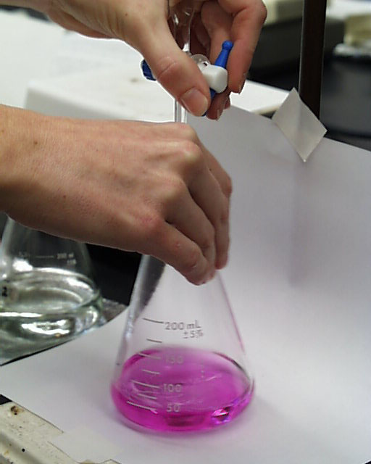
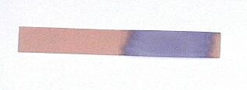
Bases Effect Indicators
Red litmus paper turns blue in contact with a base.
Phenolphthalein turns bright pink in a base.

Slide 14
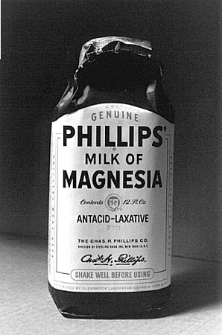
Bases Neutralize Acids
Milk of Magnesia contains magnesium hydroxide, Mg(OH)₂, which neutralizes stomach acid, HCl.
2 HCl + Mg(OH)₂
MgCl₂ + 2 H₂O

