Slide 1

Learning Objectives
Chemical Kinetics
To represent and analyze rates of reaction graphically and mathematically
To determine rate and order of reaction by calculation and experimentally, and relate these variables to reaction mechanism
Key Words –
Reactants
Products
Rate Law
Reaction Order
What to remember?
Difference between average rate and instantaneous rate
Empirical determination of rate laws

Slide 2




Reaction Rates
The speed of an event is defined as the change that occurs in a given interval of time: whenever we talk about speed, we necessarily bring in the notion of time
Speed=
=
= 300km/h

Slide 3
Reaction Rates
Similarly, we can speak about the speed of a chemical reaction, or its reaction rate
The rate of a chemical reaction is the rate of change in the concentration per unit time.
It is expressed as the number of moles per liter that react each second, and the units, in abbreviated form, are mol L^{—1} s^{—1}
Reaction rates are determined by measuring the concentration of one or more of the chemicals involved in the reaction at different times during the course of the reaction

Slide 4
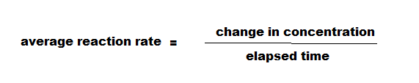

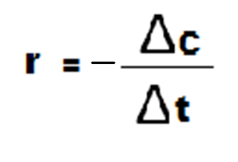
Finding a Rate of Reaction
Rate of formation of product
Rate of consumption of reactant
Most common unit for r is mol/L•s
Since the reactants disappear during a chemical reaction, the rate calculated by measuring the reactant will have a negative sign

Slide 5
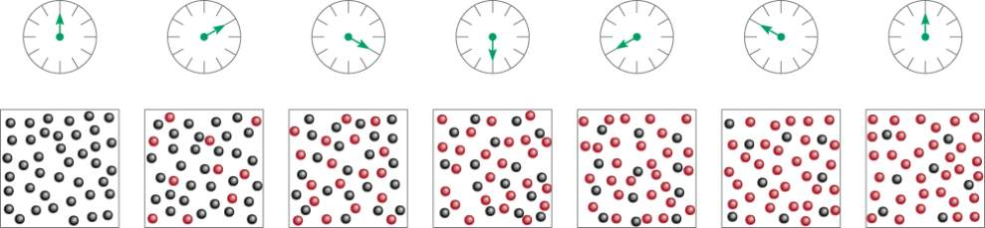
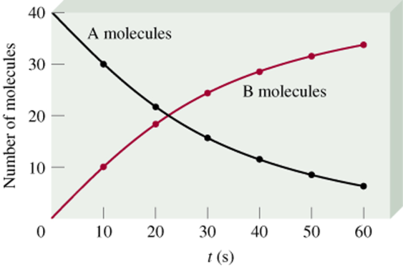
A B
time
Δ[A]
rate = -
Δt
Δ[B]
rate =
Δt
13.1

Slide 6
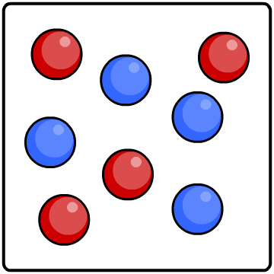
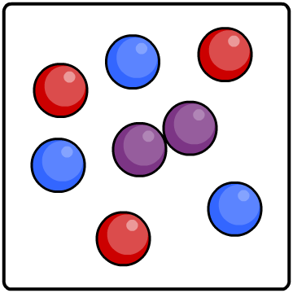
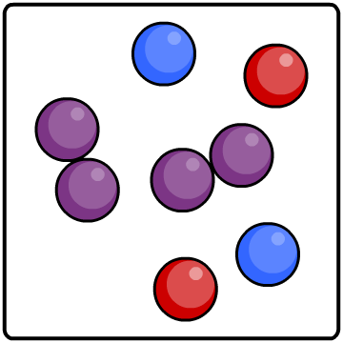
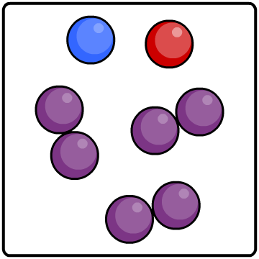
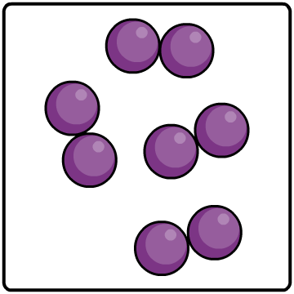



Reactions do not proceed at a steady rate. They start off at a certain speed, then get slower and slower until they stop.
As the reaction progresses, the concentration of reactants decreases.
This reduces the frequency of collisions between particles and so the reaction slows down.
0%
25%
50%
75%
100%
reactants
percentage completion of reaction
product

Slide 7
The Five Factors Affecting Rate
There are five things that we can change to make the reaction go faster.
They are:
Temperature
Surface area
Concentration
Presence of a Catalyst
Chemical nature of reactants

Slide 8
Temperature
When we increase the temperature we give the particles energy
This makes them move faster
This means they collide with other particles more often
So the reaction goes faster.

Slide 9
Surface area
If we make the pieces of the reactants smaller, we increase the number of particles on the surface which can react.
This makes the reaction faster.
The particles on the surface can react
When cut into smaller pieces the particles on the inside can react

Slide 10
Concentration
If we make one reactant more concentrated
There are more particles in the same volume to react
So the reaction goes faster.
There are less red particles in the same volume so there is less chance of a collision
There are more red particles in the same volume so there is more chance of a collision so the reaction goes faster

Slide 11
Using a catalyst
A catalyst is a chemical which is added to a reaction.
It makes the reaction go faster.
The catalyst does not get used up in the reaction.
It gives the reaction the energy to get started

Slide 12
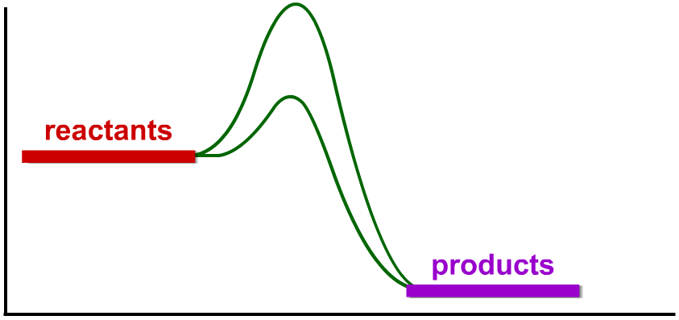
Catalysts never produce more product – they just produce the same amount more quickly.
E_{a} without
catalyst
Different catalysts work in different ways, but most lower the reaction’s activation energy (E_{a}).
energy (kJ)
E_{a} with
catalyst
reaction (time)
Notes:
Teacher notes
See the ‘Energy Transfer’ presentation for more information on activation energy.

Slide 13
Chemical Nature of reactants
different chemicals will react with the same reactant similarly but at different rates.
activity series of metals, some metals are more reactive than others
reaction of monatomic ions (Ag⁺, F⁻) are extremely fast, while molecular substances (C₆H₁₂O₆) are often slower

Slide 14
HOW TO DETERMINE RATE OF REACTION FROM GRAPH
AVERAGE RATE OF REACTION
INSTANTANEOUS RATE OF REATION

Slide 15
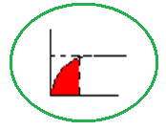
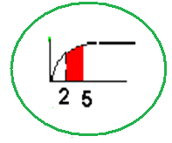
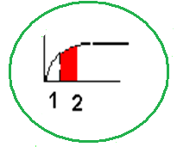
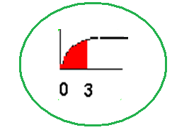
AVERAGE RATE OF REACTION
For the whole exp
From X min to Y min
On the X min (2nd)
( from 2nd to 1st)
For first x (3) min
( from 0 to 3rd )

Slide 16
INSTANTANEOUS RATE OF REACTION
( rate of reaction at that time)
Draw tangent to the graph
Rate = Y/X
Y
X

Slide 17
b) Example from the graph, determine:
i) The rate of reaction at 120 s
Instantaneous rate of reaction
= Draw tangent to the graph

Slide 18
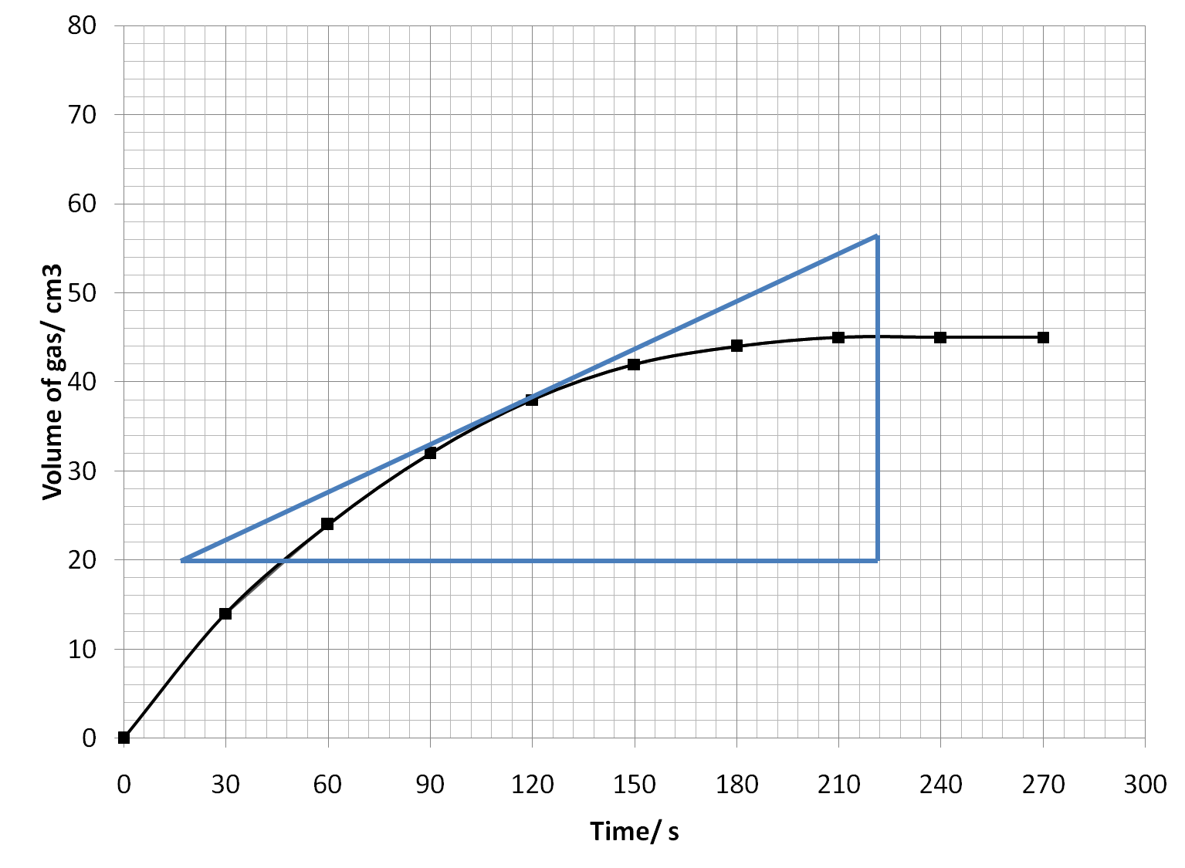
= 56 – 20 = 0.176 cm³ s⁻¹
222-18

Slide 19
Analysis of Data
Rate of reaction at t second = gradient AB
= p/q cm³ s⁻¹
Total volume of Hydrogen gas/cm³
Tangent is a line that touch just 1 point of graph in order to calculate gradient
B
Tangent
p
A
q
Cannot take directly at x
t
Time (second)

Slide 20
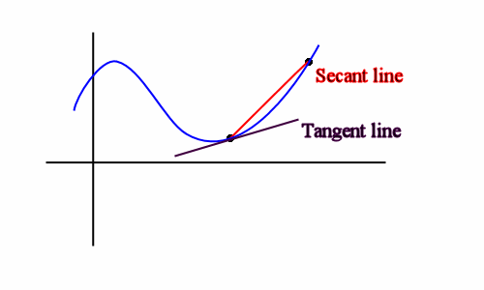
Tangent
Cannot touch more than 2 points because each of point has a different gradient
Only touch 1 point of curve

Slide 21
tangent
α

Slide 22
Two methods to calculate tangent:
Total volume of Hydrogen gas/cm³
number of small boxes × value of
1 small unit box
B
Tangent
Y
A
X
Time (second)

Slide 23
First Method
Gradient of graph:
Total volume of Hydrogen gas/cm³
m = ΔY
ΔX
B
m = Y2-y1
y2
Tangent
X2-x1
y1
A
x1
x2
Time (second)

Slide 24
Analysis of Data
Rate of reaction at t second = gradient AB
= p/q cm³ s⁻¹
Total volume of Hydrogen gas/cm³
B
Tangent
p
A
q
t
Time (second)

Slide 25
Analysis of data
Total Volume of CO₂(cm³)
F
D
E
Rate of reaction at t₁ = gradient AB
B
Rate of reaction at t₂ = gradient CD
C
Rate of reaction at t₃ = gradient EF
A
t₁
t₂
t₃
Time (second)

Slide 26
(h)
Time (seconds) | 0 | 30 | 60 | 90 | 120 | 150 | 180 | 210 | 240
Burette reading (cm³) | 49.5 | 33.5 | 23.5 | 16.0 | 10.5 | 5.0 | 2.0 | 2.0 | 2.0
Volume CO₂ (cm³) | 0 | 16 | 26 | 33.5 | 39 | 44.5 | 47.5 | 47.5 | 47.5
Time(second) | 0 | 30 | 60 | 90 | 120
Burette reading(cm³) | x 49.5 | y 33.5 | z 23.5
Total volume of gas(cm³) | x-x 0.00 | x-y 16.00 | x-z 26.00

Slide 27
Volume of CO_{2,} cm³
Connect the point without using ruler!
Not all the point is connected
Time , s

Slide 28
Volume of CO₂ cm³
Cannot make this graph
Straight line
It’s must be smooth graph
Time s

Slide 29
Average Rate Of reaction
(i)
The average rate of reaction in the first 90 seconds.
= The total volume of gas released in the first 90 seconds
Time taken
Time (seconds) | 0 | 30 | 60 | 90 | 120 | 150 | 180 | 210 | 240
Burette reading (cm³) | 49.5 | 33.5 | 23.5 | 16.0 | 10.5 | 5.0 | 2.0 | 2.0 | 2.0
Volume CO₂ (cm³) | 0 | 16 | 26 | 33.5 | 39 | 44.5 | 47.5 | 47.5 | 47.5
33.5÷90=0.372 cm³s⁻¹
unit
=

Slide 30
i(ii)
Time (seconds) | 0 | 30 | 60 | 90 | 120 | 150 | 180 | 210 | 240
Burette reading (cm³) | 49.5 | 33.5 | 23.5 | 16.0 | 10.5 | 5.0 | 2.0 | 2.0 | 2.0
Volume CO₂ (cm³) | 0 | 16 | 26 | 33.5 | 39 | 44.5 | 47.5 | 47.5 | 47.5
The average rate of reaction in the whole experiment.
= The total volume of gas released in the whole experiment
Time taken
47.5÷180= 0.264 cm³s⁻¹
=

Slide 31
THE RATE EQUATION
RATE ~ CONCENTRATION
PROPORTIONALITIES CAN BE MADE INTO EQUALITIES BY USING A CONSTANT
FOR EXAMPLE: FEET CAN ALWAYS BE CONVERTED TO INCHES BY USING THE NUMBER 12. (INCHES = FEET x 12)
RATE = A CONSTANT x CONCENTRATION
HOWEVER, ALL EQUATIONS ARE NOT LINEAR (FIRST POWER), SOME ARE SQUARES OR CUBES OR ETC.

Slide 32
THEREFORE OUR EQUATION MAY BE WRITTEN AS:
RATE = CONSTANT x CONCENTRATIN RAISED TO SOME POWER OR
RATE = k x [A]^{n}
k = A CONSTANT CALLED THE SPECIFIC RATE CONSTANT (IT IS CONSTANT FOR A SPECIFIC REACTION AT A SPECIFIC TEMPERATURE)
[A] = THE CONCENTRATION OF REACTANT A IN MOLES PER LITER (BRACKETS MEAN IN MOLES PER LITER)
n = THE POWER TO WHICH CONCENTRATION MUST BE RAISED (ALSO CALLED REACTION ORDER)

Slide 33
REACTIONS WITH RATE EQUATIONS HAVING n = 0 ARE ZERO ORDER REACTIONS. THOSE WITH n = 1 ARE FIRST ORDER AND THOSE WITH n = 2 ARE SECOND ORDER.
IN ZERO ORDER REACTIONS, CHANGING THE CONCENTRATION OF THE REACTANT HAS NO EFFECT ON THE RATE.
M
O
L
E
S
A
RXN RATE?
RATE = 0
TIME

Slide 34
Using Initial Rates to Determine Rate Laws
The rate law for any chemical reaction must be determined experimentally
We observe the effect of changing the initial concentration of the reactants on the initial rate of the reaction
If the reaction is zero order in a particular reactant, changing its concentration will have no influence on rate

Slide 35
If the reaction is first order in a reactant, changes in the concentration of that substance will double the rate and so forth
When the rate law is second order in a particular reactant, doubling its concentration increases the rate by a factor of 2² = 4,
tripling its concentration causes the rate to increase by a factor 3² = 9, and so forth

Slide 36
It is important to note that whereas the rate of a reaction depends on concentration, the rate constant does not.
The rate constant (and hence the reaction rate ) is affected by temperature and the presence of a catalyst

Slide 37
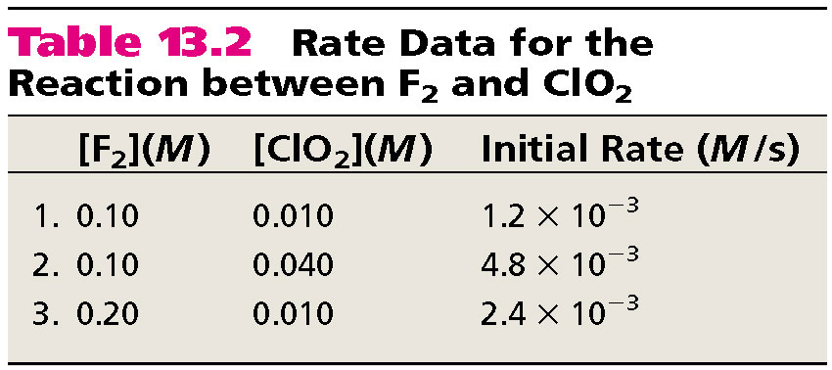
F₂ _{(g)} + 2ClO₂ _{(g)} 2FClO₂ _{(g)}
rate = k [F₂]^{m}[ClO₂]^{n}
Double [F₂] with [ClO₂] constant
Rate doubles
m = 1
Quadruple [ClO₂] with [F₂] constant
Rate quadruples
r = k [F₂][ClO₂]
n = 1

Slide 38
Determine the rate law and calculate the rate constant for the following reaction from the following data:
S₂O₈²⁻ (aq) + 3I⁻ (aq) 2SO₄²⁻ (aq) + I₃⁻ (aq)
Experiment | [S₂O₈²⁻] | [I⁻] | Initial Rate (M/s)
1 | 0.08 | 0.034 | 2.2 x 10⁻⁴
2 | 0.08 | 0.017 | 1.1 x 10⁻⁴
3 | 0.16 | 0.017 | 2.2 x 10⁻⁴
rate = k [S₂O₈²⁻]^{m}[I⁻]^{n}
m = 1
n = 1
rate = k [S₂O₈²⁻][I⁻]
Double [I⁻], rate doubles (experiment 1 & 2)
Double [S₂O₈²⁻], rate doubles (experiment 2 & 3)
rate
2.2 x 10⁻⁴ M/s
k =
=
= 0.08/M•s
[S₂O₈²⁻][I⁻]
(0.08 M)(0.034 M)

Slide 39
Overall Order of Reaction: the sum of the individual orders of reaction for each reactant.
In the first example
The overall order of reaction is 2
m + n = 2
r = k [F₂][ClO₂]

Slide 40
Zero Order | First Order | Second Order | Third Order
Rate = k | Rate = k[A] | Rate = k[A]² | Rate = K[A]³
K= units of rate =mol/dm³s | K= units of rate/ Units of concentration =mol dm⁻³s⁻¹/mol dm⁻³ = s⁻¹ | K= units of rate/ (units concentration)² ==mol dm⁻³s⁻¹/(mol dm⁻³ )² = mol⁻¹ dm³s⁻¹ | K= units of rate/ (units concentration)³ ==mol dm⁻³s⁻¹/(mol dm⁻³ )³ = mol⁻² dm⁶s⁻¹
K can be calculated from rate expression when the concentrations of reactants and corresponding rate are know

Slide 41
Let us see how the initial rates method works
2N₂O_{5(g)} 4NO_{2(g)} + O_{2(g)}
The general rate law equation for this reaction is:
Rate = k [N₂O₅]^{m}
To determine the value of m, a chemist performs three experiments. A different initial concentration of [N₂O₅]₀
Is used for each experiment. The 0 represents t=0

Slide 42
Experiment | Initial [N₂O₅]₀ (mol/L) | Initial rate (mol/(L.s))
1 | 0.010 | 4.8 x 10 ⁻⁶
2 | 0.020 | 9.6 x 10 ⁻⁶
3 | 0.030 | 1.5 x 10⁻⁵
Value of m can be determined with at least two different methods
by inspection
rate law equation

Slide 43
1. By inspection
When the [N₂O₅] is doubled expts 1 and 2 doubles
the rate also doubles
when [N₂O₅] is tripled, (expts 1 and 3) the rate triples
this indicates a first-order relationship as follows
Rate = [N₂O₅]¹

Slide 44
2. Compare rate law equation using ratios
this method very useful when relation between conc and rate are not immediately obvious from data
Write the rate expressions for expts 1 and 2 as follows:
Rate₁ = k [0.010]^{m}
= 4.8 x 10⁻⁶ mol/(L.s)
Rate₂ = k [0.020]^{m}
= 9.6 x 10⁻⁶ mol/(L.s)

Slide 45
Create a ratio to compare the two rates
Rate₁ = k(0.010 mol/L)m = 4.8 x 10⁻⁶ mol/L.s
Rate ₂ k(0.020 mol/L)m 9.6 x 10⁻⁶ mol/L.s
Since k is a constant at constant temp you can cancel out
k(0.010 mol/L)^{m} = 4.8 x 10⁻⁶ mol/L.s
k(0.020 mol/L)^{m} 9.6 x 10⁻⁶ mol/L.s
(0.5)^{m} = 0.5
m = 1 (by inspection)

Slide 46
Determining the Rate Constant
Once you know the rate law equation for a reaction, you can calculate the rate constant using results from any of the experiments
Rate = k [N₂O₅]¹
You can use data from any of the three experiments to calculate k
4.8 x 10⁻⁶ mol/(L.s) = k(0.010 mol/L)

Slide 47
k = 4.8 x 10-6 mol/ (L.s)
0.010 mol/L
= 4.8 x 10⁻⁴ s⁻¹

Slide 48
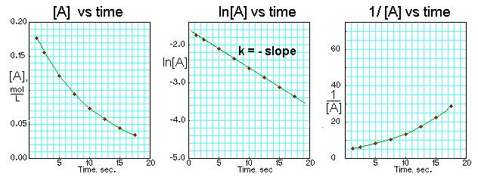
First-Order Reactions
Δ[A]
[A] = [A]₀e^{-kt}
rate = -
rate = k [A]
Δt
[A] is the concentration of A at any time t
ln[A] - ln[A]₀ = - kt
[A]₀ is the concentration of A at time t=0

Slide 49
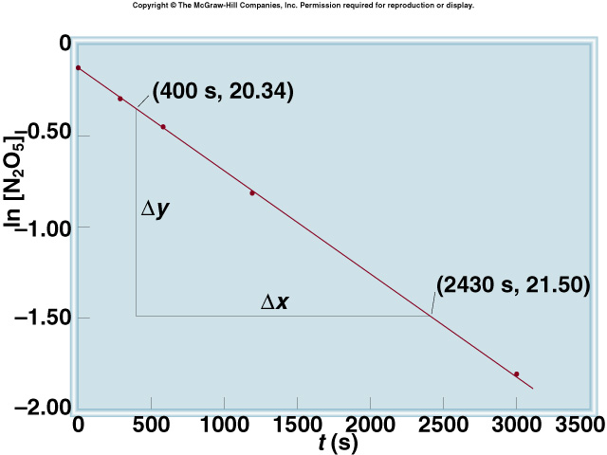
Decomposition of N₂O₅

Slide 50
The reaction 2A B is first order in A with a rate constant of 2.8 x 10⁻² s⁻¹ at 80⁰C. How long will it take for A to decrease from 0.88 M to 0.14 M ?
[A] = [A]₀e^{-kt}
[A]₀ = 0.88 M
ln[A] - ln[A]₀ = - kt
[A] = 0.14 M
ln[A]₀ - ln[A] = kt
[A]₀
0.88 M
ln
ln
ln[A]₀ – ln[A]
[A]
0.14 M
t =
=
=
= 66 s
k
k
2.8 x 10⁻² s⁻¹

Slide 51
First-Order Reactions
The half-life, t_{½}, is the time required for the concentration of a reactant to decrease to half of its initial concentration.
t_{½} = t when [A] = [A]₀/2
[A]₀
ln
[A]₀/2
Ln 2
0.693
t_{½}
=
=
=
k
k
k
What is the half-life of N₂O₅ if it decomposes with a rate constant of 5.7 x 10⁻⁴ s⁻¹?
Ln 2
0.693
t_{½}
=
=
= 1200 s = 20 minutes
k
5.7 x 10⁻⁴ s⁻¹
How do you know decomposition is first order?
units of k (s⁻¹)
13.3

Slide 52
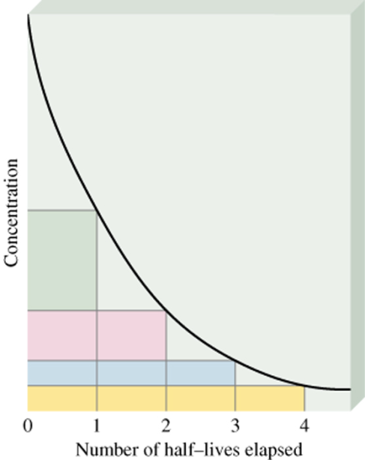
First-order reaction
A product
# of
half-lives
[A] = [A]₀/n
1
2
2
4
3
8
4
16
13.3

Slide 53
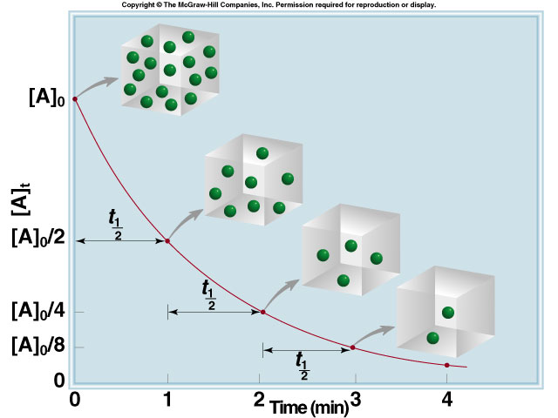
13.3

