Slide 1
Combustion and Hydrate Analysis

Slide 2
Agenda
Review
Combustion Analysis
Practice Problem
Hydrate Analysis
Practice Problem

Slide 3
Review
What is the law of multiple proportions?
What two kinds of formulas did we learn about?
Describe one way to determine the empirical formula.

Slide 4
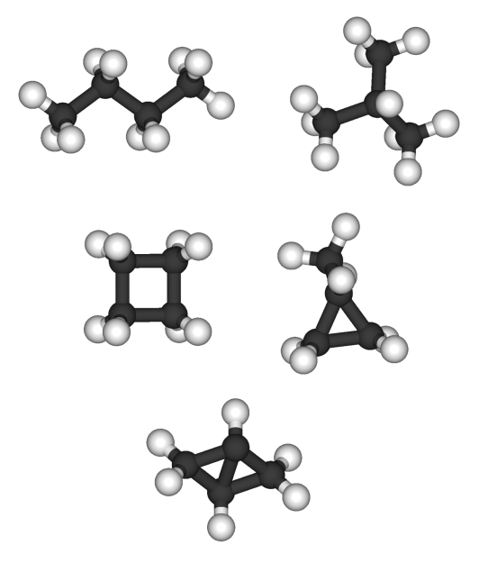
Combustion Analysis
Hydrocarbons are an important and diverse group of compounds
Chemists can determine the % composition by combustion analysis
Used anywhere unknown compounds need to be analyzed!

Slide 5
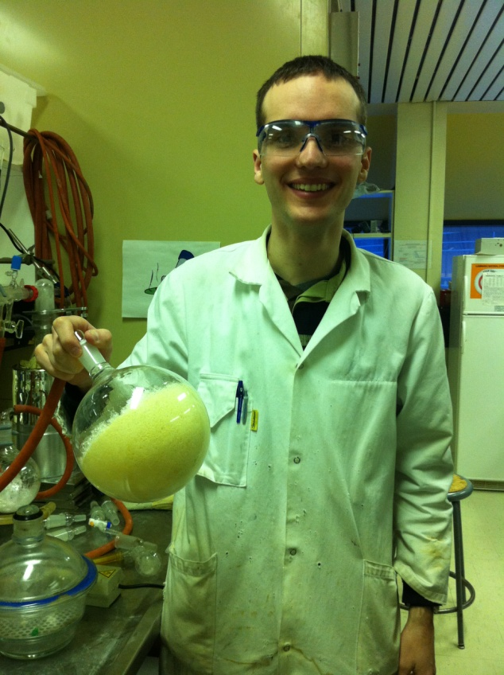
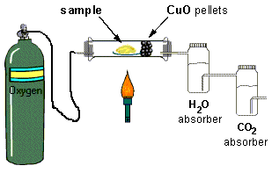
How It Works!
Hydrocarbons are burned in pure oxygen
Carbon dioxide and water are produced
CuO oxidizes unreacted C and CO to make CO₂
All H becomes H₂O and all C becomes CO₂
H₂O and CO₂ are absorbed separately
Masses of each are used to determine % composition

Slide 6
Sample Problem
A 1.00g sample of a pure compound, containing only carbon and hydrogen, was combusted in a carbon-hydrogen combustion analyzer. The combustion produced 0.619g of water and 3.338g of carbon dioxide.
a) Calculate the masses of carbon and hydrogen in the sample.
b) Find the empirical formula of the compound.

Slide 7
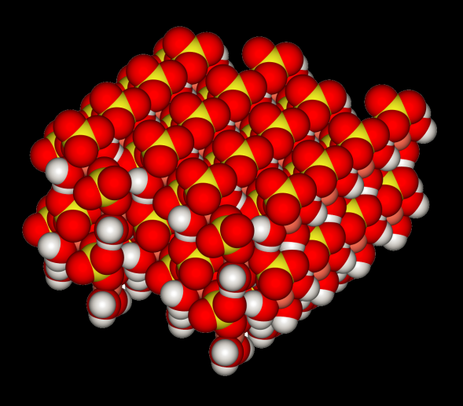
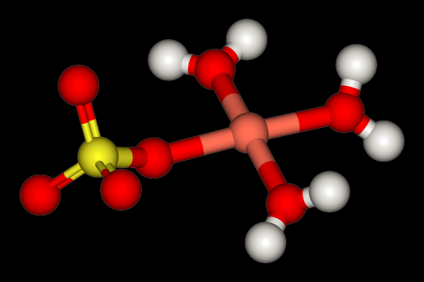
Hydrate Analysis
Hydrates are ionic compounds with water incorporated into their crystal structure
Anhydrous compounds have no water attached
Compare MgSO₄ 7H₂O and MgSO₄
The molar mass and the % composition must include the bound water molecules
H₂O

Slide 8
Hydrate Analysis
How could hydrates be converted into anhydrous compounds?
How could you use this to determine the number of molecules of water bound to the salt?
HEAT!

Slide 9
Sample Problem
A hydrate of barium hydroxide, Ba(OH)₂·xH₂O, is used to make barium salts and to prepare certain organic compounds. Since it reacts with CO₂ from the air to yield barium carbonate, BaCO₃, it must be stored in tightly stoppered bottles.
A 50g sample of the hydrate contains 27.2g of Ba(OH)₂. Calculate the percent, by mass, of water in Ba(OH)₂·xH₂O.
Find the value of x in Ba(OH)₂·xH₂O.

Slide 10
Homework
Please try the problems in your study guide!

