Slide 1
DNA Replication

Slide 2
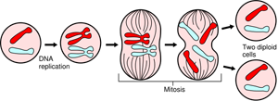
In your introductory biology/science courses you learned about the process of mitosis. Mitosis allows the nuclear material in the cell to be divided into daughter cells.

Slide 3
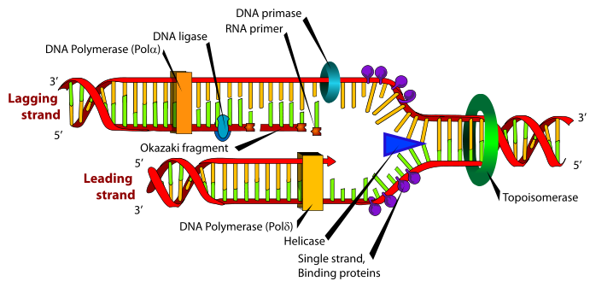
DNA replication allows both sides of the DNA to be copied simultaneously. Each strand of the DNA is used as a template to make a copy. Once the two strands are separated, this is referred to as a replication fork.

Slide 4
Let’s look at the enzyme proteins involved in the process.
Gyrase – this is a large protein that unwinds the DNA and releases stress on the molecule.
Helicase – this is a large quaternary protein (about 6 tertiary structures) that can unzip DNA by separating H-bonds.
Single-Stranded Binding Proteins (SSBs) – this is a quaternary protein that prevents the two separated strands from reannealing.
DNA Polymerases( I or III) (shown in the diagram only as DNA Polymerase) – these are a group of quaternary proteins that read single-stranded DNA in the direction of 5’ to 3’ and assembles nucleotides in the new strand from 3’ to 5’. It can read and extend a nucleotide sequence but cannot start one. There are DNA Polymerase I, DNA Polymerase III, DNA Polymerase a, etc.
Primase – an RNA Polymerase that makes short RNA primers to assist DNA Polymerase so it has a place to start the replication of nucleotides.
DNA Polymerase I / RNase H – a protein that changes the RNA primer to DNA by hydrolyzing at the 2’ carbon.
DNA Ligase – joins short sections of DNA together forming a continuous strand.

Slide 5
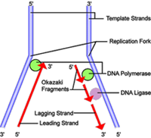
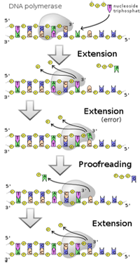
Gyrase unwinds the double helix.
Helicase unzips the DNA and SSBs prevent the two strands from rejoining.
A RNA primer is formed by primase so that DNA Polymerase III has a starting point.
DNA Polymerase III assembles nucleotides 3’ to 5’ but reads the template 5’ to 3’. Due to this, one strand can be formed continuously and this is called the leading strand and the other strand must be formed in short segments as Helicase unwinds the DNA. This is called the lagging strand and is made in short segments called Okazaki fragments.
DNA Polymerase I will convert the RNA primer into DNA.
DNA Ligase will join the fragments of DNA by connecting nucleotides through phosphodiester linkages.
Replication terminates when DNA Polymerase III reads telomeres. These are repeating sequences of DNA that get removed and become shorter after each time DNA is replicated.
Finally, there is proof reading of the replicated strands to catch any errors. This is done by another DNA Polymerase.

Slide 6
Once the replication fork is formed, each strand becomes the template for the new strand of DNA. Note, however, that each strand is not a duplicate of itself, but the compliment of itself. It will not look like the template it is copying from, but rather the antiparallel strand of the double helix. For example, this is how the original template and the newly strand will appear:
Original Strand: AATTCCG
Copied Strand: TTAAGGC

Slide 7
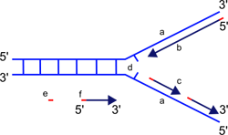
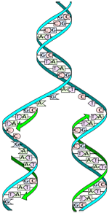
So the original strand and the copied strand will anneal forming a double helix of an old and new strand of DNA. Because each new strand contains one original strand and one copied strand, it is called semi-conservative replication.

Slide 8
Links for deeper understanding
http://www.bioteach.ubc.ca/TeachingResources/MolecularBiology/DNAReplication.swf
http://www.stolaf.edu/people/giannini/flashanimat/molgenetics/dna-rna2.swf
http://users.rcn.com/jkimball.ma.ultranet/BiologyPages/D/DNAReplication.html

