Slide 1
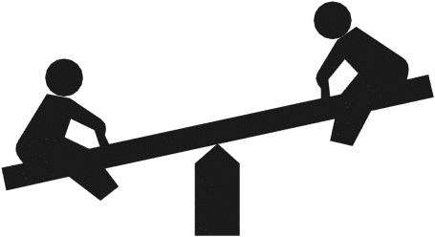
Le Chatelier’s Principle

Slide 2
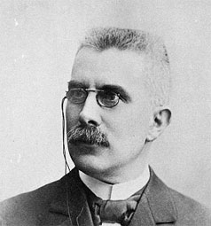
LeChatelier’s Principle
When a system at
equilibrium is placed under
stress, the system will
undergo a change in such
a way as to relieve that
stress and restore a
state of equilibrium.
Henry Le Chatelier

Slide 3
Le Chatelier Translated:
When you take something away from a system at equilibrium, the system shifts in such a way as to replace some what you’ve taken away.
When you add something to a system at equilibrium, the system shifts in such a way as to use up some of what you’ve added.

Slide 4
LeChatelier Example #1
A closed container of ice and water is at equilibrium. Then, the temperature is raised.
Ice + Energy  Water
The system temporarily shifts to the _______ to restore equilibrium.
right

Slide 5
LeChatelier Example #2
A closed container of N₂O₄ and NO₂ is at equilibrium. NO₂ is added to the container.
N₂O₄ (g) + Energy  2 NO₂ (g)
The system temporarily shifts to the _______ to restore equilibrium.
left

Slide 6
LeChatelier Example #3
A closed container of water and its vapor is at equilibrium. Vapor is removed from the system.
water + Energy  vapor
The system temporarily shifts to the _______ to restore equilibrium.
right

Slide 7
LeChatelier Example #4
A closed container of N₂O₄ and NO₂ is at equilibrium. The pressure is increased.
N₂O₄ (g) + Energy  2 NO₂ (g)
The system temporarily shifts to the _______ to restore equilibrium, because there are fewer moles of gas on that side of the equation.
left

