Slide 1
What is Light?

Slide 2
UNDERSTANDING SIGHT
To understand sight, you have to understand:
Light
Eye-Brain combination
Optics - how light behaves in the physical world

Slide 3
Brainstorm:
What Is Light?

Slide 4
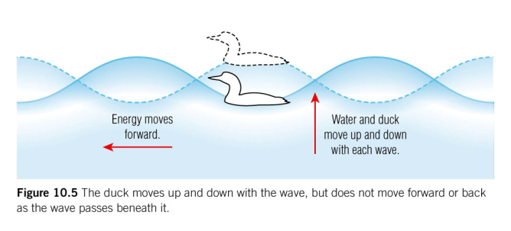
What is a wave?
A wave is a disturbance that transfers energy from one point to another without transferring matter.

Slide 5
Most waves need a medium…
Medium – any physical substance (air, water, dust) that acts as a carrier for the transmission of energy.
Sound travels through air particles
Water waves travel through water
A rope or slinky can be a medium for waves

Slide 6
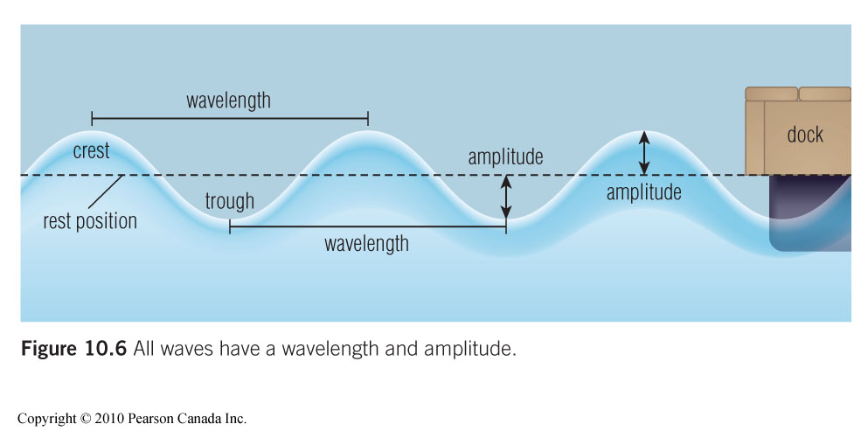

Slide 7
How does light travel through space?

Slide 8
Electromagnetic Waves
The term electromagnetic waves is used to describe light because light is made up of oscillating electric and magnetic fields.

Slide 9
How fast is light?
$c=3×{10}^{8}m/s$
Imagine how far light will travel in a year!

Slide 10
Colours

Slide 11
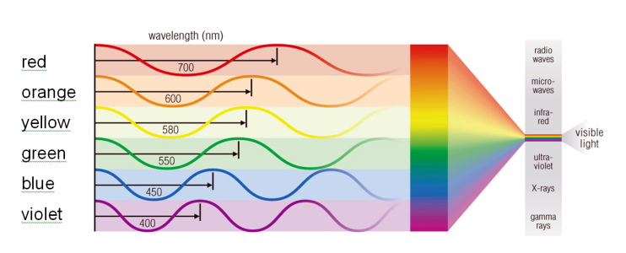
Colours
What distinguishes colours of light is the different wavelengths of light.

Slide 12
COLOUR SPECTRUM
These colours are called a SPECTRUM
White light is made up of shades of Red, Orange, Yellow, Green, Blue, Indigo and Violet
ROY G BIV is a mnemonic to help you remember the spectrum.

Slide 13
Additive Colour Theory of Light
white light is composed of different colours (wavelengths) of light
white light can be produced combining only three colours
One such combination is red, green and blue

Slide 14
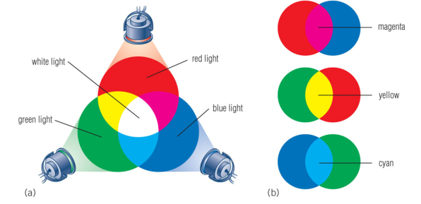
Additive Colour Theory of Light
Primary Colours for Light
Red, Green, Blue
If you mix only two primary colours together you make a secondary colour.

Slide 15
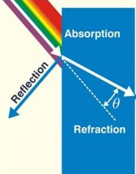
When Light Hits an Object
It can be absorbed
It can bounce off the object (reflect)
It can change direction (refraction in transparent objects)

Slide 16
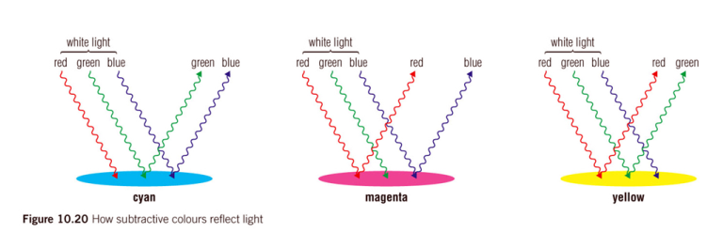
Subtractive Colour Theory of Light
The colour you see when you look at an object depends on the wavelengths that are reflected

Slide 17
How do we get the colour black?

Slide 18
How do we get the colour black?
A black object absorbs all colours while a white object reflects all colours. A blue object reflects blue and absorbs all other colours.

Slide 19
Subtractive Colour Theory of Light
The primary and secondary colours of light for the subtractive theory are opposite to the colours of the additive theory.

Slide 20
Subtractive Colour Theory of Light
Cyan, magenta and yellow are the primary subtractive colours while red, green and blue are the secondary subtractive colours.

Slide 21
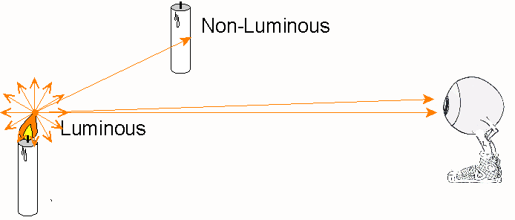
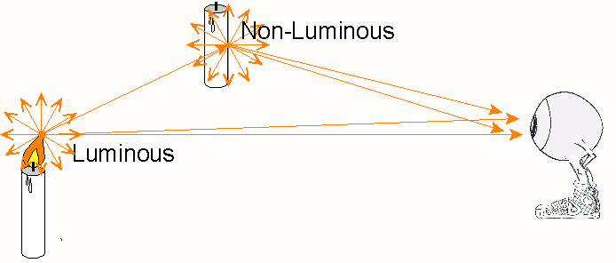
LUMINOUS SOURCES
Atoms in LUMINOUS OBJECTS emit light rays in all directions produced from other energy sources.
Atoms in NON-LUMINOUS OBJECTS scatter the light rays from luminous objects in all directions.

Slide 22
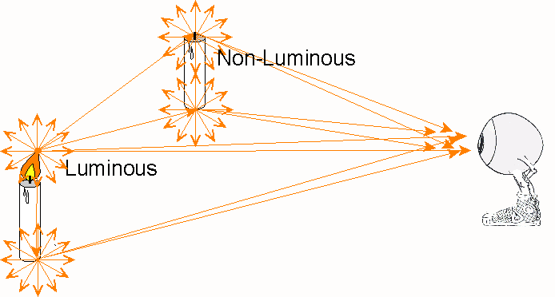
NOTE
Atoms in all objects produce or scatter light rays. This diagram only shows light rays from atoms at the top and bottom of the objects.

Slide 23
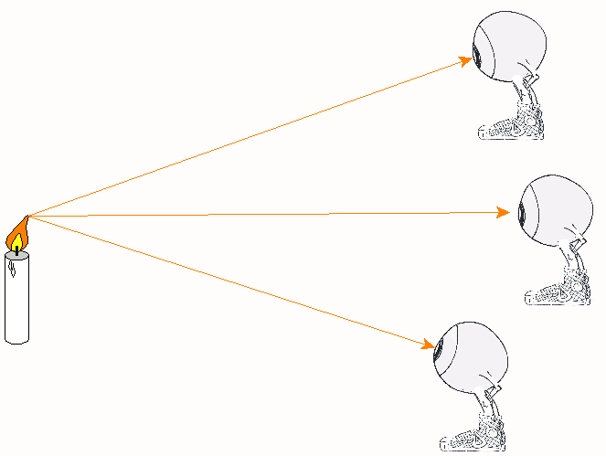
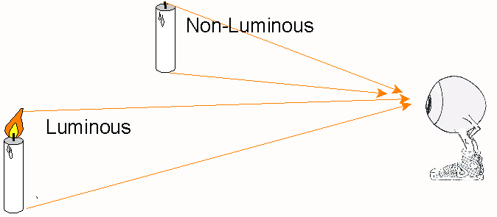
KEEP IT SIMPLE
To make diagrams simpler, we only show one ray of light from the top and bottom of objects.
We simplify it even more and just show only the rays coming from the top of the object.

Slide 24
MEDIUMS
A TRANSPARENT MEDIUM allows nearly all rays to pass straight through unaltered. (Ex. Air)
An OPAQUE MEDIUM absorbs or scatters all the rays. (Ex. Textbook, wall, etc.)

Slide 25
We can only sense so much…
When a dog whistle is blown, can you hear it?
Some sounds are at such a high frequency, we can’t hear them.

Slide 26
WE DON’T SEE IT ALL
Our eyes can’t “see” some of the electromagnetic spectrum
The “colour” hot irons emit can’t be seen, but you feel the heat

Slide 27
WE DON’T SEE IT ALL
The colour iron emits is called Infrared Radiation (sound familiar?)
Some snakes can actually see Infrared Radiation!

Slide 28
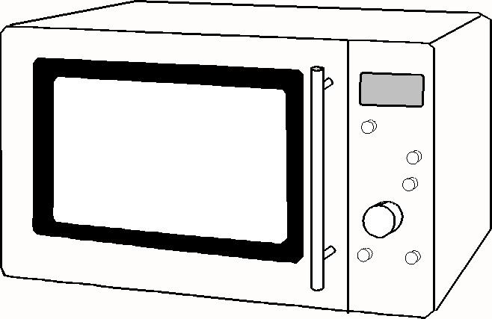
MORE EXAMPLES
When you use a microwave, you can’t see the “colour” your food is absorbing.
The “colour” used to heat your food is called Microwave radiation.

Slide 29
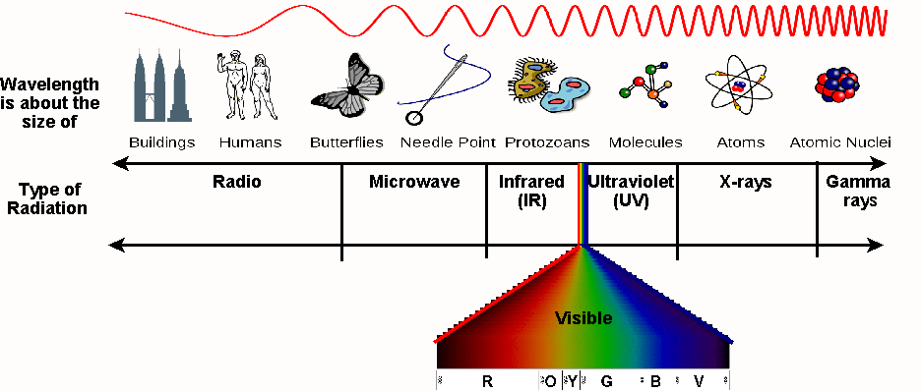
ELECTROMAGNETIC SPECTRUM
Visible light spectrum is a very small portion of a much larger spectrum called the Electromagnetic Spectrum
Sample Mnemonic:
Ramiel’s Mother Is Visiting Uncle Xavier’s Garden

Slide 30
ELECTROMAGNETIC SPECTRUM
These waves all travel at “c”
From left to right, the wavelengths get shorter
Sample Mnemonic:
Ramiel’s Mother Is Visiting Uncle Xavier’s Garden

Slide 34
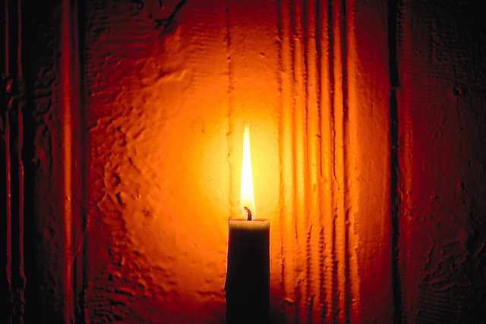
Light Production

Slide 35
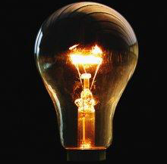
WAYS TO GAIN ENERGY & PRODUCE LIGHT
Incandescence – production of light as a result of high temperature (ex. Burning candle)

Slide 36
WAYS TO GAIN ENERGY & PRODUCE LIGHT
Electric Discharge – process of producing light by passing an electric current through a gas (ex. Neon lights)

Slide 37
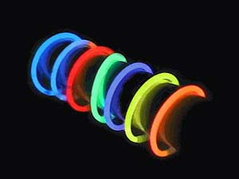
WAYS TO GAIN ENERGY & PRODUCE LIGHT
Phosphorescence – process of producing light by the absorption of UV light resulting in the emission of visible light over an extended period of time (ex. Glow in the Dark)

Slide 38
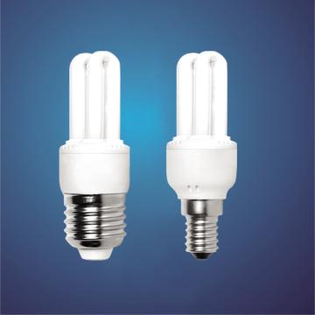
WAYS TO GAIN ENERGY & PRODUCE LIGHT
Fluorescence – immediate emission of visible light as a result of the absorption of UV light (ex. Energy saving light bulbs)

Slide 39
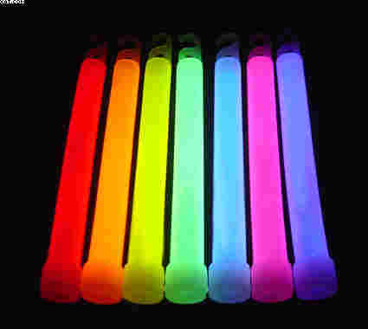
WAYS TO GAIN ENERGY & PRODUCE LIGHT
Chemiluminescence – direct production of light as the result of a chem. Rxn with little or no heat produced (ex. Glow sticks

Slide 40
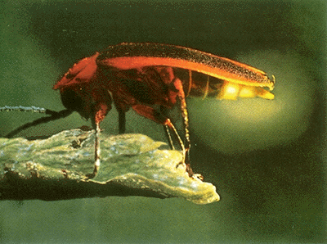
WAYS TO GAIN ENERGY & PRODUCE LIGHT
Bioluminescence – production of light in living organisms as the result of a chem. Rxn with little or no heat produced (ex. Fireflies)

Slide 41
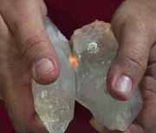
WAYS TO GAIN ENERGY & PRODUCE LIGHT
Triboluminescence – production of light from friction as a result of scratching, crushing, or rubbing certain crystals (ex. Self-sealing envelopes opened in the dark produce a blue glow)

Slide 42
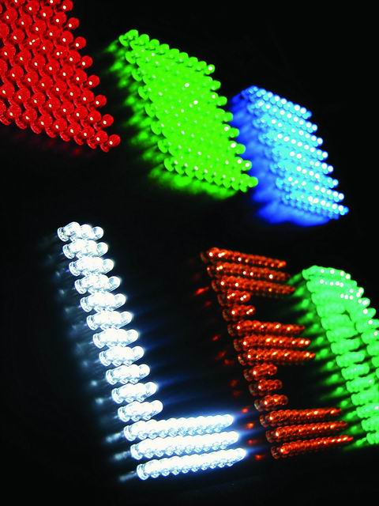
WAYS TO GAIN ENERGY & PRODUCE LIGHT
Light-Emitting Diode (LED) – light produced as a result of an electric current flowing in semi-conductors

Slide 43
Bioluminesence
https://www.ted.com/talks/edith_widder_the_weird_and_wonderful_world_of_bioluminescence

