Slide 1
Seeing Things in Curved Mirrors

Slide 2
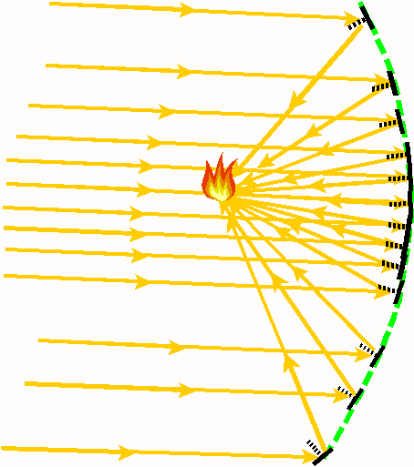
The mirrors can be aligned along a smooth curve so that they still all reflect light from the sun to the same spot. When light rays come from a distant source like the sun, they can be considered parallel.

Slide 3
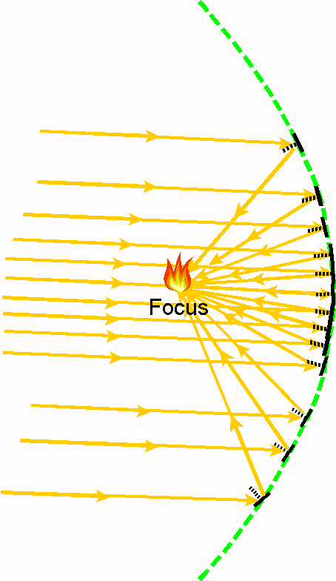
All incident light rays which are parallel to each other will reflect off any part of the smooth curve and pass through the same spot. This spot is called the Focus.

Slide 4
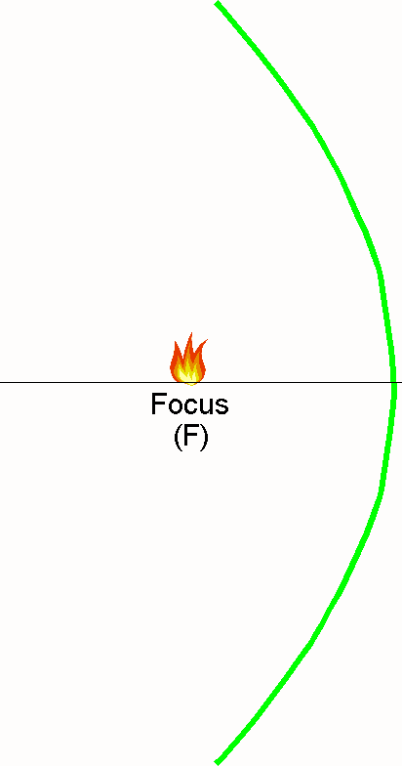
The Curve is called a Parabola. The symbol for the Focus is (F). Unfortunately, Parabolic mirrors are expensive to make.

Slide 5
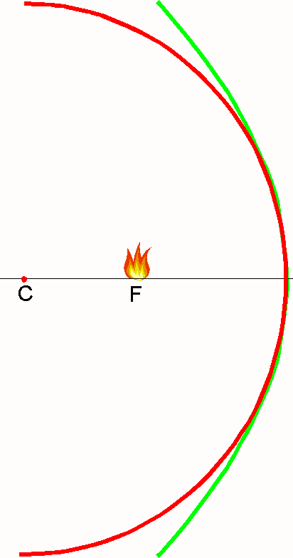
A circle can be drawn so that it closely matches the parabola near the central region. Fortunately, Circular (or in 3D, Spherical) mirrors are less expensive to make.
The symbol “C” stands for Centre of Curvature of the Spherical mirror.
Notes:
Use Kaleidoscope Mirrors (see Making Kaleidoscope Mirrors) and Flashlight with graph of a parabola and circle to show how the mirrors can be arranged in a parabola so that they all aim at the same spot (Focus). Obtain Graph from ParabolicSphericalMirrorDemoLegalSize.doc (Legal paper sized graph) and ParabolicSphericalMirrorDemoLetterSize.doc (Letter paper sized graph).
When arranged in a circle so they do not all point at the focus. Only the mirror near the centre focus correctly. Mirrors arranged in a circle near the outside will not reflect light toward the Focus. This is called “Spherical Aberration”

Slide 6
Most curved mirrors that are used have a Spherical instead of the more expensive (but better) Parabolic shape. Only a small portion of the Spherical mirror is used so that it closely matches the properties of a Parabolic mirror.

Slide 7
This is why curved mirrors often seem to be quite “flat”.

Slide 8
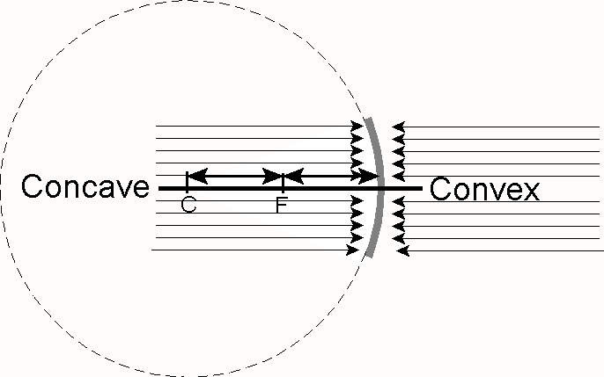
The inside of a sphere produces a concave mirror.
The outside produces a convex mirror.

Slide 9
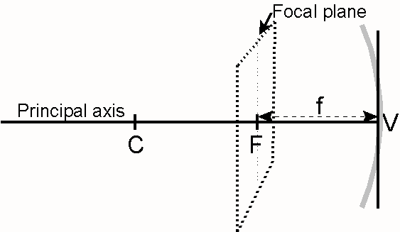
The Parts of a Concave Mirror
C ⇒ Centre of Curvature
F ⇒ Focus
f ⇒ Focal Length
V ⇒ Vertex

Slide 10
Concave Mirror Characteristic Rays
Concave mirrors can produce images but they are more complicated than plane mirrors.

Slide 11
Concave Mirror Characteristic Rays
Certain light rays called “Characteristic Rays” always reflect the same way from a Concave mirror .
These Characteristic Rays can be used to predict what the images will look like.
Notes:
The Characteristic Rays should be demonstrated using a Laser Level and demonstration mirrors. These are sold through the STAO store.

Slide 12
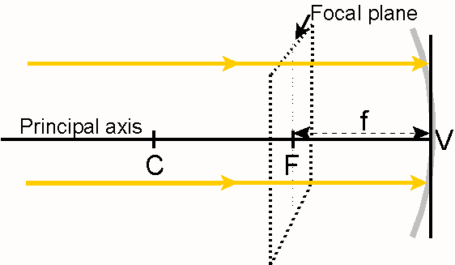
Concave Mirror Characteristic Rays
Any incident ray parallel to the principal axis will……
Notes:
The Characteristic Rays should be demonstrated using a Laser Level and demonstration mirrors. These are sold through the STAO store .

Slide 13
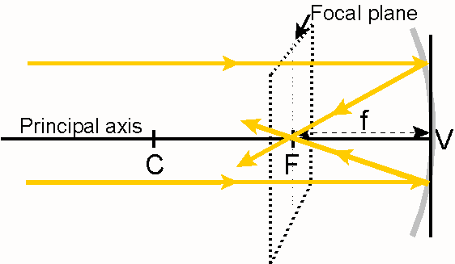
Concave Mirror Characteristic Rays
Any incident ray parallel to the principal axis will
reflect through the Focus.
Notes:
The Characteristic Rays should be demonstrated using a Laser Level and demonstration mirrors. These are sold through the STAO store .

Slide 14
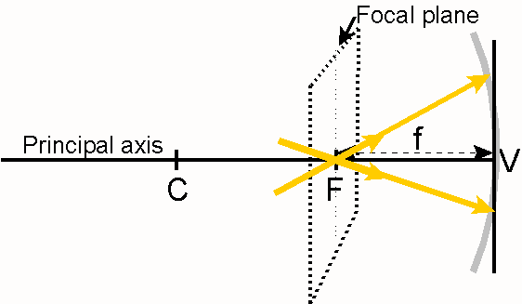
Concave Mirror Characteristic Rays
Any incident ray passing through the Focus will……
Notes:
The Characteristic Rays should be demonstrated using a Laser Level and demonstration mirrors. These are sold through the STAO store .

Slide 15
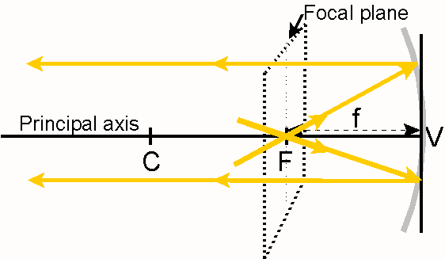
Concave Mirror Characteristic Rays
Any incident ray passing through the Focus will
reflect parallel to the principal axis.
Notes:
The Characteristic Rays should be demonstrated using a Laser Level and demonstration mirrors. These are sold through the STAO store.
The Characteristic Rays should be demonstrated using a Laser Level and demonstration mirrors. These are sold through the STAO store

Slide 16
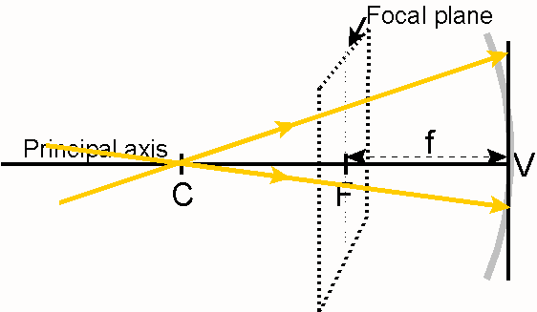
Concave Mirror Characteristic Rays
Any incident ray passing through the Centre of Curvature
will……
Notes:
The Characteristic Rays should be demonstrated using a Laser Level and demonstration mirrors. These are sold through the STAO store.

Slide 17
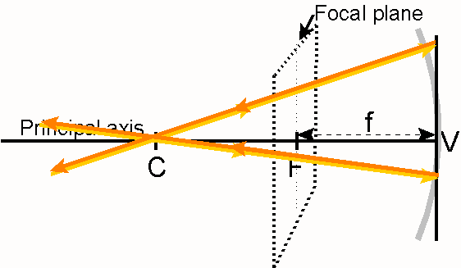
Concave Mirror Characteristic Rays
Any incident ray passing through the Centre of Curvature
will reflect back upon itself.
Notes:
The Characteristic Rays should be demonstrated using a Laser Level and demonstration mirrors. These are sold through the STAO store.

Slide 18
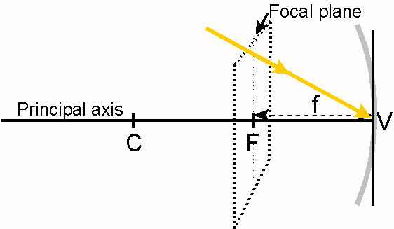
Concave Mirror Characteristic Rays
Any incident ray striking the Vertex will……
Notes:
The Characteristic Rays should be demonstrated using a Laser Level and demonstration mirrors. These are sold through the STAO store .

Slide 19
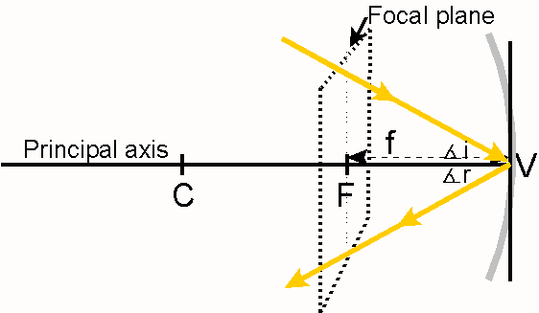
Concave Mirror Characteristic Rays
Any incident ray striking the Vertex will reflect
such that ∠i = ∠r.
Notes:
The Characteristic Rays should be demonstrated using a Laser Level and demonstration mirrors. These are sold through the STAO store.

Slide 20
If the OBJECT IS MOVED far beyond the Centre of Curvature, the image will move toward the Focus.
If the OBJECT IS MOVED close toward the Focus, the image will move far beyond the Centre of Curvature.
In order to produce a VIRTUAL IMAGE with CONCAVE MIRROR, an object must be placed between the Focus and the Vertex.

Slide 21
7) In order to produce a REAL IMAGE with CONCAVE MIRROR, an object must be placed beyond the Focus (away from the mirror).
8) In order to produce an UPRIGHT IMAGE with CONCAVE MIRROR, an object must be placed between the Focus and the Vertex.
In order to produce the LARGEST IMAGE POSSIBLE with CONCAVE MIRROR, an object must be placed close to the Focus.

