Slide 1
Seeing Things in Convex Mirrors

Slide 2
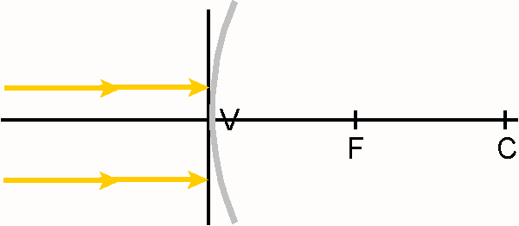
Convex Mirror Characteristic Rays
Any incident ray parallel to the principal axis will……
Notes:
The Characteristic Rays should be demonstrated using a Laser Level and demonstration mirrors. These are sold through the STAO store .

Slide 3
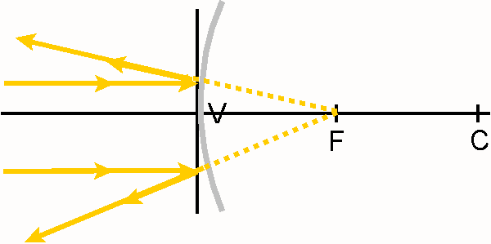
Convex Mirror Characteristic Rays
Any incident ray parallel to the principal axis will
reflect as if it had passed through the Focus.
Notes:
The Characteristic Rays should be demonstrated using a Laser Level and demonstration mirrors. These are sold through the STAO store .

Slide 4
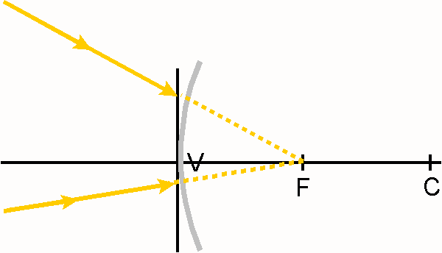
Convex Mirror Characteristic Rays
Any incident ray moving toward the Focus will……
Notes:
The Characteristic Rays should be demonstrated using a Laser Level and demonstration mirrors. These are sold through the STAO store .

Slide 5
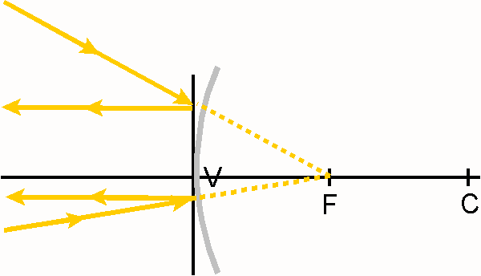
Convex Mirror Characteristic Rays
Any incident ray moving toward the Focus will
reflect parallel to the principal axis.
Notes:
The Characteristic Rays should be demonstrated using a Laser Level and demonstration mirrors. These are sold through the STAO store .

Slide 6
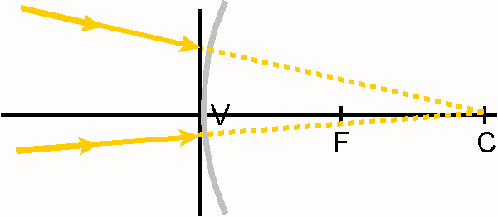
Convex Mirror Characteristic Rays
Any incident ray moving toward the Centre of Curvature
will……
Notes:
The Characteristic Rays should be demonstrated using a Laser Level and demonstration mirrors. These are sold through the STAO store.

Slide 7
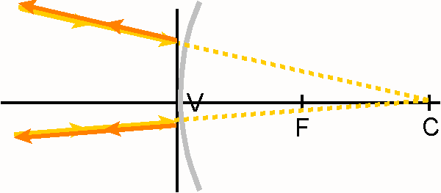
Convex Mirror Characteristic Rays
Any incident ray moving toward the Centre of Curvature
will reflect back upon itself.
Notes:
The Characteristic Rays should be demonstrated using a Laser Level and demonstration mirrors. These are sold through the STAO store.

Slide 8
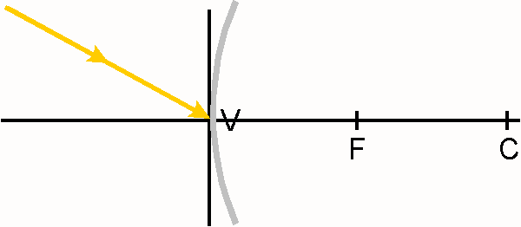
Convex Mirror Characteristic Rays
Any incident ray striking the Vertex will……
Notes:
The Characteristic Rays should be demonstrated using a Laser Level and demonstration mirrors. These are sold through the STAO store .

Slide 9
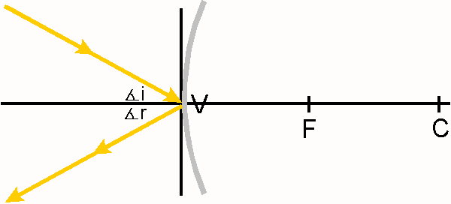
Convex Mirror Characteristic Rays
Any incident ray striking the Vertex will reflect such that ∠i = ∠r.
Notes:
The Characteristic Rays should be demonstrated using a Laser Level and demonstration mirrors. These are sold through the STAO store .

Slide 10
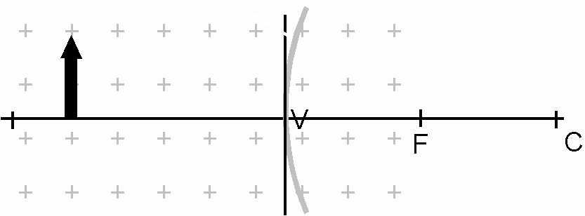
Predicting Images in a Convex Mirror

Slide 11
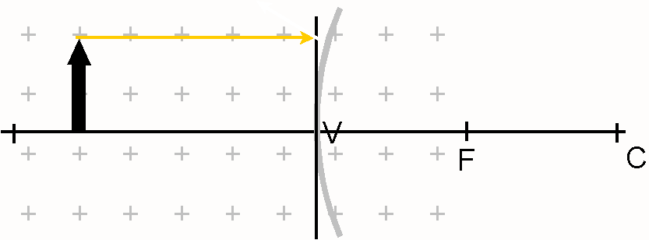
Predicting Images in a Convex Mirror
Any incident ray parallel to the principal axis will……

Slide 12
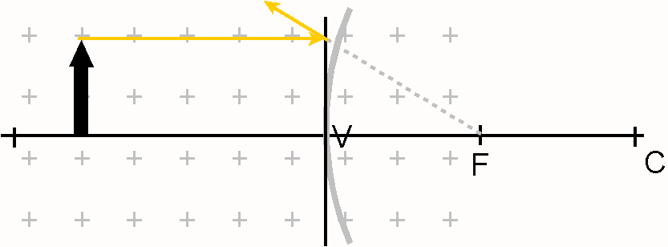
Predicting Images in a Convex Mirror
Any incident ray parallel to the principal axis will
reflect as if it had passed through the Focus.

Slide 13
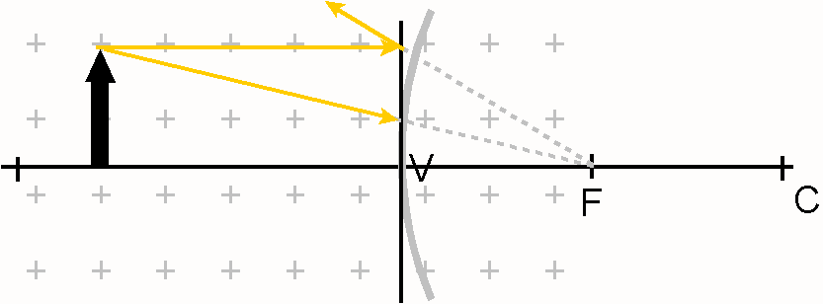
Predicting Images in a Convex Mirror
Any incident ray moving toward the Focus will……

Slide 14
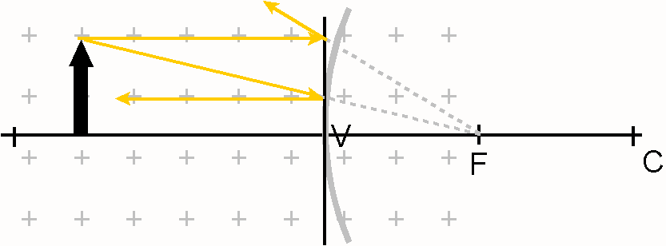
Predicting Images in a Convex Mirror
Any incident ray moving toward the Focus will
reflect parallel to the principal axis.

Slide 15
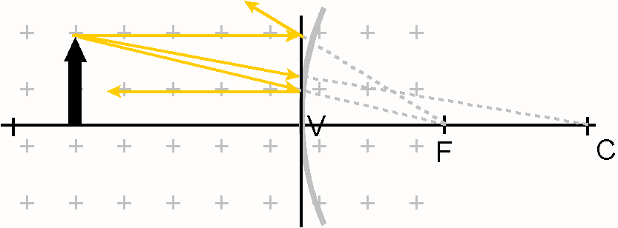
Predicting Images in a Convex Mirror
Any incident ray moving toward the Centre of Curvature
will……

Slide 16
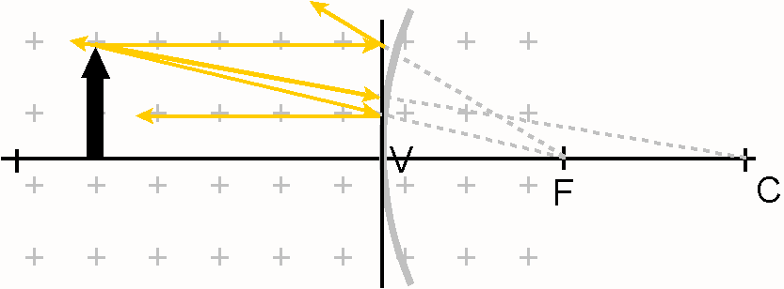
Predicting Images in a Convex Mirror
Any incident ray moving toward the Centre of Curvature
will reflect back upon itself.

Slide 17
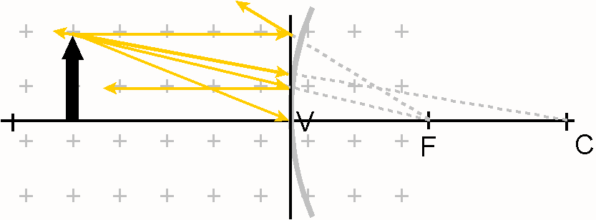
Predicting Images in a Convex Mirror
Any incident ray striking the Vertex will……

Slide 18
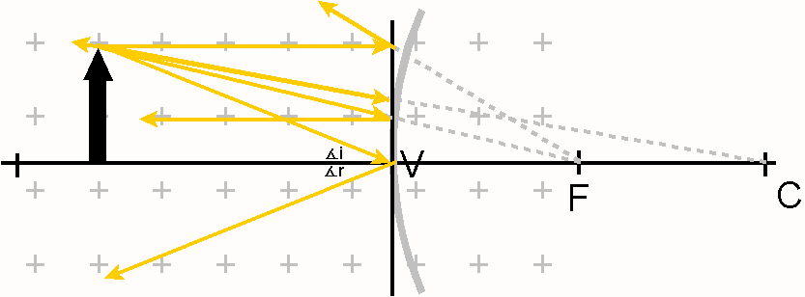
Predicting Images in a Convex Mirror
Any incident ray striking the Vertex will reflect such that ∠i = ∠r.

Slide 19
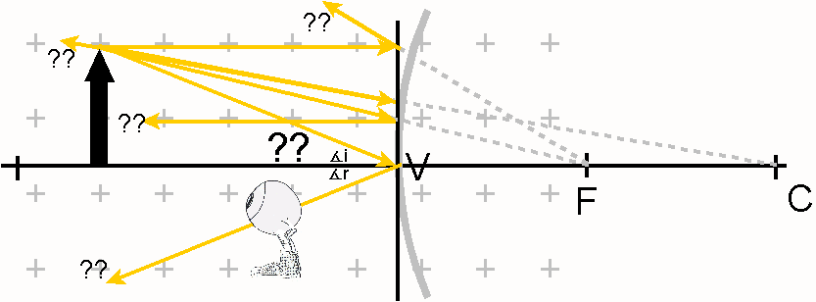
Predicting Images in a Convex Mirror
The reflected rays diverge!
Where is the image?

Slide 20
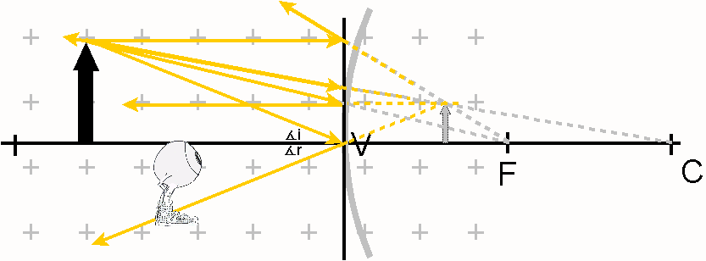
Predicting Images in a Convex Mirror
The image is where the rays appear to have come from.

Slide 21
Predicting Images in a Convex Mirror
Answers to Analysis
Follows.

Slide 22
In order to produce a VIRTUAL IMAGE with CONVEX MIRROR, an object must be placed anywhere.
In order to produce the LARGEST IMAGE POSSIBLE with CONVEX MIRROR, an object must be placed close to the mirror.
In order to produce an IMAGE SMALLER THAN THE OBJECT with CONVEX MIRROR, an object must be placed anywhere.
If the OBJECT IS MOVED far away from a CONVEX MIRROR, the image will move close to the Focus.

