Slide 1
Clean Energy

Slide 2
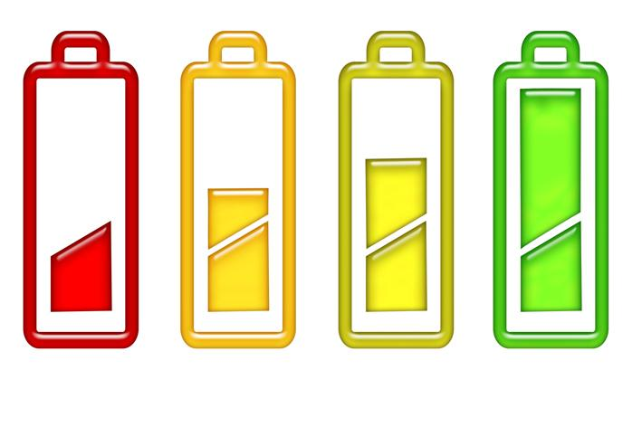
Where does energy come from?

Slide 3
Where does energy come from?
Where Energy Comes From
http://www.youtube.com/watch?v=__zB80Saglk
How Magnets Produce Electricity
http://www.youtube.com/watch?v=FehUCQKKRwo
Energy 101: Electricity Generation
http://www.youtube.com/watch?v=20Vb6hlLQSg
What can you create by knowing this information?
http://www.youtube.com/watch?v=XlqYbJps_JY

Slide 4
Steam Turbines
How a Steam Turbine Generator Works
http://www.youtube.com/watch?v=eNCyTfUvZws
Steam Turbine: How does it work?
http://www.youtube.com/watch?v=5kFOq9_10kc

Slide 5
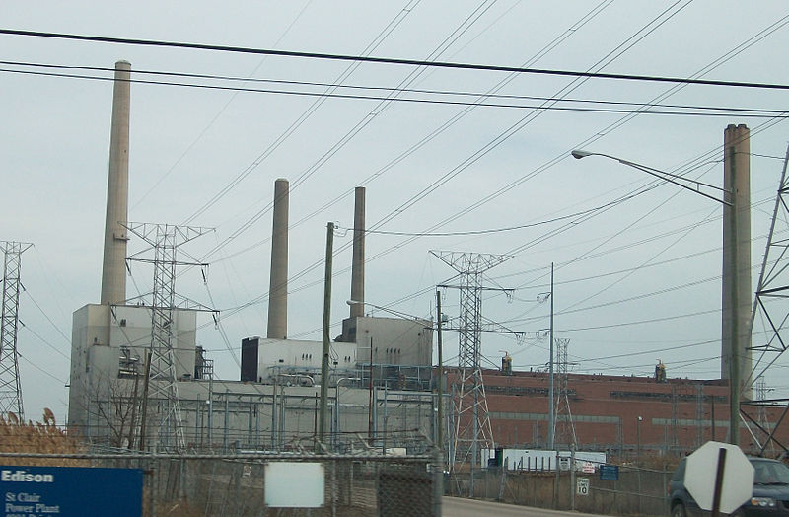
Main Current Energy Source
Fossil Fuels
Include coal, petroleum, and natural gas
Burned to produce energy (heat) to turn turbines

Slide 6
Pros of Fossil Fuels
Well Developed Technology
Cheap and Reliable

Slide 7
Cons of Fossil Fuels
Produces Greenhouse gases
Non-renewable (in the short term)
Unsustainable
Fuel Accidents

Slide 8
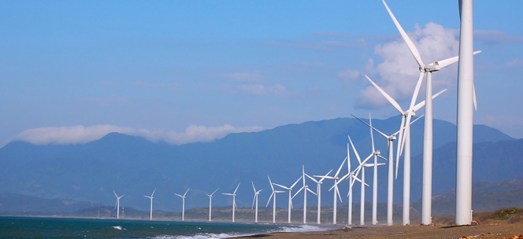
Changing Our Energy Sources
Wind Power
Wind causes the blades of wind turbines to turn, powering generators that produce electricity.

Slide 9
Pros of Wind Power
Renewable energy
Creates no waste
In Spain, Portugal, Denmark and Germany, almost one-fifth of the energy total is wind power

Slide 10
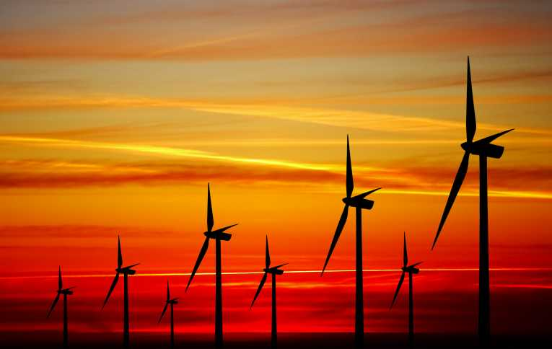
Cons of Wind Power
Wind is unpredictable, and may not be relied upon all the time
Some people dislike the appearance of wind turbines

Slide 11
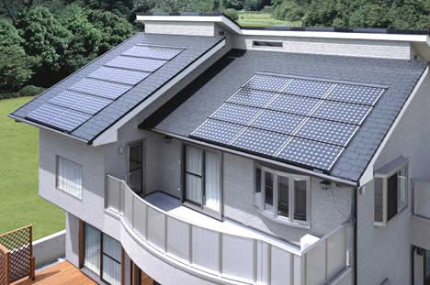
Changing Our Energy Sources
Solar Power
Solar panels absorb solar energy and convert it to electricity

Slide 12
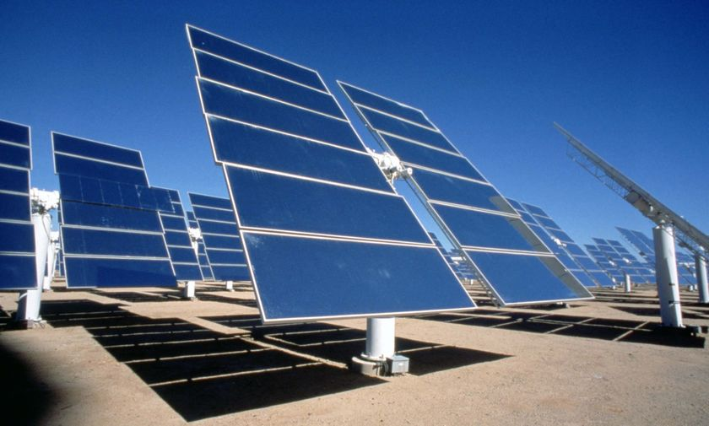
Pros of Solar Power
Renewable energy
Can get energy in remote locations
Once in place, does not cost much

Slide 13
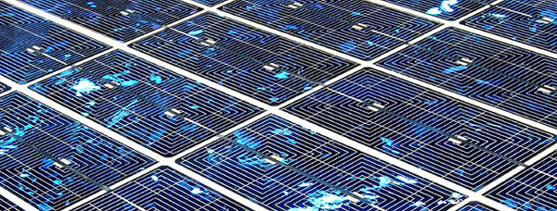
Cons of Solar Power
No energy is produced during the night
The initial cost is expensive
Weather can affect the amount of energy absorbed

Slide 14
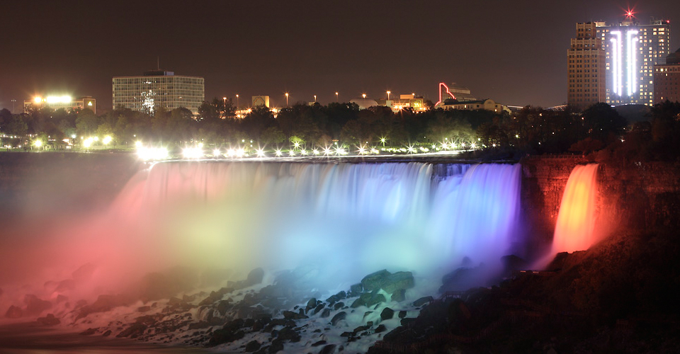
Changing Our Energy Sources

Slide 15
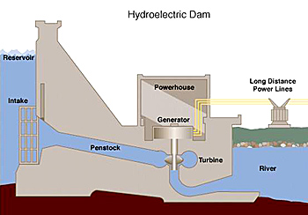
Changing Our Energy Sources
Hydroelectricity
The energy of moving water turns turbines to power generators

Slide 16
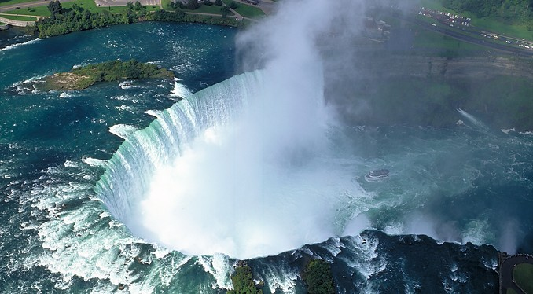
Pros of Hydroelectricity
Generates a lot of power
Waterfalls exist whether we use them or not (renewable)

Slide 17
Cons of Hydroelectricity

Slide 18
Cons of Hydroelectricity
Expensive to build
Potentially impact ecosystems
Can be affected by droughts

Slide 19
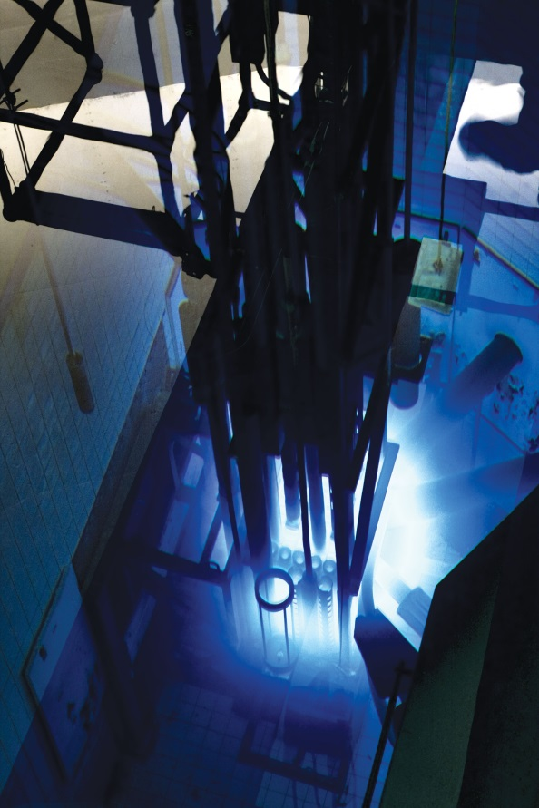
Changing Our Energy Sources
Nuclear Power
Energy is created by splitting the nuclei of atoms
A nuclear core, at the McMaster University Nuclear Reactor in Hamilton, Ontario

Slide 20
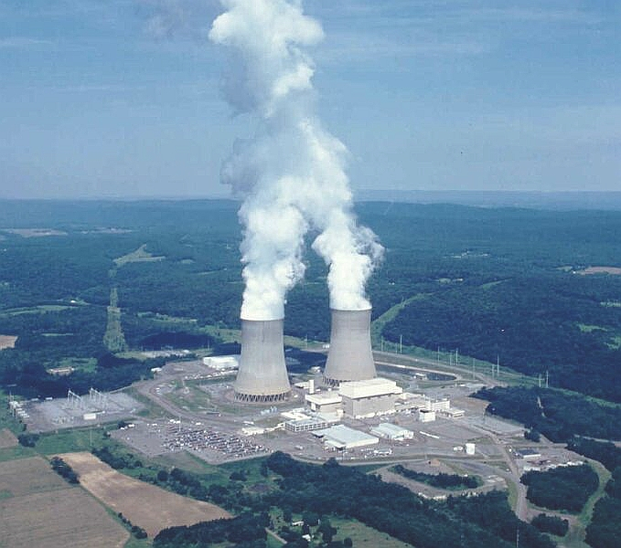
Pros of Nuclear Power
Clean-burning energy, almost no carbon emission
Produces a lot of energy through nuclear fission ($E = mc^{2}$)

Slide 21
Cons of Nuclear Power
Homer Simpson works at a nuclear plant

Slide 22
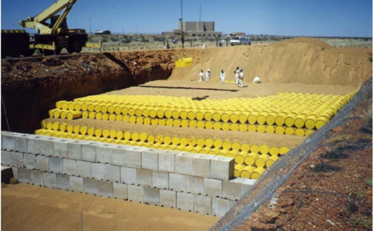
Cons of Nuclear Power
The left over atomic pieces produce nuclear waste
Nuclear waste gives off radiation

Slide 23
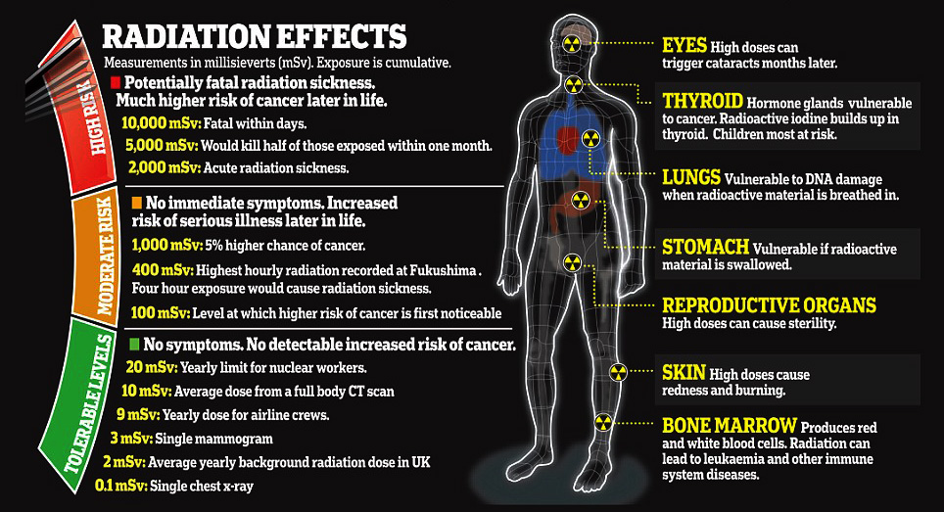
Cons of Nuclear Power

Slide 24
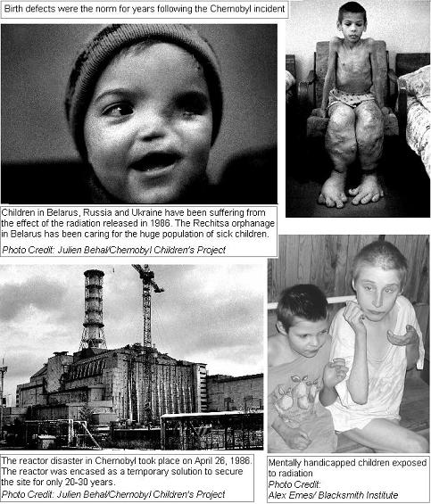
Cons of Nuclear Power
The Chernobyl Nuclear Disaster
Chernobyl Ukraine
1986

Slide 25
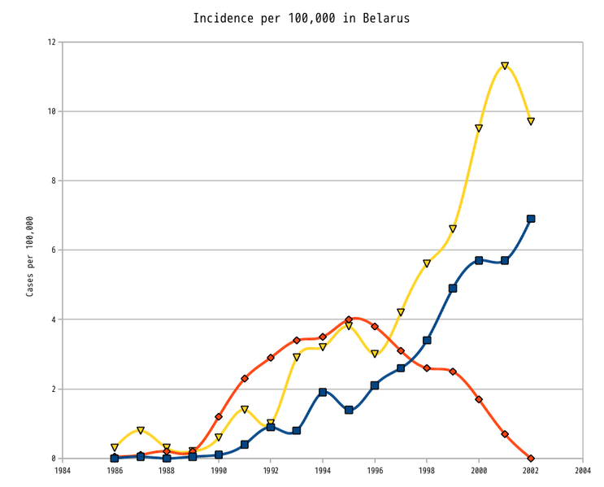
Cons of Nuclear Power
The Chernobyl Nuclear Disaster
Chernobyl Ukraine
1986
Thyroid cancer incidence in children and adolescents from Belarus after the Chernobyl accident Yellow: Adults (19–34) Blue: Adolescents (15–18) Red: Children (0–14)

Slide 26
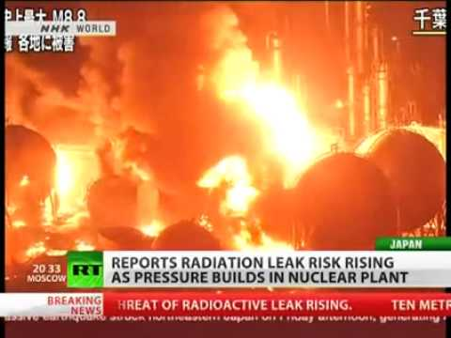
Cons of Nuclear Power
The Fukushima Nuclear Disaster
Fukushima Japan
2011

Slide 27
Cons of Nuclear Power
Japan
?
The Fukushima Nuclear Disaster
Fukushima Japan
2011
Thyroid cancer incidence in children and adolescents from Japan after the Fukushima accident Yellow: Adults (19–34) Blue: Adolescents (15–18) Red: Children (0–14)

Slide 28
Changing Our Energy Sources
Biomass
Biomass from waste such as crops, manure and garbage can be used to make biofuels like methane, gas, and biodiesel
The fuels can be burned for heat or to generate electricity with a steam turbine

Slide 29
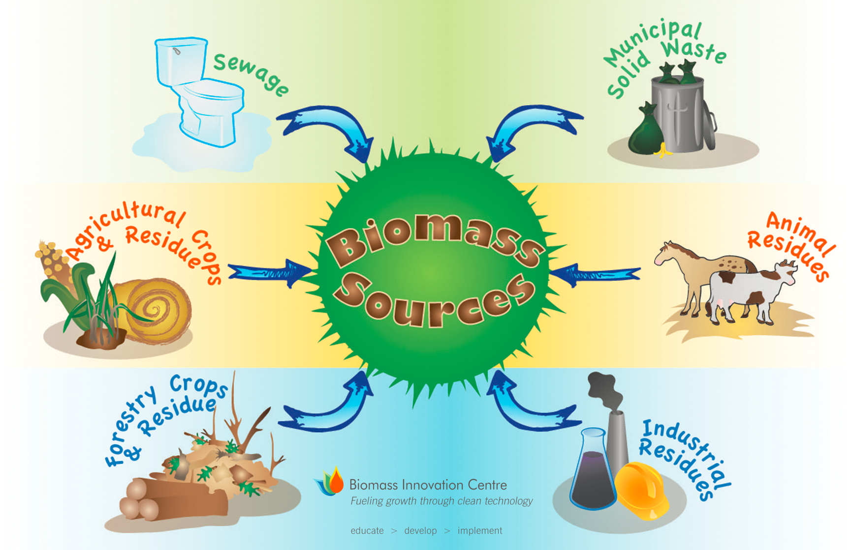
Changing Our Energy Sources

Slide 30
Pros of Biomass Energy
Renewable – we are always producing garbage, manure, and crops
Carbon Neutral - part of the carbon cycle – carbon is absorbed during photosynthesis and then released when it is burned
Not as expensive as coal and oil

Slide 31
Cons of Biomass Energy
Expensive
Requires Large Areas

