Slide 1
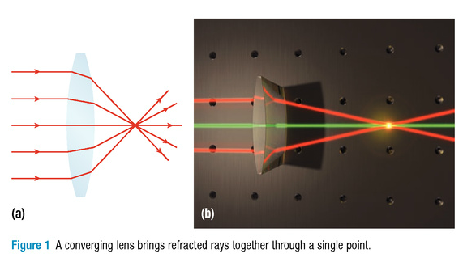
Predicting Images in a Convex Lens

Slide 2
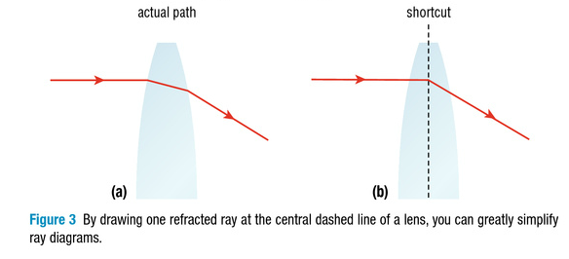

Slide 3
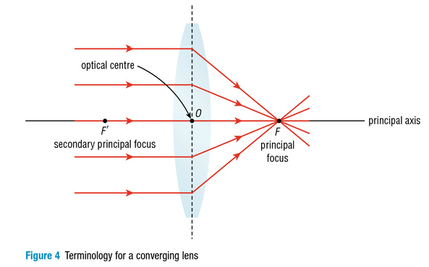

Slide 4
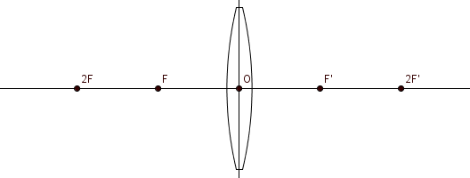
The Principal rays
A ray parallel to the principal axis is refracted through the principal focus (F ).

Slide 5
The Principal rays
A ray through the optical centre (O) continues straight through without being refracted.
Notes:
5

Slide 6
Ray diagram when the OBJECT is beyond 2F
Notes:
6

Slide 7
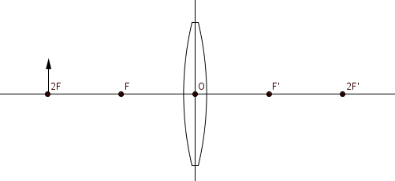
Ray diagram when the OBJECT is AT 2F
Notes:
7

Slide 8
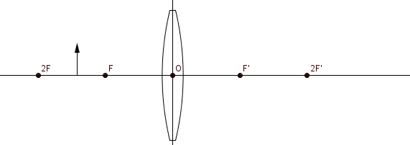
Ray diagram when thE OBJECT is BETWEEN 2F and F
Notes:
8

Slide 9
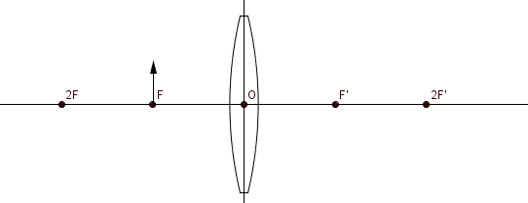
Ray diagram when the image is AT F
Notes:
9

Slide 10
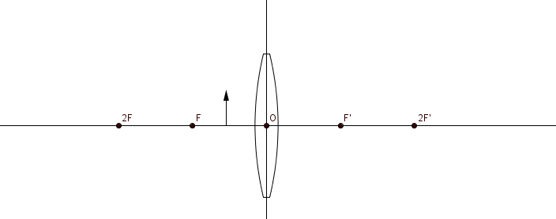
Ray diagram when the image is between F and O
Notes:
10

Slide 11
http://www.physics-chemistry-interactive-flash-animation.com/optics_interactive/converging_lens_convex_positive.htm
Notes:
11

Slide 12
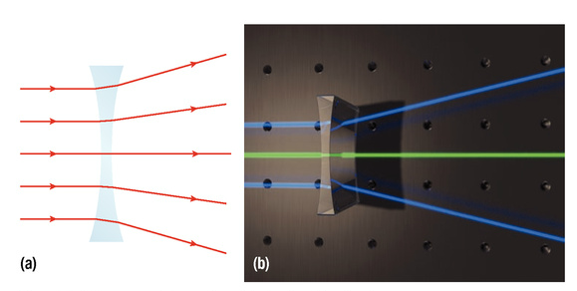
Predicting Images in a Concave Lens

Slide 13
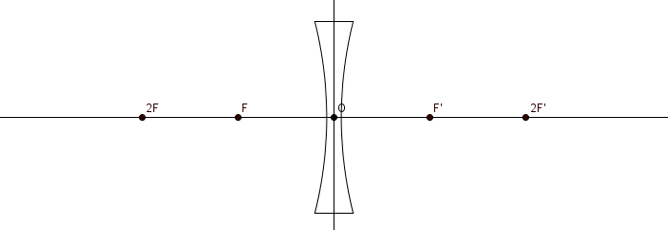
Concave Lens Characteristic Rays
Any incident ray parallel to the principal axis will
refract as if it had passed through the principal Focus.

Slide 14
Concave Lens Characteristic Rays
Any incident ray passing through the Optical Centre will pass undeviated (straight through).

Slide 15
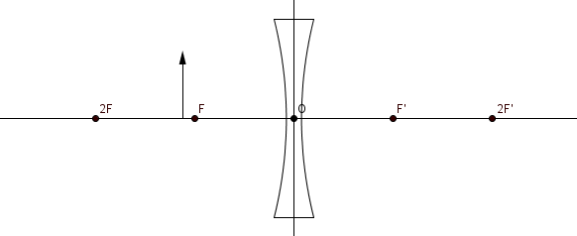
Concave Lenses All Cases

Slide 16
Homework
Pg. 561 #2, 3, 5, 6

