Slide 1
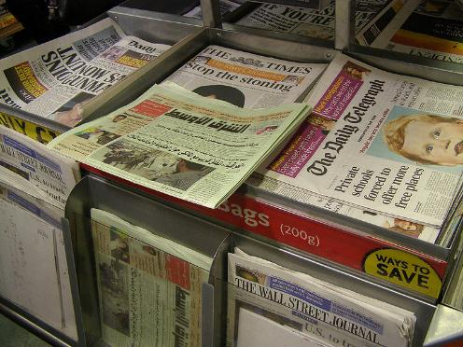
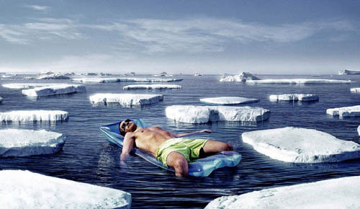
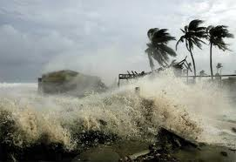
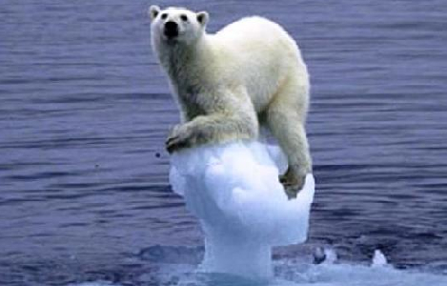
Climate Change Scepticism
… The Great Debate!
Notes:
Slide 1:
Are any of the students able to explain what they think ‘Climate Change Scepticsm’ is? – Pictures will act as clues.
Would be a good idea to let a number of students answer but not to explain the actual meaning, leaving them to think.

Slide 2
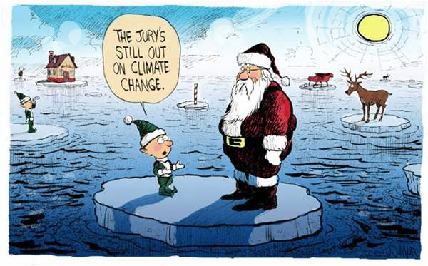
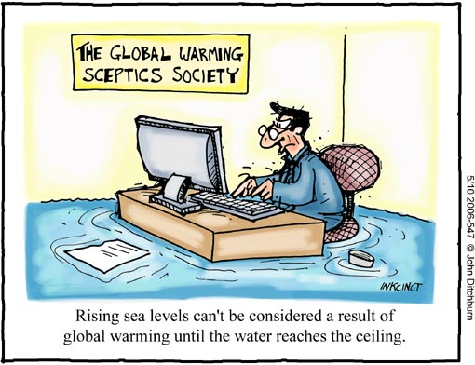
Climate Change Scepticism
There are many Sceptics, and there are certainly many things to be sceptical of…
…but is climate change one of them? Open a newspaper or simply switch on your T.V. and there is likely to be someone who is arguing that climate change is not worth worrying about.
Notes:
Slide 2:
Now ensure the students understand what the word ‘sceptic/ sceptical’ means.
Sceptic- someone who doubts that something is true or does not trust or believe something.
You could ask the class what sorts of things you might be sceptical of (e.g. psychics, diets etc.) or if they themselves are sceptical of something.
Scientific skepticism is healthy. In fact, science by its very nature is skeptical. Genuine skepticism means considering the full body of evidence before coming to a conclusion. However, when you take a close look at arguments expressing climate ‘skepticism’, what you often observe is cherry picking of pieces of evidence while rejecting any data that don’t fit the desired picture. This isn’t skepticism. It is ignoring facts and the science.

Slide 3
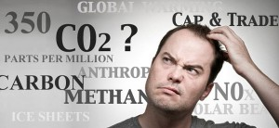
What is Climate Change?
Everyone has heard the phrase, but what does it actually mean?
Climate Change = The change in average conditions of a particular place over a long period of time. (We usually link ‘climate change’ to rising temperatures but this is NOT the full story).
It’s better to think of climate change causing more extreme and unpredictable events around the world.
HINT: Climate is what you expect, Weather is what you get!
Notes:
Slide 3:
Are the students able to explain what ‘Climate Change’ is?
Explain that ‘climate’ is different to ‘weather’: Make sure the students understand that the climate=the average temperature + atmospheric pressure + precipitation + humidity + wind of a particular place (long-term...meteorologists usually take 30 years as the average time)
You might need to explain the terms;
-Atmospheric Pressure: The force from the weight of the air (think about how the air pressure is different if you stand at the
top of a mountain).
-Humidity: Amount of moisture in the air.
-Precipitation- Rain, hail, snow.
Do the students know why this is an important topic?

Slide 4
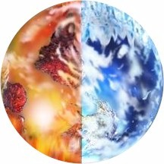
Earth’s climate is not constant.
It has warmed…
…and cooled
For BILLIONS of years!
It is the RATE that current climate change is happening that is different from what happened in the past. Since ~1800, the average global surface temperature has risen by about 1 degree Celsius.
Notes:
Slide 4:
1 degree C is a lot for the global average temperature to rise in such a short time-span (~200 years), although the number sounds small.
A few hundred thousand years ago, the UK was more like an African savannah with average temperatures only 2-3 degrees C warmer than present. 20,000 years ago, the UK was in the grips of the last Ice Age when global temperatures were 5 degrees C colder than present – a 1km thick ice sheet covered parts of the UK.
Compared to climate records from the past 800,000 years found in polar ice cores, we know that the rate of current climate change is unprecedented. (We will come back to this...)
Do the students know WHY we are making a difference to the rate of climate change?

Slide 5

Climate Change vs. Global Warming
What’s the difference?
Global warming refers to the rise in average surface temperature of the earth.
Climate change refers to all changing factors of Earth’s climate including temperature, rain, wind and humidity. Temperature is not the only thing that is changing and it is not just getting hotter.
Notes:
Slide 6:
These terms are often confused with each other and cannot be used interchangeably, ensure the pupils understand this before moving on.

Slide 6
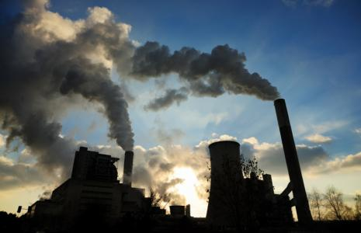
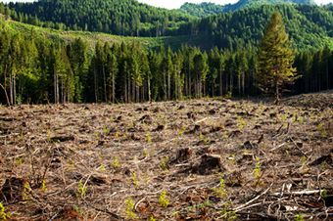
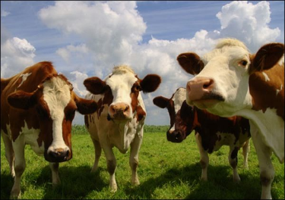
Where do WE come into this?
Everyday we do many things that are not good for our environment. By burning fossil fuels, cutting down entire forests and even breeding cows, we are polluting our atmosphere.
MOO!
Burning Fossil Fuels
Deforestation
Agriculture
By burning fossil fuels for energy such as coal, oil and gas, we are releasing extra CO2 into the atmosphere.
Trees use CO2 in the atmosphere for photosynthesis and to provide us with oxygen, but some trees are cut down for agricultural purposes.
We breed many cows for milk and meat, but when cows are ‘windy’… they release methane (another greenhouse gas) into the atmosphere. Lots of cows = lots of extra methane!
Notes:
Slide 5:
Everyone has a ‘Carbon footprint’- the total amount of greenhouse gasses produced by a person/ group of people.
Useful links: http://carboncalculator.direct.gov.uk/index.html – to work out your carbon footprints.
Or http://www.cooltheworld.com/kidscarboncalculator.php – for younger students.
Ask students if they know how to lower their carbon footprints? (Turn unnecessary electrical items and lights off, take public transport). Why does this help?
Cows are responsible for around 16% of the worlds methane emissions every year.

Slide 7
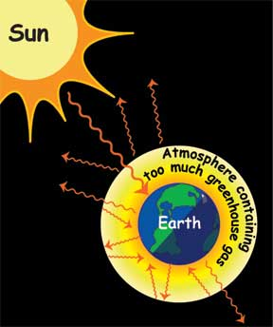
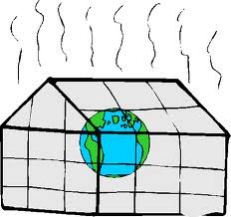
The greenhouse effect
Greenhouse gasses (including CO₂) accumulate in the atmosphere. They absorb thermal radiation (heat) from the Earth’s surface, and redirect it back down to the Earth, heating up our planet. This is called the GREENHOUSE EFFECT.
The greenhouse effect is natural.
Notes:
Slide 7:
Why is it called the greenhouse effect? – Atmosphere acts like a greenhouse, trapping the heat from the sun. Without it, this heat would be radiated from the earth and lost into space.
The parts per million of CO2 in the atmosphere at present is around 380.
Diagram (appears on click) shows how greenhouse gasses trap heat.

Slide 8
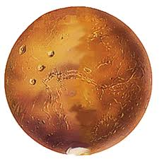
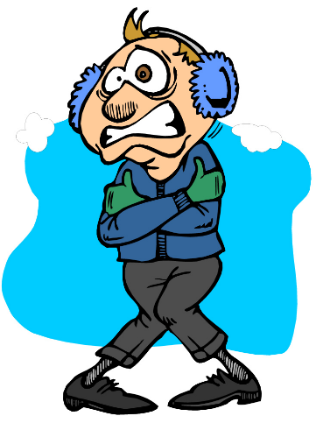
…without the Greenhouse Effect, the Earth would be too cold for life (we certainly wouldn’t be here). In fact, scientists say it might look a bit like MARS…
… Adding millions of tonnes of greenhouse gasses (including extra CO₂) to the atmosphere each year makes the greenhouse effect ‘too efficient’, causing climate change.
Notes:
Slide : 8
Make sure that the students understand that the greenhouse effect is not a ‘bad’ thing.
If Mars had a thick enough atmosphere it could be suitable for human life!
The average temperature of Earth without the greenhouse effect would be around -18 degrees Celsius.

Slide 9
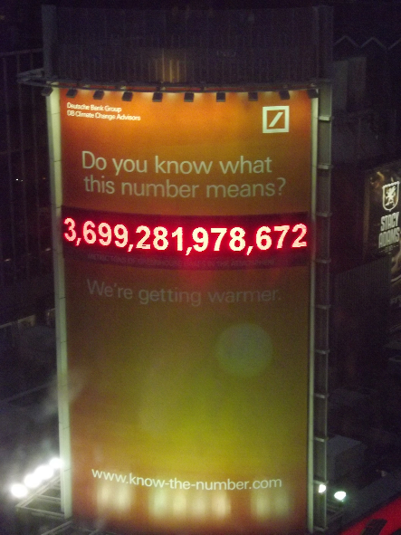
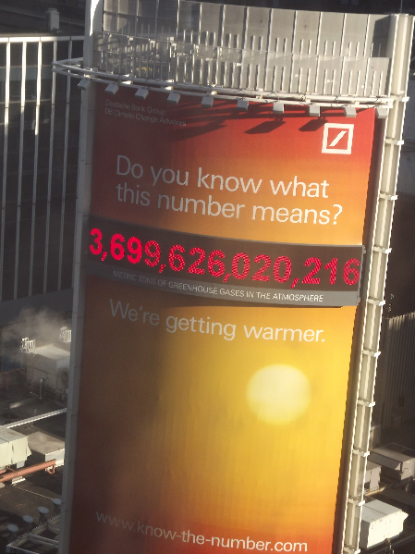
DAY 1
DAY 6
This giant sign in New York City illustrates ‘the number of metric tones of greenhouse gasses in the atmosphere’. In less than 6 days, the total had gone up by over 344,041,589…so the number of metric tones rises by 1000 every second…the weight of 700 cars!
Notes:
Slide 9:
Link to www.know-the-number.com to see how many tonnes there is now compared to the photo (taken end of March 2012) and to see the number going up.

Slide 10
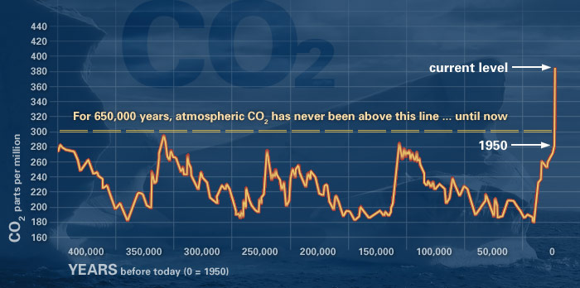
Scientific Evidence for Human Induced Climate Change
The amount of CO₂ in the atmosphere has always fluctuated. However the amount of CO₂ has quickly risen during the last 150 years.
This graph from NASA shows that since 1950, atmospheric CO2 has gone up by 100 ppm (parts per million).
www.climate.nasa.gov/evidence
Notes:
Slide 10:
GRAPH INCREASES IN SIZE ON CLICK
Highlight how modern conveniences such as fuel powered vehicles and electricity have had an impact on the amount of greenhouse gasses in the atmosphere.
The CO₂ in the atmosphere is appx. 35% higher than records show for the past 400,000 years. A rise of 100ppm would usually take at least 6000 years where as here it has taken around 100 years.
Note: Even if we made enough changes to reduce greenhouse gas emissions, it would take at least 50 years for the effects to be reversed.

Slide 11
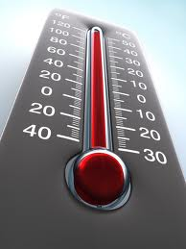

Climate Change vs Accelerating Climate change
So how is human induced climate change different? According to NASA, the rate of change is TEN times faster than the Earth’s usual rate of recovery to warmer temperatures after an ice age.
The IPCC project that the average global temperature will probably rise more than 2 degrees Celsius in the next 100 years.
Notes:
Slide 11:
Make sure the students understand that climate change is a natural phenomenon, however accelerating climate change may be linked to human activity.

Slide 12
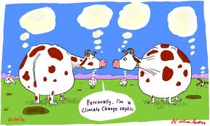
The Sceptics
Notes:
Slide 24:

Slide 13


Sceptics: Who are they?
Anyone can be a sceptic; your next door neighbour, your mum, your teacher or even yourself. It means that you have doubts that something is true.
All scientists are sceptics – they look for evidence to prove whether a theory is true or not.
The name “climate change sceptic” has been given to people who either say climate change is not caused by humans, or that it is but we don’t need to worry about it.
Notes:
Slide 25:
Sceptics who are public figures like politicians, scientists or celebrities have the opportunity to express their opinions on television, in newspapers and on the radio.
Sceptics are not labelled.
Some newspapers and television broadcasters may be ‘biased’ and may give ‘one-sided’ reports.

Slide 14
What’s to be Sceptical of?
Climate IS changing, as there is a multitude of scientific evidence to prove it. What sceptics are saying, however, is that WE (the human race) don’t need to worry about it.
“the warming.. is likely to do more good than harm.”
Nigel Lawson, ex Chancellor of the Exchequer
It is important to understand why these people are saying this and to understand the facts before making up your own mind.
“Climate change is a natural phenomenon that has occurred many times in the past”
Gerhard Lobert, physicist
Notes:
Slide 26:
For the Guardians rated top 10 sceptics, follow this link: http://www.guardian.co.uk/environment/georgemonbiot/2009/mar/06/climate-change-deniers-top-10
(this page dates from 2009 when a lot more people were still denying that there was man made climate change)

Slide 15
‘Climate change is a natural phenomenon’
‘Our climate is very unpredictable’
‘This has been the worst winter in years…and they talk about global warming!’
‘You cannot use computers to predict the future climate’
Notes:
Slide 27:
Some of the arguments a sceptic will use to try and contradict the idea of ‘human induced’ climate change.

Slide 16
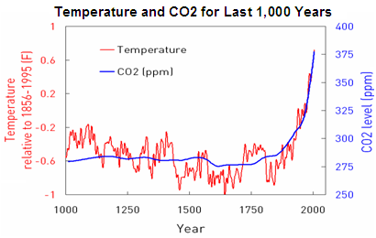
‘Climate change is a natural Phenomenon’
The earth’s climate is not constant, it has warmed and cooled for billions of years.
This graph shows the levels of CO2 and the average temperature for the Northern Hemisphere over the past 1000 years. There is a sharp rise in both temperature and CO2 concentration over the past 200 years.
http://blogs.edf.org/climate411/2007/06/29/human_cause-3/
Notes:
Slide 28:
Why might people use this argument?
Denial: ‘Climate change is not our responsibility so we do not need to do anything about it’.
Many people think that scientists are simply ‘scaremongering’ or that governments are trying to gain more money.

Slide 17
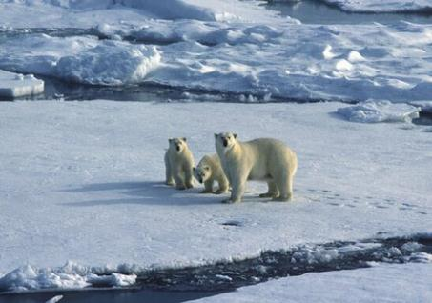

‘Our climate is very unpredictable’
The terms ‘Climate’ and ‘Weather’ are often misused and are not interchangeable. Usually, when someone says that the climate is ‘unpredictable’ they actually talking about the weather.
‘Weather’ is more variable than climate. It is the atmospheric conditions over a short period of time, i.e. it can be hot and sunny today, but cloudy and raining tomorrow. You can have unusually cold weeks in a warmer climate.
Notes:
Slide 29:
You may carry an umbrella around in the summer because there is a chance the ‘weather’ may suddenly turn and it could rain.
You would not carry around your winter coat because you know that it is not going to suddenly drop to temperatures below freezing, because this is not how the ‘climate’ behaves.
In England, we expect it to be warm/ very warm and wet or dry in the summer, and cool/ cold and wet/ dry in the winter. That is our climate.
If the weather in England was hot and sunny during the month of December, you would be surprised.

Slide 18
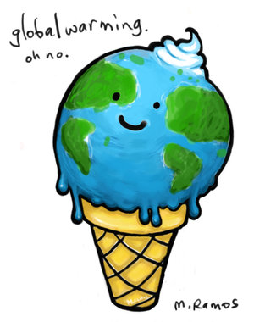
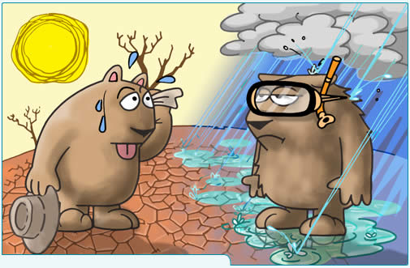
‘This has been the worst winter in years…and they talk about global warming?’
The weather in one season or year can be unusual. That doesn’t mean that the climate has changed! If the weather keeps being different, over many years, then we know the climate has changed.
What people often forget is that climate change does not just refer to the temperature. It is linked to more extreme events and other effects too, including stormier winters, hotter summers, floods and droughts.
Notes:
http://www.theweatherclub.org.uk/video/armstrong-miller-climate-change

Slide 19
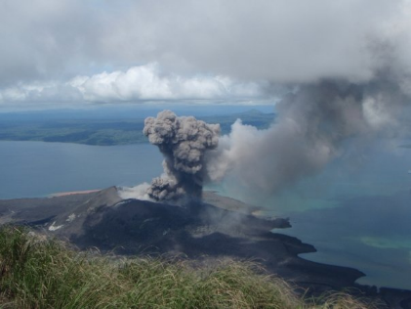
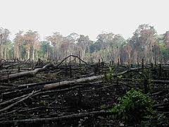
‘Most CO₂ comes from Volcanoes- it’s natural’
Many greenhouse gases in the atmosphere are produced by natural causes such as volcanoes.
The burning of fossil fuels emits far more greenhouse gas into the atmosphere than volcanoes. Explosive volcanoes can have an impact on the climate because of the ash they emit, but it only lasts a couple of years.
Notes:
Slide 31:
See: http://www.skepticalscience.com/human-co2-smaller-than-natural-emissions.htm – contains good scientific explanations of this sceptic argument.

Slide 20


‘We cant predict the weather in a week’s time, how can we predict the climate of the next 100 years?’
Remember the difference between weather and climate? Luckily, the climate is much easier to predict than weather!
A good analogy of the difference between weather and climate is to consider a swimming pool. Imagine that the pool is being slowly filled. If someone dives in there will be waves. The waves are weather, and the average water level is the climate. A diver jumping into the pool the next day will create more waves, but the water level (aka the climate) will be higher as more water has flowed into the pool.
Notes:
Weather is chaotic, climate isn’t.

Slide 21

We must ALWAYS challenge what we see on TV, hear on the radio, read in newspapers or even hear on the streets, whether it is a celebrity, a politician, a newsreader, a scientist or even your friend. A fact is not a fact with out some sort of evidence to prove it!
How science works: science is all about testing ideas, and checking conclusions.
You should now understand climate change scepticism and why some people are saying that we don’t need to worry about climate change.
Notes:
Slide 33:
Explain that some sources of information are more reliable than others

