Slide 1
Earth’s Climate System Air and Ocean Circulation

Slide 2
In order to understand climate change, we have to understand how climate first works.

Slide 3
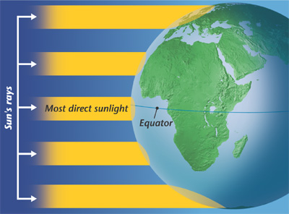
The Earth is unevenly heated....
The Sun’s radiation reaches Earth’s surface at different intensities
Water and land absorb energy at different rates
Water absorbs more thermal energy than air

Slide 4
Thermal Energy Circulation
Thermal Energy is transported from areas that receive a lot of radiation to areas that receive less radiation.
This keeps polar regions warmer and tropical regions cooler than they would otherwise be

Slide 5
Uneven Heating Creates Currents
Warm air is less dense than cold air which means that hot air rises; this creates currents
http://www.youtube.com/watch?v=4cOMushj7w8
Warm water is less dense than cold water which means that warm water rises; this creates currents
http://www.youtube.com/watch?v=bN7E6FCuMbY

Slide 6
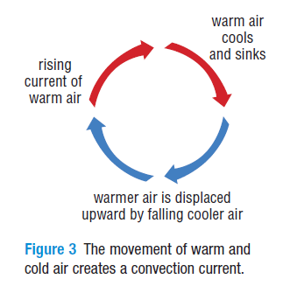
Convection Currents
A circular current in air and other fluids (water) caused by the rising of warm fluid as cold fluid sinks

Slide 7
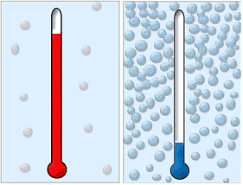
Energy Transfer in the Atmosphere
As warm air rises, it creates an area of low pressure below it
As cool air falls, it creates an area of high pressure

Slide 8
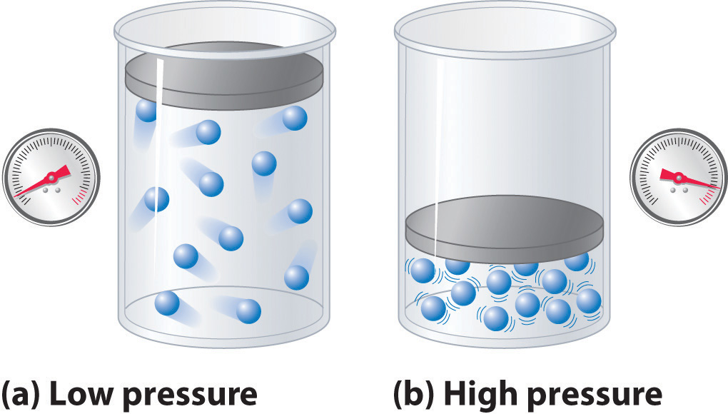
Energy Transfer in the Atmosphere
Air flows from areas of high pressure to areas of low pressure – this makes air currents or wind

Slide 9
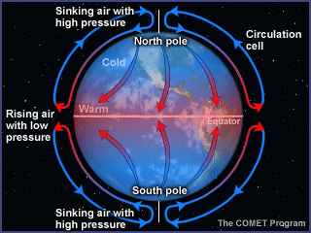

Slide 10
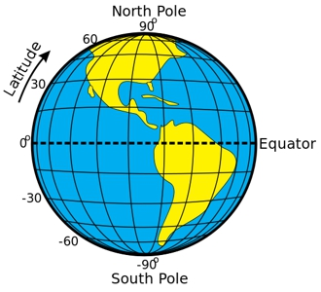
Prevailing Winds
The Earth has permanent bands of high and low pressure
at the equator, 30º latitude, 60º latitude, and poles

Slide 11
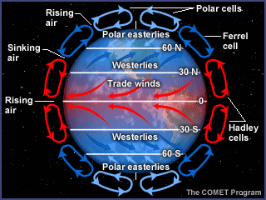
Prevailing Winds
High and Low pressure, along with the rotation of the Earth causes winds that curve around the globe in the same direction almost all the time

Slide 12
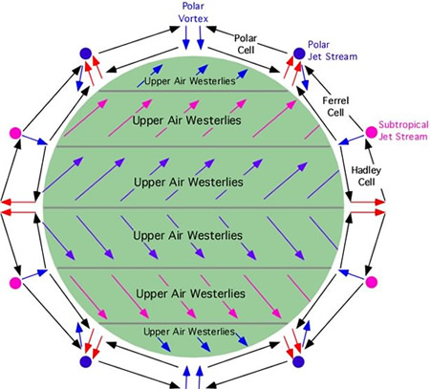
Prevailing winds push warm air (as well as warm ocean water) from equator to the poles
Prevailing Winds

Slide 13
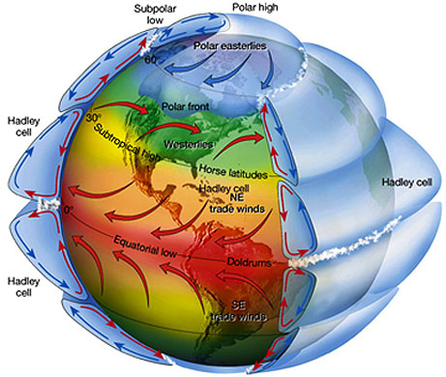

Slide 14
http://www.youtube.com/watch?v=mPsLanVS1Q8 National Geographic – Coriolis Effect
http://www.youtube.com/watch?v=7DVL0ugj1O4 Paper

Slide 16
Global Air Circulation Animation
Prevailing winds are named based on the direction they originate from
http://www.youtube.com/watch?v=DHrapzHPCSA

Slide 17
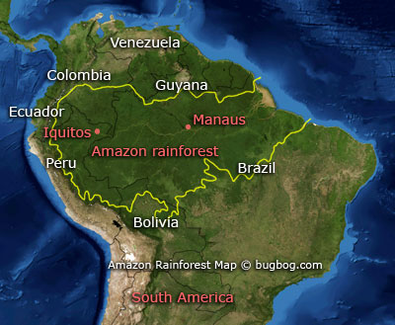
Prevailing Winds and Climate Zones
Regions where prevailing winds pass over water before reaching land have higher amounts of precipitation (ie: South American rainforest)

Slide 18
Prevailing Winds and Climate Zones
Prevailing winds from the North Pole will be cold and dry and cause areas that receive this wind to be cold and dry (ie: Northern Canada)

Slide 19
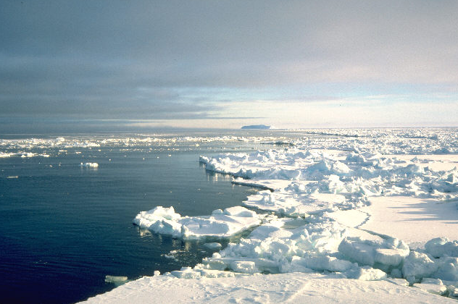
Energy Transfer in the Oceans
As water travels to the poles, it gets colder and saltier and therefore more dense
Surface water evaporates and sea ice forms (both reject salt)

Slide 20
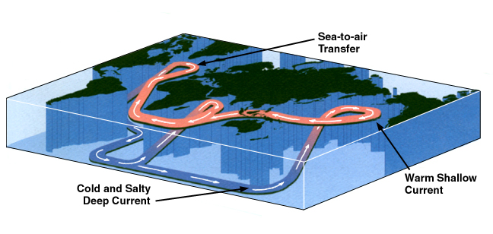
Energy Transfer in the Oceans
Dense water at the poles will sink to the ocean floor
Warmer surface water from the equator flows towards the poles to take its place

Slide 21
Thermohaline Circulation
The continuous flow of water around the world’s oceans driven by differences in water temperature and salinity
http://www.youtube.com/watch?v=w_8mw-1HYFg
http://www.youtube.com/watch?v=FuOX23yXhZ8

Slide 22
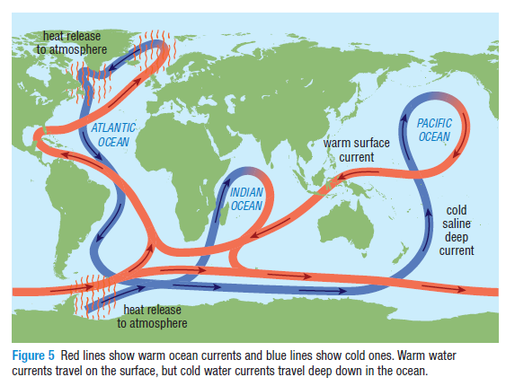

Slide 23
Ocean Currents & Climate Zones
Warm ocean currents heat the air above them which moves to the land and produces rain
Cold ocean currents cool the air above them causing cool, dry air to reach the land creating desert areas

