Slide 1
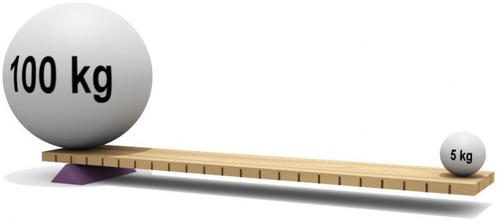
Mechanical Advantage and Efficiency
Lesson 6

Slide 2
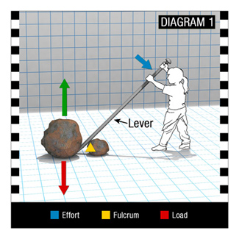
Mechanical Advantage and Efficiency
Simple machines allow us to move objects with less effort force then the load force due to force advantage.
The force advantage can be found by dividing the load force by the effort force,
F_{L} /F_{E}

Slide 3
Example:
The force advantage = F_{L}/F_{E}
= 36 N / 12 N = 3.
This means that load force is 3 times greater than the effort force.
If we rearrange the equation of the lever we have F_{E}d_{E} = F_{L}d_{L}
Effort force 12 N
Load force
36 N

Slide 4
This gives us two ratios: the force ratio and the distance ratio. In a machine in static equilibrium or in an ideal perfect machine, the ratios are the same. Although, since most machines have friction they are not ideal.

Slide 5
Actual mechanical advantage (AMA)
The ratio of the load force to effort force for a machine

Slide 6
Ideal mechanical advantage (IMA)
The ratio of the effort arm (or effort distance) to the load arm (or load distance) for a machine.
The units cancel in both ratios, so both AMA and IMA have no units.

Slide 7
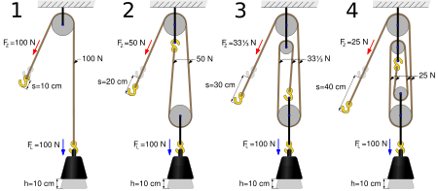
In the fixed pulley diagram seen to below, the IMA is seen in the top right corner. As each pulley is added the IMA ratio increases by one

Slide 8
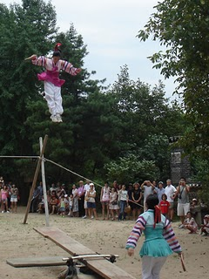
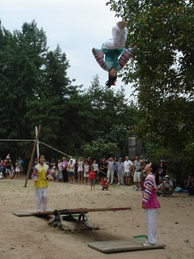
Example problem 1:
In an acrobatic demonstration, one person jumps onto the end of a plank (lever). This creates a large effort force of magnitude 9.2 x 10² N at the end of the board at a distance of 1.7 m from the fulcrum. A smaller person (a load force of 4.6 x 10² N located 3.1 m away from the fulcrum) moves a larger distance and high enough to perform acrobatic moves. Calculate
(a) the AMA of the board and
(b) the IMA of the board.

Slide 9
(a)
F_{E} = 9.2 x 10² N
F_{L} = 4.6 x 10² N
AMA =?

Slide 10
AMA = 0.50
The AMA of the board is 0.50

Slide 11
(b)
d_{E} = 1.7 m
d_{L} = 3.1 m
IMA =?

Slide 12
IMA = 0.55
The IMA of the board is 0.55

Slide 13
The AMA of a first class lever system can be greater than 1, less than 1 or equal to one depending on the situation.
AMA | Load Force | Load Distance | Example
 | Load force = effort force | Load distance and effort distance are approximately equal

Slide 14
AMA | Load Force | Load Distance | Example
 | Larger load force than effort force | Smaller load distance than effort distance
Effort force 12 N
Load force
36 N

Slide 15
AMA | Load Force | Load Distance | Example
 | Smaller load force than effort force | Larger load distance than effort distance
Effort force 36 N
Load force
12 N

Slide 16
Efficiency of Machines
In many situations, friction is undesirable; reducing this friction can improve a machines efficiency.
Percent Efficiency – the ratio of the AMA to the IMA of a machine, expressed as a percentage. Machines with large amounts of friction will have a low percent efficiency.

Slide 17
Example problem 2:
A 14 N cart is pulled 1.2 m up a ramp with an effort force of magnitude 5.0 N parallel to the ramp, raising the cart 0.40 m above its initial level. Calculate
(a) the IMA,
(b) the AMA,
(c) the percent efficiency.

Slide 18
(a)
d_{E} = 1.2 m
d_{L} = 0.40 m
IMA =?

Slide 19
IMA = 3.0
The IMA of the ramp is 3.0

Slide 20
(b)
F_{E} = 5.0 N
F_{L} = 14 N
AMA =?

Slide 21
AMA = 2.8
The AMA of the ramp is 2.8

Slide 22
Use the calculations from (a) and (b)

Slide 23
= 93 % efficiency
The percent efficiency of the ramp is 93%

Slide 24
Questions: hand in
Calculate the AMA in each of the following cases: T (2) (a) 1.9 (b) 5.2
In a pulley system, an effort force of magnitude 17 N raises a load force of magnitude 32N.
To turn a truck’s steering wheel, an effort force of magnitude 2.9 N on the wheel creates a load force on the steering column of magnitude 15 N.

Slide 25
Calculate the IMA in each of the cases: T (2) (a) 3.7 (b) 1.0
Assume that in the load force in a first class lever is 0.35 m and the effort arm is 1.3 m.
In raising a flag 6.2 m up a pole, the effort force is moved 6.2 m downward.
Explain why the AMA of a machine is generally less than its IMA. C (1)

Slide 26
Calculate the percent efficiency in each of the following. T (2) (a) 86% (b) 86%
The distance ratio of a lever is 3.6 and the force ratio is 3.1
The AMA of a wheel and axel is 6.0 and the IMA is 7.0.
Assume that you are attempting to determine the efficiency of a ramp that is used to raise a box. You investigate by pushing the box up the ramp. What could you do to improve the ramps efficiency? C (2)

