Slide 1
From Newton Two New Concepts Impulse & Momentum
Impulse = Change in Momentum
Momentum;
Momentum is vector in direction
of velocity.
Impulse is vector in direction of
force.
Impulse
Change In
Momentum

Slide 2
Think
Is it possible for a system of two objects to have zero total momentum while having a non-zero total kinetic energy?
1. YES
2. NO
correct
yes, when two objects have the same mass and velocities and they push off each other..momentum is zero and kinetic energy is nonezero.
2 balls traveling at the same speed hit each other head-on.

Slide 3
Change in Momentum
If the bear and the ball have equal masses, which toy
experiences the greater change in momentum?
Change in momentum: Δp = p_{after} - p_{before}
Teddy Bear: Δp = 0-(-mv) = mv
Bouncing Ball: Δp = mv-(-mv) = 2mv

Slide 4
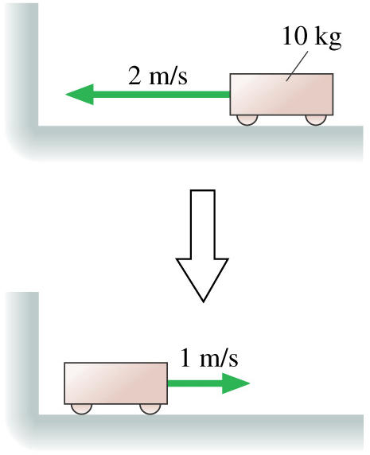
Question 1
A 10 kg cart collides with a wall and changes its direction. What is its change in x-momentum Δp_{x}?
y
x
−30 kg m/s
−10 kg m/s
10 kg m/s
20 kg m/s
30 kg m/s

Slide 5
Question
You drop an egg onto 1) the floor 2) a thick piece of foam rubber. In both cases, the egg does not bounce.
In which case is the impulse greater?
A) Floor
B) Foam
C) the same
I = ΔP
Same change in momentum
 same impulse
In which case is the average force greater
A) Floor
B) Foam
C) the same
Δp = F Δt
F = Δp/Δt
Smaller Δt = larger F

Slide 6
Pushing Off…
Fred (75 kg) and Jane (50 kg) are at rest on skates facing each other. Jane then pushes Fred w/ a constant force F = 45 N for a time Δt=3 seconds. Who will be moving fastest at the end of the push?
A) Fred B) Same C) Jane
Fred
F = +45 N (positive direct.)
I = +45 (3) N-s = 135 N-s
Ι = Δp
= mv_{f} – mv_{i}
Ι/m = v_{f} - v_{i}
v_{f} = 135 N-s / 75 kg
= 1.8 m/s
Jane
F = -45 N Newton’s 3rd law
I = -45 (3) N-s = -135 N-s
Ι = Δp
= mv_{f} – mv_{i}
Ι/m = v_{f} - v_{i}
v_{f} = -135 N-s / 50 kg
= -2.7 m/s
Note: P_{fred} + P_{jane} = 75 (1.8) + 50 (-2.7) = 0!

Slide 7
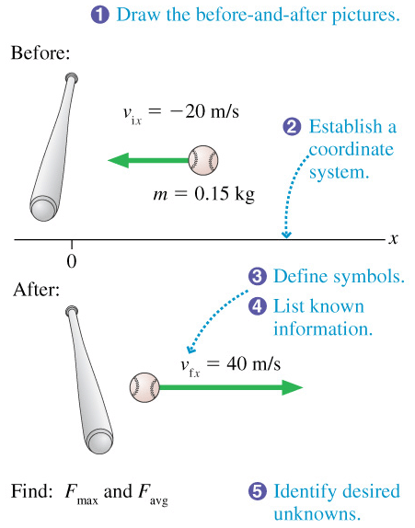
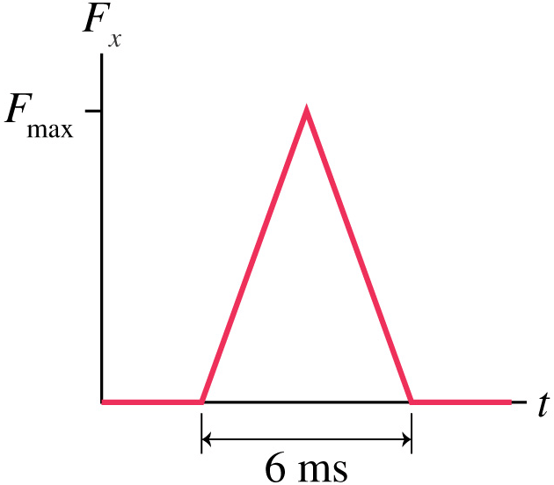
Hitting a Baseball
A 150 g baseball is thrown at a speed of 20 m/s. It is hit straight back to the pitcher at a speed of 40 m/s. The interaction force is as shown here.
What is the maximum force F_{max} that the bat exerts on the ball?
What is the average force F_{av} that the bat exerts on the ball?

Slide 8
Momentum Conservation
The concept of momentum conservation is one of the most fundamental principles in physics.
This is a component (vector) equation.
We can apply it to any direction in which there is no external force applied.
You will see that we often have momentum conservation (F_{EXT}=0) even when mechanical energy is not conserved.
Elastic collisions don’t lose mechanical energy
In inelastic collisions mechanical energy is reduced
We will show that linear momentum must still be conserved, F=ma

Slide 9
Elastic vs. Inelastic Collisions
A collision is said to be elastic when kinetic energy as well as momentum is conserved before and after the collision. K_{before} = K_{after}
Carts colliding with a spring in between, billiard balls, etc.
v_{i}
A collision is said to be inelastic when kinetic energy is not conserved before and after the collision, but momentum is conserved. K_{before} ≠ K_{after}
Car crashes, collisions where objects stick together, etc.

Slide 10
Inelastic collision in 1-D: Example 1
A block of mass M is initially at rest on a frictionless horizontal surface. A bullet of mass m is fired at the block with a muzzle velocity (speed) v. The bullet lodges in the block, and the block ends up with a speed V. In terms of m, M, and V :
What is the initial speed of the bullet v?
What is the initial energy of the system?
What is the final energy of the system?
Is kinetic energy conserved?
x
v
V
before
after

Slide 11
Example 1...
Consider the bullet & block as a system. After the bullet is shot, there are no external forces acting on the system in the x-direction. Momentum is conserved in the x direction!
P_{x, i} = P_{x, f}
mv +Mv= MV+mV
mv=(M+m)V
x
v
V
initial
final

Slide 12
Example 1...
Now consider the kinetic energy of the system before and after:
Before:
After:
So
Kinetic energy is NOT conserved! (friction stopped the bullet)
However, momentum was conserved, and this was useful.

Slide 13
Inelastic Collision in 1-D: Example 2
M
m
ice
V
v = 0
(no friction)
M + m
v = ?

Slide 14
Example 2...
Use conservation of momentum to find v after the collision.
Before the collision:
After the collision:
Conservation of momentum:
vector equation

Slide 15
Example 2...
Now consider the K.E. of the system before and after:
Before:
After:
So
Kinetic energy is NOT conserved
in an inelastic collision!

Slide 16
Momentum Conservation
Two balls of equal mass are thrown horizontally with the same initial velocity. They hit identical stationary boxes resting on a frictionless horizontal surface.
The ball hitting box 1 bounces back, while the ball hitting box 2 gets stuck.
Which box ends up moving faster?
(a) Box 1 (b) Box 2 (c) same
1
2

Slide 17
Momentum Conservation
Since the total external force in the x-direction is zero, momentum is conserved along the x-axis.
In both cases the initial momentum is the same (mv of ball).
In case 1 the ball has negative momentum after the collision, hence the box must have more positive momentum if the total is to be conserved.
The speed of the box in case 1 is biggest!
x
V₁
V₂
1
2

Slide 18
Momentum Conservation
mv_{init} = MV₁ - mv_{fin}
mv_{init} = (M+m)V₂
V₁ = (mv_{init} + mv_{fin}) / M
V₂ = mv_{init} / (M+m)
V₁ numerator is bigger and its denominator is smaller than that of V₂.
V₁ > V₂
x
V₁
V₂
1
2

Slide 19
Inelastic collision in 2-D
Consider a collision in 2-D (cars crashing at a slippery intersection...no friction).
v₁
V
m₁ + m₂
m₁
m₂
v₂
before
after

Slide 20
Inelastic collision in 2-D...
There are no net external forces acting.
Use momentum conservation for both components.
X:
y:
v₁
V = (V_{x},V_{y})
m₁
m₁ + m₂
m₂
v₂

Slide 21
Inelastic collision in 2-D...
So we know all about the motion after the collision!
V = (V_{x},V_{y})
V_{y}
θ
V_{x}

Slide 22
Inelastic collision in 2-D...
We can see the same thing using momentum vectors:
P
P
p₂
p₁
θ
p₂
p₁

Slide 23
Explosion (inelastic collision)
Before the explosion:
M
After the explosion:
v₁
v₂
m₁
m₂

Slide 24
Explosion...
No external forces, so P is conserved.
Initially: P = 0
Finally: P = m₁v₁ + m₂v₂ = 0
m₁v₁ = - m₂v₂
M
v₁
v₂
m₁
m₂

Slide 25
Center of Mass
A bomb explodes into 3 identical pieces. Which of the following configurations of velocities is possible?
(a) 1 (b) 2 (c) both
v
v
m
m
v
V
v
v
m
m
m
m
(1)
(2)

Slide 26
Center of Mass
No external forces, so P must be conserved.
Initially: P = 0
In explosion (1) there is nothing to balance the upward momentum of the top piece so P_{final} ≠ 0.
v
mv
mv
m
mv
v
v
m
m
(1)

Slide 27
Center of Mass
No external forces, so P must be conserved.
All the momenta cancel out.
P_{final} = 0.
mv
v
mv
m
mv
v
v
m
m
(2)

Slide 28
Comment on Energy Conservation
We have seen that the total kinetic energy of a system undergoing an inelastic collision is not conserved.
Mechanical Energy is lost: Where does it go??
Heat (bomb)
Bending of metal (crashing cars)
Kinetic energy is not conserved since work is done during the collision!
Momentum along a certain direction is conserved when there are no external forces acting in this direction.
In general, momentum conservation is easier to satisfy than energy conservation.

Slide 29
Question
A 4.0 kg mass is moving to the right at 2.0 m/s. It collides with a 10.0 kg mass sitting still. Given that the collision is perfectly elastic, determine the final velocities of each of the masses.

Slide 30
Solutions Question
A 4.0 kg mass is moving to the right at 2.0 m/s. It collides with a 10.0 kg mass sitting still. Given that the collision is perfectly elastic, determine the final velocities of each of the masses.
Conservation of Momentum
Conservation of Energy

Slide 31
Question
A 4.0 kg mass is moving to the right at 2.0 m/s. It collides with a 10.0 kg mass sitting still. Given that the collision is perfectly elastic, determine the final velocities of each of the masses.

Slide 32
Ballistic Pendulum
L
L
V=0
L
L
m
v
H
M + m
V
M
A projectile of mass m moving horizontally with speed v strikes a stationary mass M suspended by strings of length L. Subsequently, m + M rise to a height of H.
Given H, what is the initial speed v of the projectile?

Slide 33
Ballistic Pendulum...
Two stage process:
1. m collides with M, inelastically. Both M and m then move together with a velocity V (before having risen significantly).
2. M and m rise a height H, conserving K+U energy E. (no non-conservative forces acting after collision)

Slide 34
Ballistic Pendulum...
Stage 1: Momentum is conserved
in x-direction:
Stage 2: K+U Energy is conserved
Eliminating V gives:

