Slide 1
How are elements organized?

Slide 2
Patterns in Element Properties
Pure elements at room temperature and atmospheric pressure can be solids, liquids, or gases.
Some elements are colorless. Others are colored.
Despite the differences between elements, groups of elements share certain properties.

Slide 3
Newlands’ Law
In 1865, John Newlands arranged the elements by atomic mass and noticed that physical properties repeated every eighth element.
This is called the Law of Octaves.

Slide 4
Mendeleev
In 1869, Dmitri Mendeleev used Newlands’s observation and other information to produce the first orderly arrangement, or periodic table, of all 63 elements known at the time.
Mendeleev wrote the symbol for each element, along with the physical and chemical properties and the relative atomic mass of the element, on a card.

Slide 5
Mendeleev
Mendeleev started a new row each time the properties of the elements repeated.
Mendeleev predicted the properties of the missing elements.

Slide 6
Beyond Mendeleev
When the elements were arranged by increasing atomic number, the discrepancies in Mendeleev’s table disappeared.
Moseley’s work led to both the modern definition of atomic number, and showed that atomic number, not atomic mass, is the basis for the organization of the periodic table

Slide 7
Periodic Law
Mendeleev’s principle of chemical periodicity is known as the periodic law, which states that when the elements are arranged according to their atomic numbers, elements with similar properties appear at regular intervals.
Elements in each column of the periodic table have the same number of electrons in their outer energy level (Valence Electrons).

Slide 8
Periodic Law
Valence electrons are found in the outermost shell of an atom and that determines the atom’s chemical properties.
Elements with the same number of valence electrons tend to react in similar ways.

Slide 9
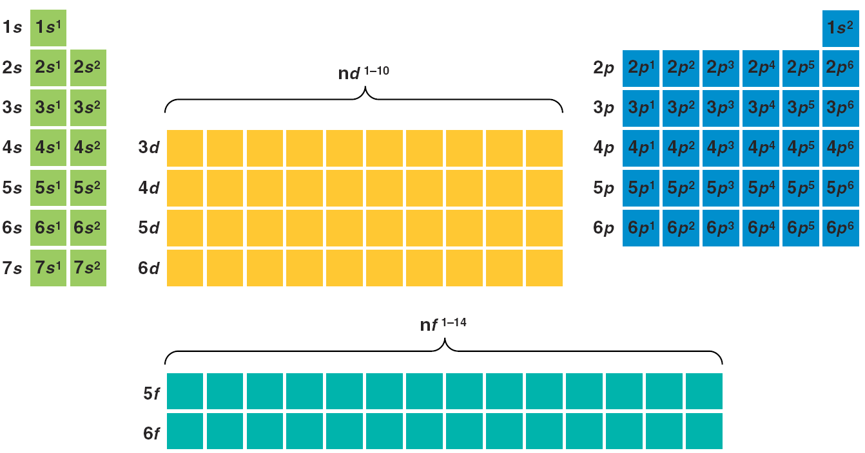
Blocks of the Periodic Table

Slide 10
Periodic Law
A vertical column on the periodic table is called a group. Elements in a group share chemical properties.
A horizontal row on the periodic table is called a period. Elements in the same period have the same number of occupied energy levels.

Slide 11
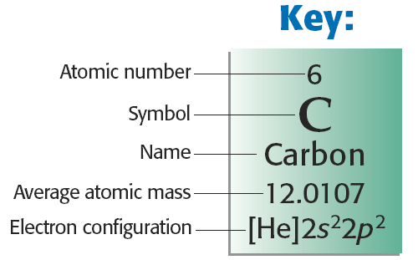
The Periodic Law, continued
Organization of the Periodic Table, continued

Slide 12
Trends in the Periodic Table

Slide 13
Atomic Radius
The atomic radius is the distance from the centre of the atom to the outer shell of the electrons
As you move across the period left to right the radius decreases
The nuclear charge increases attracting all electrons in the shell more tightly

Slide 14
Atomic Radius
As you move down a group or family the atomic radius increases
The distance to outer shells is increased and the inner electrons shield the outer electrons from the attractive force of the nucleus lowering the effective nuclear charge

Slide 15
Ionization Energy
Ionization energy is the energy required to remove an outer electron
As you move left to right across a period the ionization energy increases (the effective nuclear charge is greater)
As you go down a group the ionization energy decreases

Slide 16
Electron Affinity
The energy absorbed or released when an electron is added
As you move left to right across a period the electron affinity increases (the atom is closer to full valence shell)
As you go down a group the electron affinity decreases

Slide 17
Electronegativity
Electronegativity(EN) is a unitless measure of an atoms ability to attract shared electrons
Smaller atoms have higher electronegativity than larger atoms
Across a period left to right EN increases
Down a group EN decreases

