Slide 1
Relating speed to distance and time

Slide 2
Relating speed to distance and time
Distance
The amount of space between two objects or points
Time
The duration between two events and is usually measured in seconds, minutes and hours.

Slide 3
Average speed (v_{av)}
The total distance divided by the total time for a trip.
Δ is read as “change in”

Slide 4
Δd is read as “change in distance”
Δd = d₂ – d₁
d₁ is one distance measurement; d₁ is often 0
d₂ is a later distance measurement
Δt is read as “change it time”
Δt = t₂ – t₁
t₁ is one time measurement; t₁ is often the start time, 0.
t₂ is a later time measurement

Slide 5
Example 1:
What is the average speed of the polar bear express train if it travels 300 km in 5 hours?
Write down what you know
Δd = 300 km
Δt = 5 hours
Write down what you want to find
v_{av} = ?

Slide 6
Example 1:
Write down the formula you will use
Substitute the numbers into the formula
= 60 km /h

Slide 7
Example 1
Write a conclusion statement
Therefore the average velocity of the train is 60 km/h.

Slide 8
Example 2:
While watching a Red Bull Air race, Mr. Hoover hears that in one 1/10th of a second the planes are traveling 10 meters? What is the average velocity of the airplane?
Write down what you know
Δd = 10 m
Δt = 0.1 seconds
Write down what you want to find
v_{av} = ?

Slide 9
Example 2:
Write down the formula you are going to use
Substitute the numbers into the equation
= 100 m/s

Slide 10
Example 2
Therefore the average velocity of the plane is 100 m/s
But is that a speed you are familiar with?
Let’s convert it to km/h
If you do not want to write that out every time, know the conversion factor is 1 m/s = 3.6 km/h

Slide 11
Example 3:
You are riding on the train from Cochrane to Moosonee, you see a mile marker that says 150 miles. You know that the train ride is a total of 186 miles. If the train has an average speed of 60 km/h, how long will it be before you are in Moosonee?

Slide 12
Example 3:
Write down what you know
Δd = d₂ – d₁
Δd = 186 mi – 150mi
Δd = 36 mi
Convert miles to km ( 1km = 0.621mi)
Δd = 58 km
v_{av} = 50 km/h
Write down what you don’t know
Δt = ?

Slide 13
Example 3:
Write down the formula
Is this the one we need?
Rearrange the formula to find Δt

Slide 14
Example 3:
Therefore, the trip will take 1.2 more hours.
If you want to convert to minutes use the conversion factor
1 h = 60 min
= 72 minutes

Slide 15
Quantity Symbols
Italic letters used to represent quantities (distance, time, speed) in scientific equations.
They do not always represent the same thing
Example: d = distance, diameter, density.
These are different from unit symbols that are not italic.
m = mass vs m = meters

Slide 16
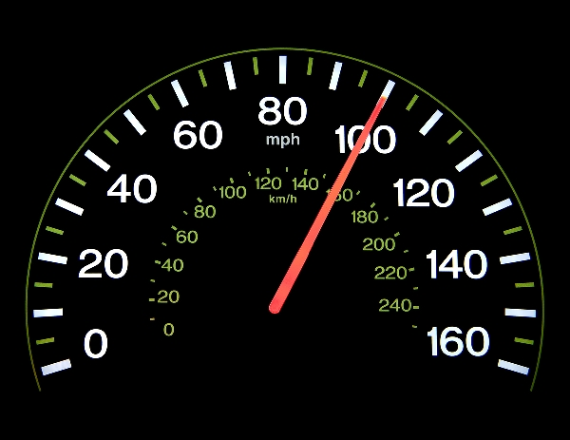
Instantaneous Speed
The speed at which an object is travelling at a particular instant.
It is not affected by its previous speed, or by how long it has been moving

Slide 17
Constant Speed (uniform motion)
If the instantaneous speed of an object remains the same over a period of time, the object is said to be traveling at a constant speed.

Slide 18
Practice problems:
A student is rides their bicycle a distance of 45 km with an average velocity of 20km/h. How long would this take the student? T (2) C (1)
Mr. Hoover often drives his car from Cochrane to Sault Ste. Marie at an average speed of 25 m/s for 7.6 hours. What is the distance of this trip? T (3) C (1)
The distance from Wasaga Beach to Collingwood is 20.6km. The speed limit between the two cities is 50 km/h. How long will it take to you to travel from Wasaga Beach to Collingwood? T (2) C (1)
The current world record for the 100m sprint was set by Usain Bolt in 2009. His time was 9.578 seconds. What was his average speed? T (1) C (1)
The current world record for the 400m sprint was set by Michael Johnson in 1999. His time was 43.18 seconds. What was his average speed T (1) C (1)
How many m/s slower was Michael Johnson compared to Usain Bolt? T (1)
What is the difference between instantaneous speed and average speed? Give an example for each. C (2)

