Slide 1
Metabolism of Macromolecules

Slide 2
Metabolsim
Metabolism = Catabolism + Anabolism
Catabolism refers to energy-releasing exergonic reactions that breakdown large molecules into smaller molecules. e.g., hydrolysis
Anabolism refers to energy-absorbing endergonic reactions that create larger molecules from smaller molecules. e.g., dehydration synthesis

Slide 3
Digestion and Metabolism
In the process of digestion, macromolecules obtained from our food are broken down into their smaller constituents so that nutrients can be obtained.
Nucleic acids → nucleotides
Complex carbohydrates → simple sugars
Proteins → amino acids
Lipids → glycerol and fatty acids
These smaller components can enter different stages of cellular respiration for energy production.

Slide 4
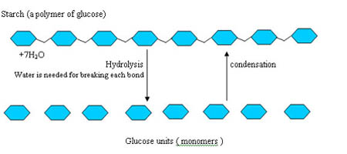
Carbohydrate Catabolism
Polysaccharides (i.e., starch and glycogen) are broken down into monosaccharides (i.e., glucose).
Glucose becomes 2 Pyruvate molecules at the end of glycolysis. Pyruvate has three fates:
Acetyl-CoA (aerobic respiration)
Lactic Acid (anaerobic respiration, animal cells)
Ethanol (anaerobic respiration, plant/yeast cells)

Slide 5
Protein Catabolism
Deamination – the removal of the amino group of an amino acid as NH₃ (ammonia)
NH₃ is excreted as waste in animals but is used as a byproduct in plants.
Remaining portions of amino acids converted into forms needed by Glycolysis or Krebs cycle.
e.g., Alanine can be converted into Pyruvate when needed.

Slide 6
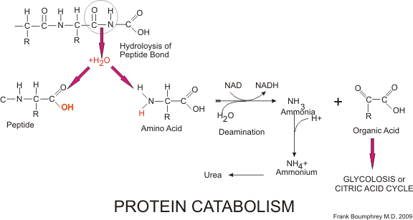
Protein Catabolism

Slide 7
Lipid Catabolism
Glycerol can be converted into Glucose, or
It can be converted into DHAP or G3P/PGAL
Fatty acids go to the mitochondrial matrix and undergo β-oxidation (sequential removal of acetyl groups) and becomes Acetyl-CoA
Lipids typically generate more than 2x the amount of ATP created by carbohydrates.
Notes:
More ATP can be produced through oxidative phosphorylation, depending on the length of the fatty acid chain, e.g., Lauric acid – split 5 times for an overall contributing yield of 75 ATP!

Slide 8
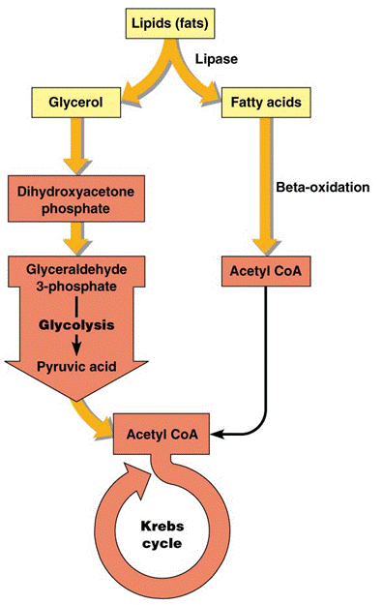
Lipid Catabolism

Slide 9
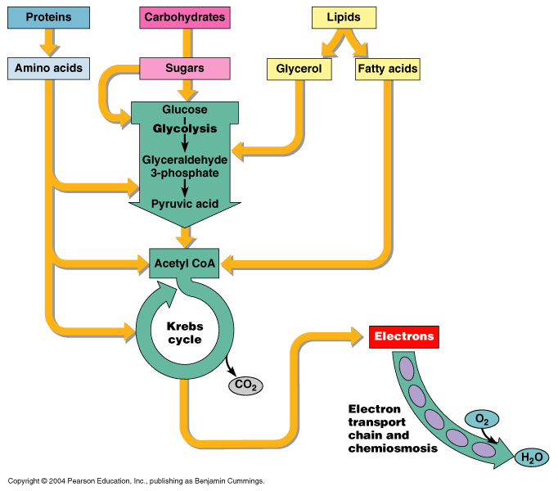
Simplified Overview of Metabolism

Slide 10
Anaerobic Respiration
In the absence of oxygen, fermentation occurs in Eukaryotic cells.
Lactic Acid Fermentation
Ethanol Fermentation

Slide 11
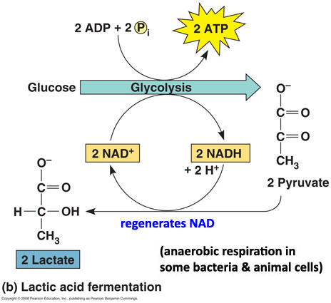
Lactic Acid Fermentation
Occurs in animal cells (e.g., muscles)
NADH acts directly with the pyruvate at the end of glycolysis in a redox reaction.
NADH is oxidized to NAD⁺ + H⁺
Pyruvate is reduced to Lactate

Slide 12
Lactic Acid Fermentation
Lactic acid (lactate) travels through the bloodstream to the liver and muscles.
Lactic acid build up in the muscle cells is felt as fatigue, pain/ache, stiffness, etc.
Solution:
Repay “oxygen debt” . . . take deep breaths
Lactate is catabolized to CO₂ + H₂O, thereby converting back to pyruvate, which can undergo oxidation and enter the Krebs cycle.

Slide 13
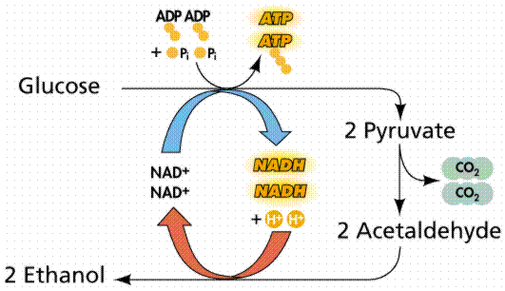
Ethanol Fermentation
Occurs in plants, yeast, and some bacteria.
At the end of glycolysis, pyruvate loses its carboxyl group, forming acetylaldehyde.
NADH combines with acetylaldehyde and forms ethanol.
NADH can be oxidized to NAD⁺ and re-enter glycolysis.

Slide 14
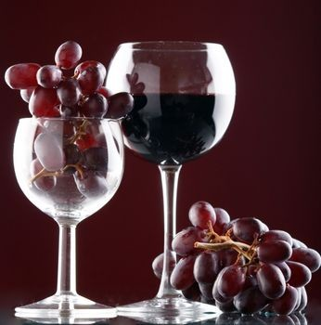
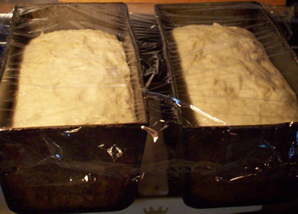
Ethanol Fermentation
Several practical applications, particularly in food industry:
Wine-making / Beer-making
Sugar from fruit or grain ferments to produce alcohol
Bread-making
The CO₂ released when yeast ferments causes bread dough to rise

Slide 15
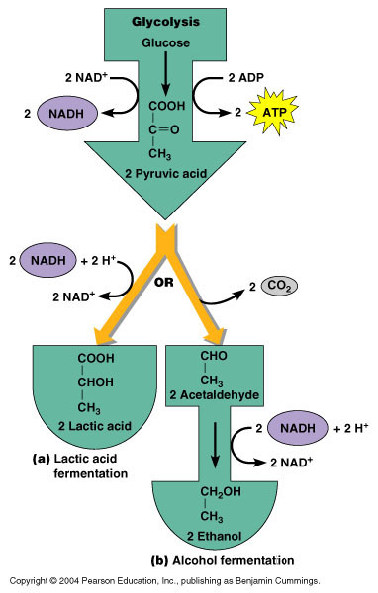
Simplified Overview of Fermentation

