Slide 1
Regulating the rate of Cellular Respiration

Slide 2
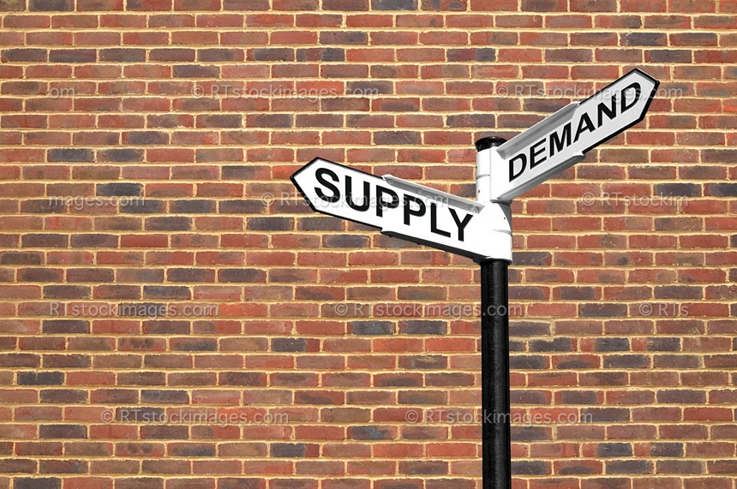
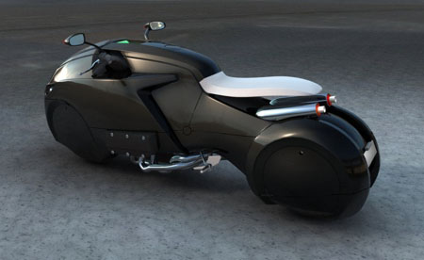
Rate
Supply and Demand
High when working
Low when resting
Enzyme controlled
Phosphofructokinase most important
Build-up of ATP inhibits Phosphofructokinase
Also inhibited by citrate

Slide 3
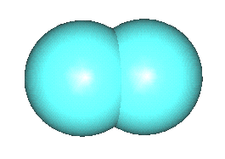
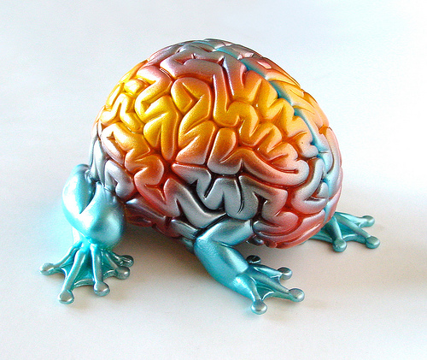
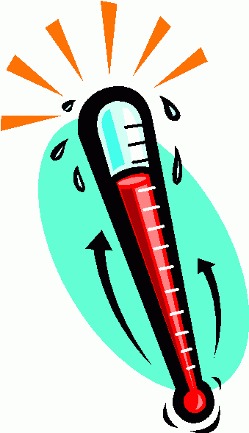
Other factors
Temperature
Higher temp, faster reactions move
Concentration of nutrients
Higher concentration, faster reaction moves
Availability of oxygen

Slide 4
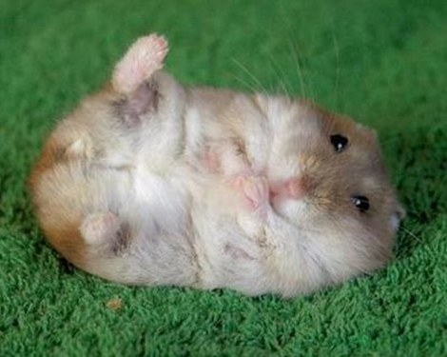
Catabolism
Catabolism – To break apart
Protein catabolism
Lipid (Fat) Catabolism

Slide 5
Protein Catabolism
Breaks Protein into amino acids
Primarily used to rebuild required proteins
Sometimes used for energy
Deamination – First step in protein catabolism, involves removal of the amino group (NH₂) of an amino acid as ammonia (NH₃)
Occurs in Liver, removed by kidney
Various other parts are broken down to fit into glycolysis or krebs cycle

Slide 6
Lipid Catabolism
Triglycerides broken down into glycerol and fatty acids
2 glycerol molecules can combine to form
glucose (gluconeogenesis)
DHAP (and in turn G3P)
Fatty acids enter the mitochondrial matrix & undergo β-oxidation to become acetyl-CoA

