Slide 1
Unit 6: Gases and Atmospheric Chemistry
Properties of Matter and
The Kinetic Molecular Theory

Slide 2
States of Matter
Most substances can exist in the solid, liquid or gas states. Recall that the attractions between particles influence the state each substance is in at room temperature:
Ionic Compounds: contain strong electrostatic attractions and are therefore found in the solid state at room temperature. They have a high boiling point (e.g. NaCl _{(s)})
Polar Molecules: These compounds contain permanent dipoles and form strong dipole-dipole intermolecular bonds. They are found in the liquid or solid state but have a lower boiling point. (e.g. H₂O _{(l)})
Non-polar Molecules: These have no dipoles and contain very weak intermolecular bonds. They are usually gases. (e.g. H₂ _{(g)}, Cl₂ _{(g)} , CO_{2 (g)}).

Slide 3
Changes of State
Changes of State occur as energy is added to a substance:
H₂O _{(s)} H₂O _{(l)} H₂O _{(g)}
The added energy increases the motion (or kinetic energy) of the particles.
+ energy
+ energy

Slide 4
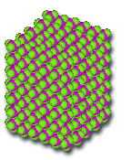
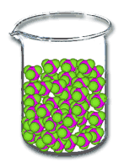
Melting
Sublimation
Solidification
Sublimation
Condensation
Evaporation / Boiling

Slide 5
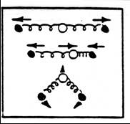
Types of Molecular Motion
Vibrational Motion:
atoms within a molecule/lattice move.
Rotational Motion:
molecules rotate and change position.
Translational Motion:
particles move from place to place.

Slide 6
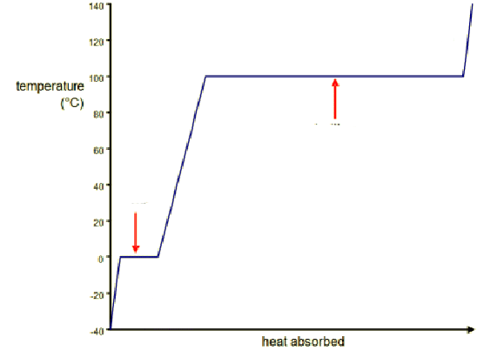
Heating Curve of Water:
gas
boiling
liquid
melting
solid

Slide 7
Interpreting the Heating Curve
 | State or Change | What is happening?
A | solid
B | melting
C | liquid
D | boiling
E | gas
Increasing vibrational motion (kinetic energy).
Intermolecular bonds are weakened.
Increasing vibrational and rotational motion.
Intermolecular bonds are broken.
Increasing vibrational, rotational and translational motion.

Slide 8
Comparing the States of Matter
Properties | Solid | Liquid | Gas
Volume
Shape
Attractive Forces Between Particles
Space Between Particles
Compressibility
Motion of Molecules
Degree of Disorder (Randomness)
fixed
fixed
very
variable
fixed
variable
variable
strong
e.g. NaCl _{(s)}
weaker
e.g. H₂O _{(l)}
very weak
e.g. Ne, Cl₂, CO₂
low
low
high
incompressible
incompressible
very
compressible
vibrational
rotational
vibrational
rotational
translational
vibrational
low
moderate
very high

Slide 9
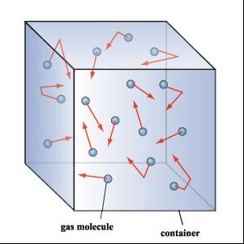
The Kinetic Molecular Theory of Gases
Most gases share very similar physical properties. These can be understood using the kinetic molecular theory.

Slide 10
The Kinetic Molecular Theory of Gases
Postulates:
Individual gas particles have virtually no volume compared to the space between the particles.
No attractive or repulsive forces exist between the particles in a gas.
Gas particles have very high translational energy. They move randomly in a straight line.
When gas particles collide with each other or the walls of a container, the collision is elastic. There is no loss of kinetic energy.
The average kinetic energy of a gas is directly related to temperature. The greater the temperature, the greater the kinetic energy.

Slide 11
Real and ideal gases
These postulates describe a hypothetical gas called an ideal gas.
Many real gases have predictable properties under normal temperature and pressure conditions since these assumptions are valid.

Slide 12
States of Matter and the Kinetic Molecular Theory Questions
Why are changes of state considered physical changes, not chemical changes?
Which of these substances do you predict exists as a gas at room temperature? Explain your choice for each.
a) RbF b) C₄H₁₀ c) F₂ d) CH₃OH e) H₂S
Explain how the particles in a solid can possess molecular motion yet remain fixed in space.
Molecules of liquid water can take the form of their container but they do not float away (as they would in zero gravity). What keeps the liquid molecules together?

Slide 13
Pressure, temperature and volume
Pop can demonstration.

Slide 14
Pressure, temperature and volume
Pressure is a measure of force per area.
As the particles strike the walls of their container, they exert a force. The force per area is the pressure of the gas.
Units : The metric unit for pressure is the Pascal:

Slide 15
Atmospheric pressure
The pressure of the atmosphere can be measured with a barometer:
760 mm Hg = 760 Torr = 1.00 atm = 101.3 kPa
Since all of these units are equivalent, we can use them as conversion factors:
e.g. Convert a pressure of 700 mm Hg into kPa:

Slide 16
Temperature
Temperature is a measure of the average kinetic energy possessed by the particles of a substance.
Celcius (ºC) Kelvin (K)
100
373
To convert from ºC to K:
T_{K} = T_{C} + 273
25
298
0
273
To convert from K to ºC:
T_{C} = T_{K} - 273
-273
0
Absolute zero (where all particle motion stops) = 0 K = -273.15 ºC.

Slide 17
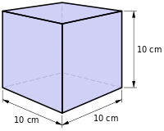
Volume
Units: 1 mL = 1 cm³ 1 L = 1000 mL = 1000 cm³
25 cm³ mL
182 cm³ L
3.680 L mL
$$x \frac{1 mL}{1 {cm}^{3}}$$
= 25
$$x \frac{1 L}{1000 {cm}^{3}}$$
= 0.182
$$x \frac{1000 mL}{1 L}$$
= 3680
STANDARD TEMPERATURE AND PRESSURE (STP)
Temperature = 0ºC = 273 K
Pressure = 101.3 kPa

Slide 18
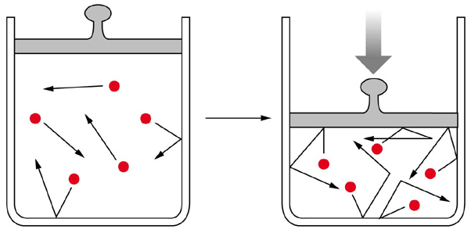
Boyle’s Law
If the pressure on a specific amount of gas is increased, the volume will decrease.
↑ V
↓ P
↓ V
↑ P

Slide 19
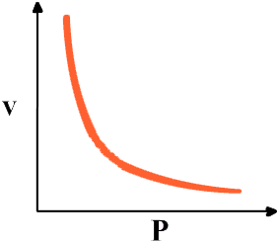

Boyle’s law
“The volume of a fixed mass of gas is INVERSELY PROPORTIONAL to pressure, provided temperature remains constant.”
$$V= \frac{k}{P} where k=a constant$$
$$V∝ \frac{1}{P}$$

Slide 20
Boyle’s Law
Since $V= \frac{k}{P}$ , then $PV=k$
∴ ${ P}_{1}V_{1}= P_{2}V_{2}$
e.g. A 100 L volume of gas is at a pressure of 32 kPa. If the pressure increases to 44 kPa, what is the final volume?

Slide 21
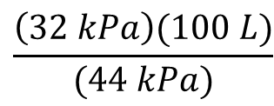
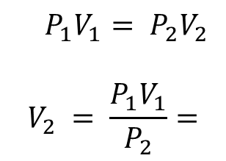
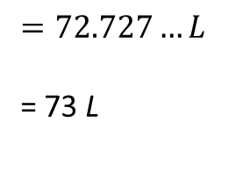
e.g. A 100 L volume of gas is at a pressure of 32 kPa. If the pressure increases to 44 kPa, what is the final volume?
Given: P₁ = P₂ =
V₁ = V₂ =
32 kpa
44 kpa
100 L
?
Always list given information.
$${ P}_{1}V_{1}= P_{2}V_{2}$$
$$V_{2} = \frac{P_{1}V_{1}}{P_{2}}=$$
$$\frac{\left(32 kPa\right)(100 L)}{(44 kPa)}$$
$$=72.727…L$$
= 73 L
Rounded to 2 sig. digits.

