Slide 1
Atomic Theory 1
Democritus to the Planetary Model

Slide 2
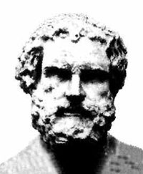
Democritus
Greek philosopher (460 - 370 BCE)
Believed in the philosophy of materialism
With Leucippus, they though that matter can not be divided infinitely.
Proposed the existence of indestructible, indivisible particles called atoms.
The variety of matter in the universe was due to the various types of atoms.

Slide 3
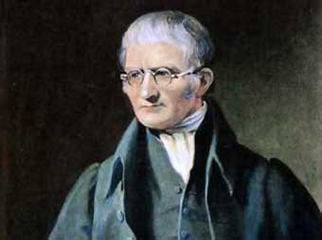
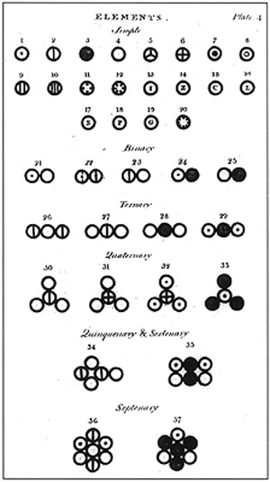
John Dalton
British chemist, physicist, meteorologist,
Proposed the first “modern” atomic theory in 1803 based on various chemical laws (e.g. LCM, LDP)
Dalton’s atomic model: Billiard Ball Model

Slide 4
5 Points of Dalton’s Atomic Theory:
All matter is made of tiny indivisible particles called atoms.
Atoms cannot be created or destroyed.
All atoms of a particular element are identical.
Compounds are formed through the combination of elements.
Chemical reactions involve atoms recombining to form new substances.

Slide 5
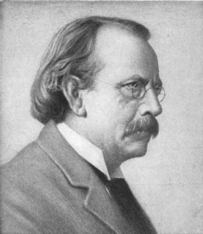
J.J. Thomson
Studied behaviour of strange beams in evacuated glass cathode ray tubes (CRT) in 1897
When high voltage is applied across a CRT tube, fluorescence is produced from an invisible beam striking a ZnS coating
Beam was influenced by magnetic & electric fields

Slide 6
Using the charge to mass ratio, he concluded that cathode rays consist of tiny “particles”
These charged particles were much smaller than the tiniest atom and came from within the atoms of the metal electrode
These “subatomic” particles were called electrons and led to the Plum Pudding Model
e-
e-
e-

Slide 7
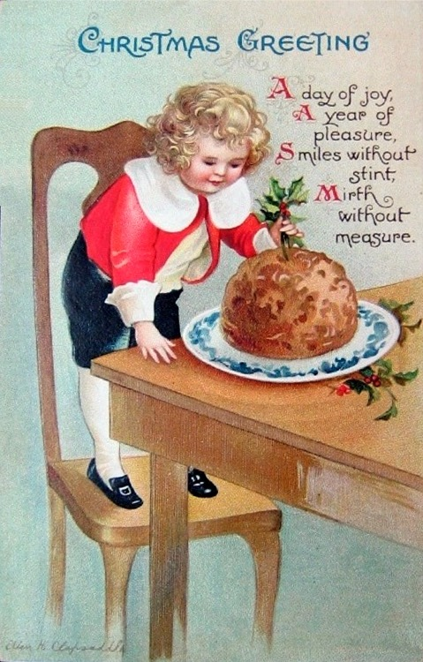
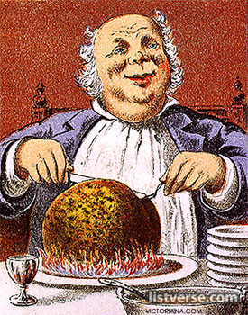
Plum Pudding….

Slide 9
Rutherford and the Nuclear Atom
Work by the Curies and Bequerel led to the discovery of strange beams called radiation
Lead Block Experiment: Rutherford discovered radiation came in 3 forms: alpha (+), beta (-) and gamma rays
This radiation came from the spontaneous disintegration of unstable atoms called “radioisotopes” (e.g. radium, uranium)

Slide 10
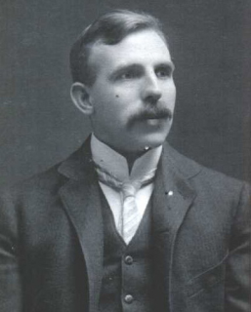
Gold Foil Experiment (1909)
Rutherford proposed that a beam of alpha particles (He²⁺ ions) should have enough energy to pass through a thin gold foil and be detected on a ZnS screed behind the foil
The experiment initially seemed work, confirming Thomson’s Plum Pudding Model of the atom with a diffuse positive sphere

Slide 11
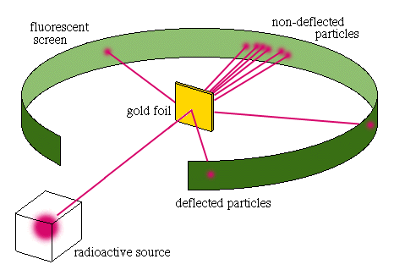
The Gold Foil Experiment

Slide 12
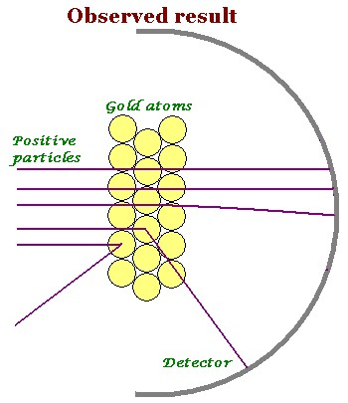
Most alpha particles behaved as expected
But 1 in 8000 deflected back (anomalies)

Slide 13
Rutherford’s Conclusions
The positive charge is not distributed evenly but is in a very dense positive core.
Most of the atom is simply empty space occupied by tiny electrons.
Rutherford proposed a new model called the Planetary Model due to its resemblance to our solar system.

Slide 14
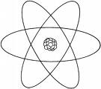
Planetary Model of the Atom
It was quite the most incredible event that has ever happened to me in my life. It was almost as incredible as if you fired a 15-inch [artillery] shell at a piece of tissue paper and it came back and hit you. On consideration, I realized that this scattering backward must be the result of a single collision, and when I made calculations I saw that it was impossible to get anything of that order of magnitude unless you took a system in which the greater part of the mass of the atom was concentrated in a minute nucleus. It was then that I had the idea of an atom with a minute massive centre, carrying a charge.^{[2]}
—Ernest Rutherford

Slide 15
The Proton (1919)
Rutherford’s nucleus was extremely tiny – only 1/10,000th the diameter of the entire atom!
Later, Rutherford proved that other atoms contain hydrogen nuclei
He concluded this is the simplest positively charged particle and named it the proton

Slide 16
The Mass Problem
Protons seemed to account for most of the mass of the atom
But evidence showed that atoms had only half the positive charge that was expected if the nucleus was composed only of protons
The answer to the problem came from another radioactive beam….

Slide 17
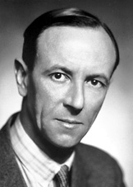
James Chadwick
In 1932, Chadwick experimented with a new type of radiation emitted from beryllium
The particle had no charge but almost the same mass as the proton; he called these particles neutrons
beryllium + alpha rays
carbon + neutrons

Slide 18
The Structure of the Atom
Particle | Symbol | Location | Charge | Mass (amu)
proton | p | nucleus | + 1 | 1.007276
neutron | n | nucleus | 0 | 1.008664
electron | e- | outside nucleus | - 1 | 0.0005486

