Slide 1
Atomic Theory Part 2
The Bohr Model of the Atom

Slide 2
Problems with Rutherford’s Model
Two pieces of evidence could not be explained:
The Stability of the Atom: A charged electron orbiting a charged nucleus should release electromagnetic radiation as it orbits, losing energy and collapsing into the nucleus.
The Line Spectra of Elements: All elements create a unique signature colour when excited. This is due to the series of spectral lines each element forms.

Slide 3
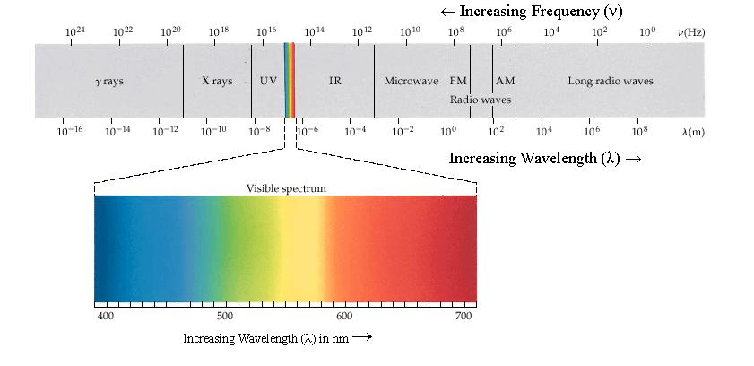
Emission Spectra of the Elements
Max Planck discovered that the energy in light is “quantized”
The “colour” or frequency of light is proportional to the energy of its packets called photons.
e.g. photons of red light possess less energy than photons of blue light

Slide 4
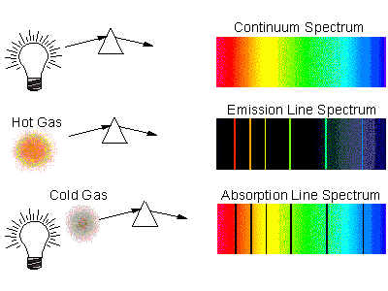
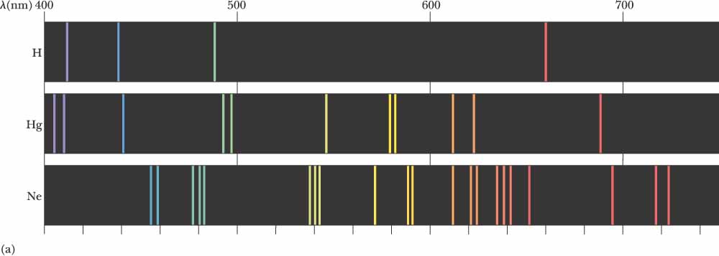
White light consists of a continuous spectrum
Cold gases produce an absorption spectrum
Hot gases produce an emission spectrum
Each element has a unique series of lines

Slide 5
Explaining the Lines
Bohr understood that the 4 visible (and other invisible) emission lines of hydrogen corresponded to specific quantum jumps.
Electrons could only exist at specific orbits or “energy levels” around the nucleus.
Bohr developed a mathematical equation that correctly related the energy of each jump and involved an integer, n

Slide 6
Bohr Model of Hydrogen
The relationship between light and atomic structure can be visualized here.

Slide 7
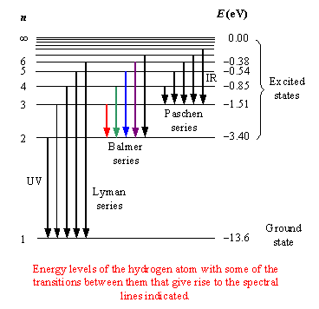
Line Spectrum of Hydrogen

Slide 8
Bohr’s Quantized Shell Model (1913)
1. Electrons can only occupy certain discrete orbits or energy levels.
2. Electrons can exist in an energy level without losing energy.
3. Electrons absorb or release energy only when they change their energy levels.

Slide 9
The Bohr Model and Electron Arrangement
Bohr’s orbits (energy levels) can only hold a certain number of electrons (2, 8, 8…)
When an inner orbit is filled, electrons occupy orbits further from the nucleus
Bohr’s shell model finally explained the structure of the Periodic Table, which had been published in 1869!

Slide 10
Bohr Model and the Periodic Table
Periods (Rows) correspond to the number of Bohr orbits an element has.
Groups (Columns) correspond to the number of outer shell (valence) electrons.
Although this is not the modern atomic model, its simplicity and ability to predict the property of elements make it very useful.

