Slide 1
Introduction to Equilibrium
SCH4U1 Unit 4

Slide 2
Equilibrium [noun]
1a: a state of intellectual or emotional balance : poise <trying to recover his equilibrium> b: a state of adjustment between opposing or divergent influences or elements.
2: a state of balance between opposing forces or actions that is either static (as in a body acted on by forces whose resultant is zero) or dynamic (as in a reversible chemical reaction when the rates of reaction in both directions are equal)

Slide 3
Quantitative Reactions
A + B AB
This symbol means that > 99% of the product AB is formed.
AB no reaction
Therefore in the opposite direction < 1% of AB reacts.

Slide 4
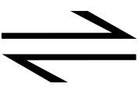
Equilibrium Systems
Many reactions actually take place in both the forward and reverse directions at the same time.
These reactions can be shown together using a double arrow,
A + B AB
If left long enough, chemical systems may reach a stable state called dynamic equilibrium.

Slide 5
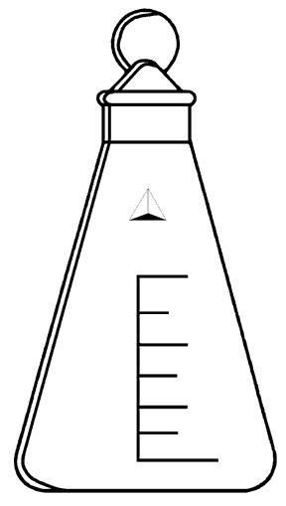
Phase Equilibrium
A sealed flask containing water will contain a mixture of liquid and vapour water that will eventually establish a stable or balanced condition known as equilibrium.
H₂O (l) H₂O (g)
Despite appearing static, the equilibrium is dynamic since water molecules continue to move in both directions at equilibrium.

Slide 6
Properties of an Equilibrium System
1. The system is closed.
2. The forward reaction rate equals the reverse reaction rate.
3. The concentration of the reactants and products are constant.
4. The temperature and pressure remain constant.
5. The same equilibrium state can be reached by starting with reactants or products.

Slide 7
The Factors that Determine the Equilibrium State
1. Energy
Systems tend to move toward a state of minimum potential energy (enthalpy) to create products that are more stable.
Enthalpy changes favour the exothermic direction of a reaction since these involve products with lower potential energy.
A + B C + D + kinetic energy

Slide 8
The Factors that Determine the Equilibrium State
2. Degree of Randomness
Systems tend to move spontaneously toward a state of maximum randomness or disorder (entropy).
This means that the entropy state favours the side of the reaction which produces more particles since this creates greater disorder.
AB A + B
Lower disorder Higher disorder
Low entropy Higher entropy

Slide 9
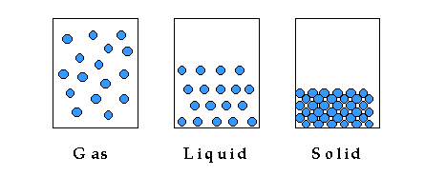
Disorder and States of Matter
In addition, the states of matter have different degrees of disorder:
Most disorder Least disorder
High entropy Low entropy

Slide 10
3. The Compromise
The composition of the equilibrium state is a compromise between these two factors:
i) minimum potential energy (enthalpy)
ii) maximum randomness (entropy)
If both factors favour the products, reactions are usually considered spontaneous.
If both factors favour reactants, they are considered non-spontaneous.
If these factors oppose each other, a mixture of products and reactants can exist at equilibrium:.

Slide 11
Equilibrium Systems
AB A + B + energy
Enthalpy favours products.
Entropy favours products.
∴ AB A + B + energy

Slide 12
Equilibrium Systems
A + B + energy AB
Enthalpy favours reactants.
Entropy favours reactants.
∴ A + B no reaction

Slide 13
Equilibrium Systems
A + B AB + energy
Enthalpy favours products.
Entropy favours reactants.
∴ Mixture of reactants and products produced.

Slide 14
Equilibrium Systems
A + B AB + + energy
Enthalpy favours products.
Entropy favours reactants.
∴ Mixture of reactants and products produced.

Slide 15
Sample Questions:
For each of the following reactions state:
i) Whether the tendency towards minimum enthalpy favours the reactants (R) or products (P).
Ii Whether the tendency towards maximum entropy favours the reactants (R) or products (P).
1) AB (l) + energy ⇌ AB (g)
Lower Enthalpy Favours: ____________
Higher Entropy Favours: _____________
R
P

Slide 16
2) AB (l) ⇌ AB (s) + energy
Lower Enthalpy Favours: ____________
Higher Entropy Favours: _____________
3) N₂ (g) + 2 O₂ (g) + 67.7 kJ ⇌ 2 NO₂ (g)
Lower Enthalpy Favours: _____________
Higher Entropy Favours: ______________
P
R
3 mol gas
2 mol gas
R
R

Slide 17
4) CO (g) + 2 H₂ (g) ⇌ CH₃OH (g) + 209 kJ
Lower Enthalpy Favours: _____________
Higher Entropy Favours: _____________
5) CO₂ (g) ⇌ CO₂ (s) + energy
Lower Enthalpy Favours: _____________
Higher Entropy Favours: ______________
P
R
P
R

Slide 18
6) XY (g) + energy ⇌ X (g) + Y (g)
Lower Enthalpy Favours: _____________
Higher Entropy Favours: ______________
7) H₂O₂ (l) ⇌ 2H₂O(l) + O₂(g) ∆H = -98.2 kJ/mol
Lower Enthalpy Favours: _____________
Higher Entropy Favours: ______________
R
P
P
P

Slide 19
Recap: The Factors Affecting Equilibrium
The composition of the equilibrium state (i.e. the proportion of reactants and products) is determined by:
Enthalpy Change (ΔH)
Entropy Change (ΔS)

Slide 20
1) The Tendency Towards Minimum Potential Energy
ΔH = H_{products} - H_{reactants}
ΔH < 0: The forward reaction is exothermic and favoured.
ΔH > 0: The forward reaction is endothermic and the reverse reaction is favoured.
∴ Most reactions we study are exothermic because these tend to be spontaneous.

Slide 21
2) The Tendency Towards Maximum Entropy
ΔS = S_{products} - S_{reactants}
ΔS > 0: Products are more random and the forward reaction is favoured.
ΔS < 0: Products are less random and the reverse reaction is favoured.
∴ Reactions favour the direction that produce maximum randomness.

Slide 22
The Influence of Temperature
At low temperatures, enthalpy change has the greatest influence and exothermic reactions are generally spontaneous.
At high temperatures, the random motion of molecules is increased and the entropy factor (ΔS) has more influence on the equilibrium state.
Thus temperature can influence the composition of an equilibrium system.

