Slide 1
Inertia and Newton’s First Law of Motion

Slide 2
DEMO TIME
Can you drop the penny in the flask by only touching the ring?

Slide 3
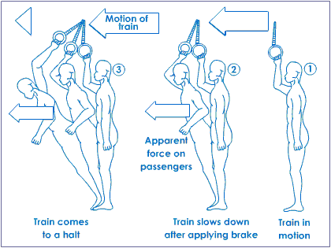
Question:
When you are standing on the train and it suddenly starts to move, what happens?
You fall backwards.
What happens if you are standing on the train as it is moving and it starts to slow down?
You fall forwards.
What causes this movement?

Slide 4
Inertia
A property of matter that causes an object to resist changes in its state of motion; it is directly proportional to the mass of the object.
The greater the mass, the greater the inertia an object possesses.

Slide 5
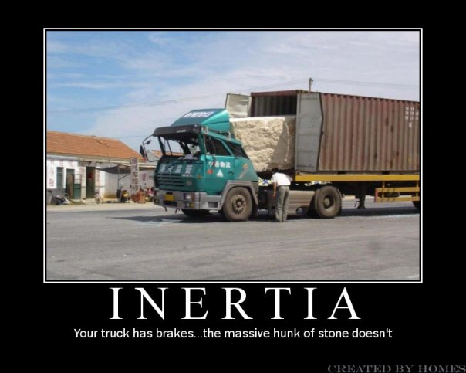

Slide 6
In physics we pretend that there is no friction for some of our problems.
If the carpet of the train did not have any friction and there was no air resistance, when the train starts, you would stay in the same spot as the train moves forward until the back wall hits you.
When the train slows down, you would continue to move forward until you hit a wall.

Slide 7
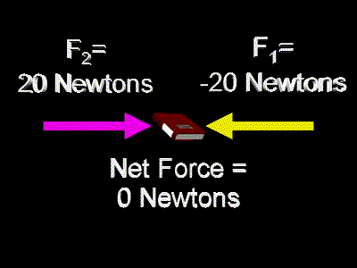
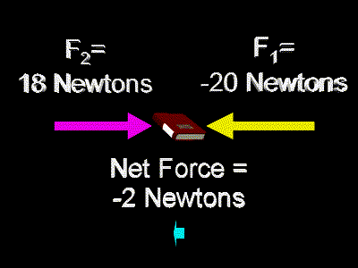
Net Forces
As we have already learned, several forces can act on one object at the same time. The vector sum of all the forces acting on the object is known as the net force.
The net force is not an actual force or a separate force of nature; it is the sum of actual forces.

Slide 8
Example:
A weight lifter holds a weight above the head by exerting a force of 1.6 kN [up]. The force of the gravity acting on the weight is 1.6 kN [down].
Draw a Free body diagram of the system.
Find the net force.

Slide 9
Find the net force.
= 1.6 kN [up] - 1.6 kN [down]
= 0

Slide 10
Newton’s First Law of Motion (Law of Inertia)
If the Net force acting on an object is zero, the object will maintain its state of rest or constant velocity.

Slide 11
This can be stated in layman’s terms as:
Objects at rest or moving with a constant velocity maintain their state of rest or constant velocity unless acted upon by a net force.
The net force must be external in order to change an objects velocity.
Internal forces have no effect on an objects motion.

Slide 12
This law of inertia helps us to understand the principles behind using seatbelts and air bags. Once an object is moving, it tends to keep moving at a constant velocity because of its inertia.
Air bags and seatbelts help to slow us down safely.

Slide 13
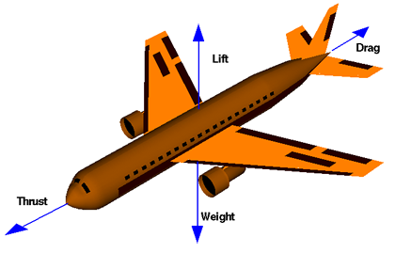
Example:
A 12 passenger jet aircraft of mass 1.6 x 10⁴ kg is travelling at a constant velocity of 850 km/h [E] while maintain a constant altitude. Besides gravity and air resistance, the aircraft also experiences an upward force called “lift” and a forward force of the engines called “thrust.”
Draw an FBD of the aircraft, and state the net force acting on the aircraft.

Slide 15
What is the net force?

Slide 16
Law of inertia Summary
Objects at rest remain at rest unless acted upon by a net force.
Objects in motion remain in motion unless action upon by a net force.
If the velocity of an object is constant (or zero), the net external force acing it must be zero.
If the velocity of an object is changing either in magnitude, direction, or both, the change must be caused by a net external force on the object.

Slide 17
Questions
Calculate the net force when each of the following sets forces act on the same object;
54 N [up], 65 N [down], and 92 N [up] 81 N [up]
8.6 N [S], 1.8 N [N], and 2.4 N [N] 4.4 N [S]
13.5 N [E], 21.2 N [W], 33.0 N [E], and 25.3 N [W] 0.0 N
A store clerk pushes a parcel on a counter with a force of 7.6 N [W]. The kinetic friction on the parcel is 6.5 N [E]. Both the force of gravity and the normal force have a magnitude of 9.9 N. Draw an FBD of the parcel and determine the net force acting on it.

Slide 18
Questions
Explain why Newton’s first law of motion can be also be called the law of inertia.
You exert a force of 46 N [up] on your backpack, causing it to move upward with a constant velocity. Draw an FBD of the backpack and determine the force of gravity on the pack.
Explain the danger of storing heavy or sharp objects in the rear window space of a car.

Slide 19
A curling rock moving along a rink eventually comes to a stop. Does this disagree with Newton’s first law of motion? Explain your answer.
Draw an FBD for the birdie in each case:
A badminton racket makes contact with a badminton birdie
The birdie goes straight up, just above the racket.
The birdie stops for a brief instant at the top of its flight.
The birdie begins to fall straight down; air resistance exists but has not reached maximum value.
State the value of the net force acting on an object that is
At rest
Moving with constant speed.

