Slide 1
Electrostatics
Electricity at rest

Slide 2
Electrically Charged Particles
An element is a pure substance that cannot be broken down into simpler substances.
An element is made up of tiny particles called atoms.

Slide 3

Electrically Charged Particles
Within an atom, there are three types of smaller particles:
  Protons have a positive electric charge (+)
  Electrons have a negative electric charge (–).
  Neutrons have no electric charge, they are neutral.

Slide 4
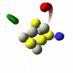
Electrically Charged Particles
The protons and neutrons are in the nucleus at the centre of the atom.
The electrons are outside the nucleus

Slide 5
Atoms are neutral. The number of protons in the nucleus equals the number of electrons around the nucleus. This makes an atom neutral.

Slide 6
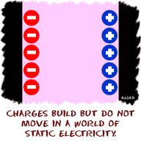
Static Charges
Objects can become charged when electrons move from one object to another.
The electric charge that builds up on the surface of the object is called a static charge or static electricity.

Slide 7
Static Charges
The charges are “static” because they remain very nearly fixed in one location on the surface of the object until they are given a path to escape
An object that has more electrons than protons is negatively charged.

Slide 8
Static Charges
An object that has more protons than electrons is positively charged.
If a neutral object obtains extra electrons, the object becomes negatively charged. If a neutral object loses electrons, the object becomes positively charged.

Slide 9
Friction and the Movement of Electrons

Slide 10
Friction
All solid materials are charged by the transfer of electrons.
  One common cause of electron transfer is friction.

Slide 11
Friction
    Friction is the force resisting the relative motion of two surfaces in contact. The force of friction can remove electrons from one object and cause them to transfer to the other object.

Slide 12
Friction
As one object loses electrons, the other object gains them. The total number electrons remains the same, they are transferred from one surface to another.
Positive Charges do not move.

Slide 13
For any charging procedure, it’s important to keep in mind that new electric charges are not being created. The electrons in each object are just being rearranged within the object or transferred to another object.

Slide 14
Electron Affinity
Different substances have different abilities to hold on to electrons. The tendency of a substance to hold on to the electrons is called electron affinity.

Slide 15
Electron Affinity
The table on the left is known as a triboelectric series
Tribo in Greek means to rub

Slide 16
Electron Affinity
This table lists a series of selected materials in order of their electron affinity.
The higher the material is in the list, the greater the tendency for that material to lose electrons.

Slide 17
Electron Affinity
This allows one to determine what charge a material will have if it is rubbed against another material on the table.

Slide 18
Note that there can be a slightly different order for materials such as fur or wood depending on which type of animal the fur is from and which type of tree the wood is from

Slide 19
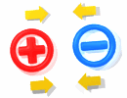
Laws of Attraction and Repulsion
Scientists studying the interaction of objects have observed that when a positively charged object is brought close to a negatively charged object, the two objects attract each other

Slide 20
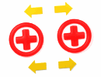
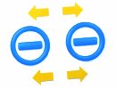
Laws of Attraction and Repulsion
objects with the same charge are placed close together, the objects repel each other.

Slide 21
As a result of many scientific investigations, scientists have established the following laws of static electric charges.
• The law of attraction states that particles with opposite charges attract each other.

Slide 22
The law of repulsion states that particles with like charges repel each other.
It should also be noted that when a charged object is brought near a neutral object it will attract it.

Slide 23
Exploring the Nature of Electricity 2
Coulombs
Charles-Augustin de Coulomb was a French physicist who worked with electric charges and made several important discoveries.
When two charged objects are placed closer together, the attraction or repulsion increases.

Slide 24
Exploring the Nature of Electricity 2
Coulombs
When the charged objects are moved farther apart, the attraction or repulsion decreases.
In his honour, the metric unit for electric charge is named the coulomb (C). One coulomb equals 6.24 x 10¹⁸ electrons added to or removed from a neutral object.

Slide 25
Electrical Insulators and Conductors
Another way to group materials is by their conductivity.
Conductivity is the ability of materials to allow electrons to move freely in them.

Slide 26
Electrical Insulators and Conductors
Materials that hold onto their electrons and do not allow them to move easily are called electrical insulators.
  An electrical insulator is a solid, liquid, or gas that resists or blocks the movement of electrons.
    Example: Dry wood, glass, and plastic.
An insulator can hold a static charge because static charges remain nearly fixed in place.

Slide 27
Electrical Insulators and Conductors
Materials that allow electrons to change positions are called conductors.
Conduction is the movement or transmission of electrons through a substance.
Examples: metals such copper and aluminum.

Slide 28
Electrical Insulators and Conductors
Some materials allow only some movement of electrons. This is the category of materials called fair conductors. In a fair conductor, the electrons do not move as freely as in a conductor, but they are not held almost in place as they are in an insulator

Slide 29
Conductivity of selected materials
Conductors | Fair Conductors | Insulators
Copper | Water with dissolved minerals | Rubber
Aluminum | Moist Air | Wood
Iron | Human Body | Plastic
Mercury | Carbon | Pure Water
Other metals | Soil | Metal oxides such as rust

Slide 30
Water as a Conductor
Water is an insulator only if it is pure.
However, most water has dissolved minerals in it, so its conductive properties change and it becomes a fair conductor.
This is why you do not want to be in a lake during a thunderstorm.
This also why you should not use water to try to put out an electrical fire.
You also need to take care not to operate electrical appliances near water or with wet hands

Slide 31
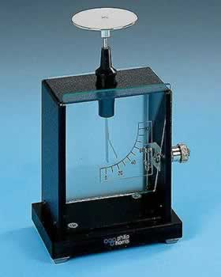
Charged Objects
The study of static electric charges is called electrostatics.
An electroscope is an instrument that can be used to detect static charge.
The electroscope was first invented in 1748 by a French clergyman and physicist named Jean Nollet.

Slide 32
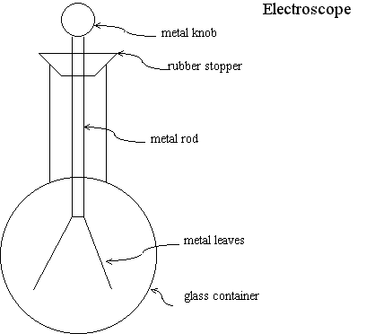
  A metal-leaf electroscope has two very thin metal pieces, called leaves, suspended from a metal rod. The metal rod is attached to a top plate or metal knob.
  When a charge is transferred to the plate or knob, the charges spread out over the whole structure, including the leaves. The greater the charge, the greater the separation between the leaves.

Slide 33
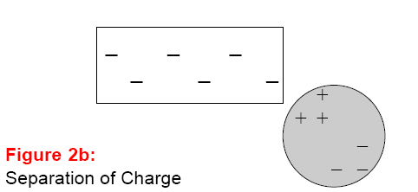
Detecting Static Charge
When a negatively charged rod is brought near a neutral electroscope, the electrons in the electroscope are repelled by the rod. The electrons move down into the leaves of the electroscope. The leaves are now both negatively charged, so they repel each other and move apart.
The movement of the charges is called Charge Separation

Slide 34
Detecting Static Charge
When the negatively charged rod is taken away, the negative charges in the electroscope are no longer repelled, so they move throughout the leaves, stem, and knob. The leaves drop down, and the electroscope is neutral again.

Slide 35
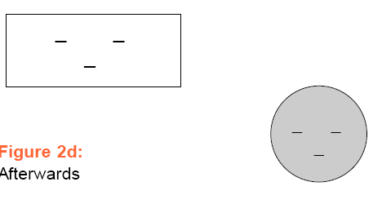
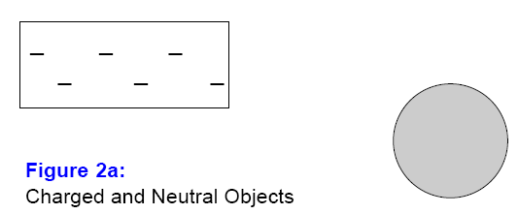
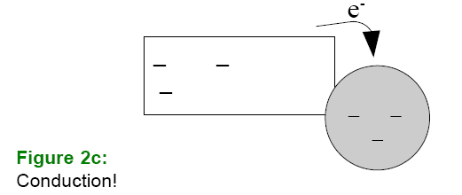
Charging By Contact
Electrons can be transferred through contact and conduction.
You can charge a neutral object by contact when you touch it with a charged object.
Charging by contact occurs when electrons transfer from the charged object to the neutral object that it touches.

Slide 36
Charging By Contact
The neutral object gains the same type of charge as the object that touched it because the electrons move from one object to the other

Slide 37
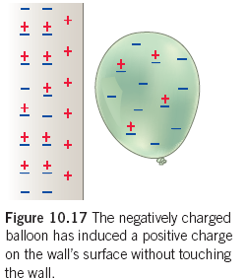
Induction
The movement of electrons within a substance caused by a nearby charged object, without direct contact between the substance and the object.
Example:

Slide 38
Charging by Induction
When charging an object by induction, a charged object is used to induce a charge in a neutral object and then ground the charged object so it retains the charge.
This newly charged object has the opposite charge to the charge on the charging object.

Slide 39
Charging by Induction
Grounding is the process of connecting a charged object to Earth’s surface.
When you connect a charged object to the ground, you provide a path for charges to travel to or from the ground.

Slide 40
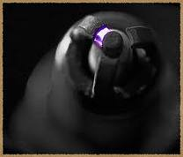
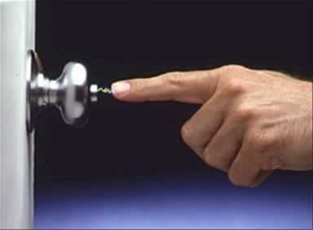
Electrical Discharge
Once an object is charged, the charges are trapped on it until they are given a path to escape.
When electric charges are transferred very quickly, the process is called an electrical discharge.
This can be caused by induction. The discharge happens before contact actually occurs.
  Example: Sparks or shocks

