Slide 1
Resistance – Ohm’s Law
Lesson 5

Slide 2
Resistance
The amount of current flow in a circuit, and the amount of energy transferred to any useful device, depends on two things;
The potential difference of the power supply
The nature of the pathway through the loads that are using electric potential energy.

Slide 3
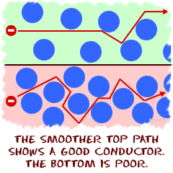
The more difficult the path is for the electrons to travel the more opposition there will be. Good conductors have less resistance than poor conductors. Heavier gauge wires also have less resistance than lighter gauge wires when the potential difference is the same because it is easier for the electrons to pass through.

Slide 4
The measure of opposition to flow is called electrical resistance.

Slide 5
Resistance in a Wire –comparing water to electricity
Longer thinner pipes have more resistance to the flow of water than pipes with a larger diameter.
The same idea applies to electricity.
The more resistance that you have in a circuit, the more it will decrease current at a given potential difference.

Slide 6
How much current flows over a load when the potential difference is varied? The schematic diagram below will be used for our example.
A
V

Slide 7
As the voltage is increased so does the load. The graph above shows voltage vs current is a straight line. The slope of the graph is resistance which remained unchanged in the experiment.

Slide 8
I (A) | V (V)
0 | 0 | -
0.12 | 0.31 | 2.6
0.25 | 0.64 | 2.6
0.40 | 1.04 | 2.6
0.57 | 1.47 | 2.6

Slide 9
Gerog Simon Ohm, found that the volts/ampere ratio was consistent for a particular resistor and created the formula

Slide 10
Resistance | Voltage | Current
Where R is the resistance in volts/ampere, which is given the unit of Ohm (Ω), V is the potential difference in Volts (V) and I is the resulting current in amperes (A)

Slide 11
Ohm’s Law
The amount of current flowing though a resistor varies directly as the amount of potential difference applied across the resistor as long as other variables, such as temperature, are controlled.
There is a resistance of 1 Ω when 1 A flows with a potential difference of 1 V across a resistor.

Slide 12
Example 1: Calculating Current
An electric stove element is connected to a 240 V supply and has a known resistance of 19.8 Ω. What current will this element draw?
V = 240 V
R = 19.8 Ω
I = ?

Slide 14
I = 12.1 A
Therefore, the current that the elements draws is 12.1 A

Slide 15
Example 2: Calculate Resistance
What is the resistance of a 1200 W hair dryer that draws about 10 A from a 120 V circuit?
I = 10 A
V = 120 V
R = ?

Slide 17
R = 12 Ω
Therefore, the hair dryer has a resistance of about 12 Ω

Slide 18
Example 3: Calculating Voltage
An electric heater has a resistance of 10.9 Ω and draws 11.0 A. What is the voltage reuired for the heater to run?
R = 10.9 Ω
I = 11.0 A
V = ?

Slide 20
V = 120 V
Therefore the heater requires 120 V.

Slide 21
Factors that Determine Resistance

Slide 22
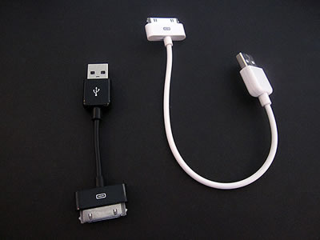
Length
The longer the conductor, the greater the resistance
If the wire doubles in length, it doubles in resistance

Slide 23
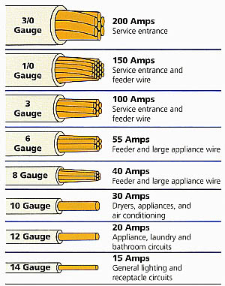
Cross-sectional Area
The larger the cross sectional area or thickness of the conductor, the less resistance it has to charge flow.

Slide 24
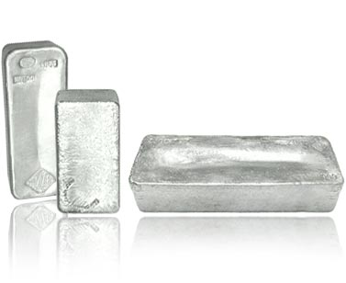
Type of material
Some materials are better conductors than others. The general measure of the resistance of a substance is called the resistivity which has the units Ωm

Slide 25
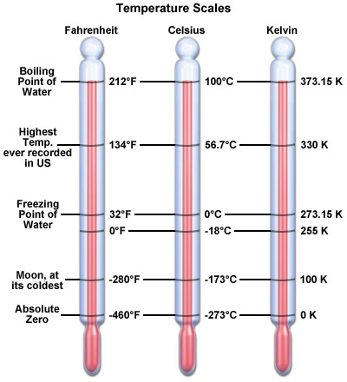
Temperature
Since moving charge is impeded by molecules, greater motion at higher temperatures tends to increase resistance.

Slide 26
Questions
Use the Values V = 120 V, I = 10.6 A, and R = 11.3 Ω to create problems, using each variable as the unknown.
A Voltmeter connected across the ends of a stove heating element indicates a potential difference of 120 V when an ammeter shows a current through the coil of 6.0 A. What is the resistance of the coil?
A TV remote has a resistance of 9.2 Ω and is connected to two AA batteries with a potential difference of 3.0 V. What is the current through the remote control?
What is the potential difference across a computer power supply with a resistance of 50 Ω if the motor draws a current of 2.2 A

Slide 27
A flashlight uses a 6.0 V battery and has a resistance of 20 Ohms, what is the current draw in the circuit?
A 12 V car battery has a resistance of 0.02 ohms as the current passes through the starter. What is the current in the system?
Household current is a consistent 120 volts. What will happen to the resistance and current as a light bulb heats up?

