Slide 1
Speed –Time Graphs for Acceleration
January 27th, 2011
Lesson 7

Slide 2
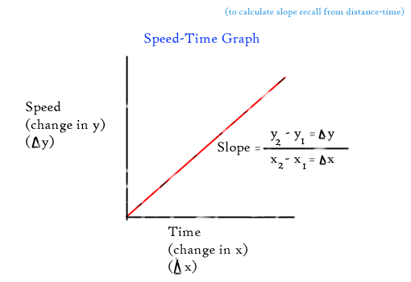
Speed –Time Graphs for Acceleration
Acceleration is a description of the relationship between speed and time.
Essentially it is a change in speed over time.
The variables in a speed time graph are speed on the y-axis and time on the x-axis, then the slope (Δy/Δx) corresponds to the definition of accleration (Δv/Δt) .

Slide 3
Therefore, the slope of a speed time graph is equal to acceleration.

Slide 4
Example:
The speed of a snowboarder is shown over time in the graph below.
The acceleration can be calculated by using the slope.
Draw a triangle on the line of best fit to calculate the slope.

Slide 6
Speed –Time Graphs
The type of slope of a speed graph tells us a lot about the type of acceleration
Slope – positive value
Positive acceleration
Increasing in speed
The steeper the slope the
more the object is accelerating.
V
t
V
t

Slide 7
Speed –Time Graphs
Slope – Zero
Zero Acceleration - Constant speed
V
t

Slide 8
Speed –Time Graphs
Slope – Negative value
Negative acceleration
Decreasing speed
The steeper the slope the more the object is decelerating.
V
t

Slide 9
Area Under the Line on a Speed Time Graph – Uniform Acceleration
The area of a speed time graph can be used to claculate the total distance traveled.
Distance units can be obtained by multiplying speed (m/s) by time (s)
Example

Slide 10
This also corresponds to the distance as calculated from the defining equation for speed:

Slide 11
In the example below, a student is in a 250 m bicycle race. They are accelerating at a rate of 2.0 m/s every 10.0 seconds.

Slide 12
Two variables multiplied together suggest the area of the geometric shape.
The area defined by the dotted lines would represent 500m

Slide 13
However, since we are accelerating, we do not take up all of that area. We can do 1 of two things. (they are the same thing)
Divide the area by 2
Find the area of the triangle.

Slide 14
The area under the line in a speed –time graph equals the distance travelled during the time interval.

Slide 15
Questions:
How can you tell from a speed-time table whether an object is accelerating? K (1)
How can you tell from a speed-time graph whether an object is accelerating? K (1)
Sketch a speed-time graph with two separate labelled lines for. C (2)
High positive acceleration
Low negative acceleration .
What feature of a speed time graph communicates K (2)
The acceleration?
The distance?

Slide 16
Two runners, Cathryn and Keir take part in a fundraising marathon. The graph below shows how their speeds change from the first 100 m from the start of the marathon. C (1) T (2)
Which runner has the greater acceleration?
Which runner is ahead after 100 s? Calculate and compare the distance travelled.

