Slide 1
Friction and the Coefficients of Friction

Slide 2
Friction
Friction is a part of everyday life, without it the world would be a very different place. Walking would not be possible, either would driving a car or playing sports. Even sitting on a stool would be difficult.

Slide 3
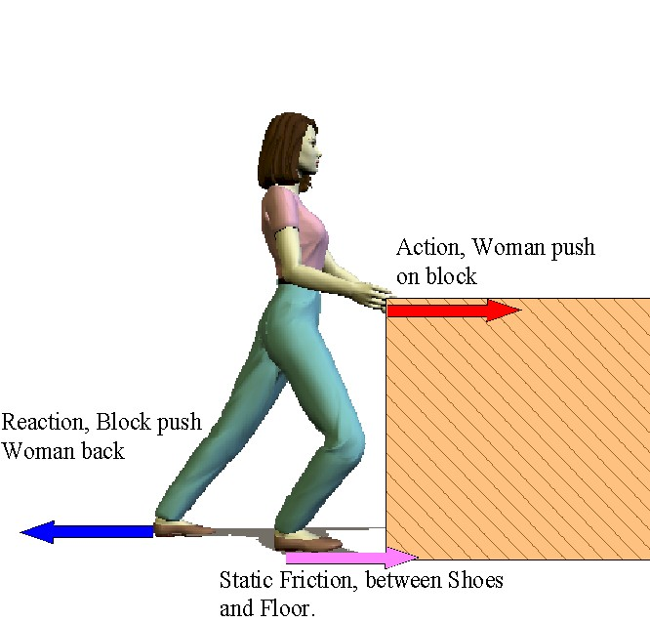
Static Friction
The force exerted on a stationary object by a surface that prevents the object from staring to move.
The object remains at rest because the static friction is equal in magnitude and opposite in direction to the applied force

Slide 4
Starting friction
The amount of force that must be overcome to start a stationary object moving

Slide 5
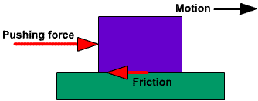
Kinetic Friction
The force exerted on a moving object by a surface, and acts opposite to the direction of the motion of the object.

Slide 6
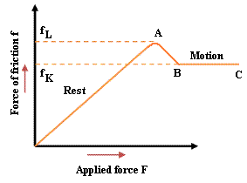
The Graph below shows the magnitude of friction vs the magnitude of the applied force. Once the object starts to move the friction drops suddenly.
f_{S}

Slide 7
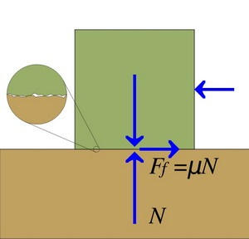
Coefficients of Friction
The ratio of the magnitude of the force of friction between two surfaces to the magnitude of the normal force between the surfaces.

Slide 8
We will use the Greek letter mu, μ, to represent this ratio.
Where F_{f} = the magnitude of the force of friction, in newtons;
F_{N} = the magnitude of the normal force, in newtons;
μ = the coefficient of friction. ( it has no units because it is a ratio of forces)

Slide 9
Rearranging the equation gives the equation for the force of friction;
F_{f} = μF_{N}

Slide 10
Generally, the force needed to start an object moving from rest is greater than the force needed to keep it moving at a constant velocity. Thus, to account for the differences we have two coefficients of friction.

Slide 11
The coefficient of kinetic friction is the ratio of the magnitude of the kinetic friction to the magnitude of the normal force

Slide 12
The coefficient of static friction is the ratio of the magnitude of the static friction to the magnitude of the normal force. The maximum force occurs just when the stationary object start to move.

Slide 13
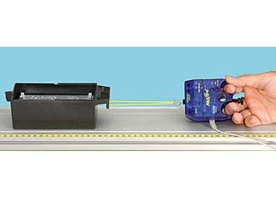
The coefficients of friction for various surfaces can only be determined experimentally.

Slide 14
Example 1
In the horizontal starting area for a bobsled race, four athletes with a combined mass of 295 kg, need a horizontal force of 41 N [forward] to get the 315 kg sled to start moving. Calculate the coefficient of static friction.

Slide 15
F_{N} = mg = (315 kg) x (9.81 m/s²)
= 3.1 x 10³ N
F_{S} = 41 N
μ_{S} = ?

Slide 16
μ_{S} = 0.013

Slide 17
Example 2
A trucks brakes are applied so hard that the truck goes into a skid on dry asphalt road. If the truck and its contents have a mass of 4.2 x 10² kg, calculate the magnitude of the force of kinetic friction on the truck.

Slide 18
F_{N} = mg = (4.2 x 10² kg) x (9.81 m/s²)
μ_{S} = 1.0 (from table, rubber on asphalt)
F_{K} = ?

Slide 19
F_{K} = μ_{K}F_{N}
F_{K} = μ_{K}mg
= (1.0) (4.2 x 10² kg) x (9.81 m/s²)

Slide 20
F_{K} = 4.1 x 10⁴ N
The magnitude of the force of kinetic friction is F_{K} = 4.1 x 10⁴ N ( in the direction opposite to the trucks initial motion)

Slide 21
Questions: - Hand in
Provide an example that shows that the coefficient of static friction tens to be greater than the coefficient of kinetic friction for two surfaces together. C (1)
Calculate the appropriate coefficient of friction in each of the following: T (2)
It takes 59 N of force to get a 22 kg suitcase to just start to move across a floor.
A horizontal force of 54 N keeps the suitcase in (a) moving at a constant velocity.
A 73 kg hockey player glides across the ice with steel blades. Calculate the magnitude of the force of kinetic friction acting on the skater. T (1)

Slide 22
A 1.5 x 10³ kg car moving a long a concrete road has its breaks locked but skids to a smooth stop. Calculate the magnitude of the force of kinetic friction on a (a) dry road and (b) a wet road. T (1)
The table below gives the data from an experiment in which a box containing different masses is pulled along the same floor at a constant speed.
Plot a graph of F_{K} (vertical axis) versus F_{N}. C (1)
Calculate the slope of the line. State what the slope represents. T (1) C (1)

Slide 23
F_{N} (N) | F_{K} (N)
0.0 | 0.0
10.0 | 2.2
20.0 | 4.3
30.0 | 6.7
40.0 | 8.8

