Slide 1
SPH4U1 “Free Body Diagrams”
Notes:
1

Slide 2
Review: Newton's Laws
Law 1: An object subject to no external forces is at rest or moves with a constant velocity if viewed from an inertial reference frame.
Law 2: For any object, F_{NET} = ma
Where F_{NET} = Σ F
Law 3: Forces occur in action-reaction pairs,
F_{A ,B} = - F_{B ,A}. Where F_{A ,B} is the force acting on object A due to its interaction with object B and vice-versa.
m is “mass” of object

Slide 3
Gravity:Mass vs Weight
What is the force of gravity exerted by the earth on a typical physics student?
Typical student mass m = 55kg
g = 9.81 m/s².
F_{g} = mg = (55 kg)x(9.81 m/s² )
F_{g} = 540 N = WEIGHT
F_{S,E} = F_{g} = mg
F_{E,S} = -mg

Slide 4
The Free Body Diagram
Newton’s 2nd Law says that for an object F = ma.
Key phrase here is for an object.
Object has mass and experiences forces
So before we can apply F = ma to any given object we isolate the forces acting on this object:

Slide 5
The Free Body Diagram...
Consider the following case as an example of this….
What are the forces acting on the plank ?
Other forces act on F, W and E. focus on plank
P = plank
F = floor
W = wall
E = earth
F_{P,W}
F_{W,P}
F_{P,F}
F_{P,E}
F_{F,P}
F_{E,P}

Slide 6
The Free Body Diagram...
Consider the following case
What are the forces acting on the plank ?
Isolate the plank from
the rest of the world.
F_{P,W}
F_{W,P}
F_{P,F}
F_{P,E}
F_{F,P}
F_{E,P}

Slide 7
The Free Body Diagram...
The forces acting on the plank should reveal themselves...
F_{P,W}
F_{P,F}
F_{P,E}

Slide 8
Aside...
In this example the plank is not moving...
It is certainly not accelerating!
So F_{NET} = ma becomes F_{NET} = 0
This is the basic idea behind statics, which we will discuss later.
F_{P,W}
F_{P,W} + F_{P,F} + F_{P,E} = 0
F_{P,F}
F_{P,E}

Slide 9
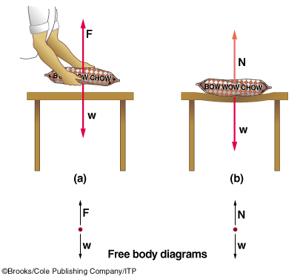
The Normal Force
When person is holding the bag above the table he must supply a force.
When the bag is placed on the table, the table supplies the force that holds the bag on it
That force is perpendicular or normal to the surface of table

Slide 10
Example
Example dynamics problem:
A box of mass m = 2 kg slides on a horizontal frictionless floor. A force F_{x} = 10 N pushes on it in the x direction. What is the acceleration of the box?
y
F = F_{x} i
a = ?
m
x

Slide 11
Example...
Draw a picture showing all of the forces
y
F_{B,F}
F
x
F_{F,B}
F_{B,E}
F_{E,B}

Slide 12
Example...
Draw a picture showing all of the forces.
Isolate the forces acting on the block.
y
F_{B,F}
F
x
F_{F,B}
F_{B,E} = mg
F_{E,B}

Slide 13
Example...
Draw a picture showing all of the forces.
Isolate the forces acting on the block.
Draw a free body diagram.
y
F_{B,F}
x
F
mg

Slide 14
Example...
Draw a picture showing all of the forces.
Isolate the forces acting on the block.
Draw a free body diagram.
Solve Newton’s equations for each component.
F_{X} = ma_{X}
F_{B,F} - mg = ma_{Y}
y
x
F_{B,F}
F
mg

Slide 15
Example...
F_{X} = ma_{X}
So a_{X} = F_{X} / m = (10 N)/(2 kg) = 5 m/s².
F_{B,F} - mg = ma_{Y}
But a_{Y} = 0
So F_{B,F} = mg.
The vertical component of the force of the floor on the object (F_{B,F} ) is often called the Normal Force (N).
Since a_{Y} = 0 , N = mg in this case.
N
y
F_{X}
x
mg

Slide 16
Example Recap
N = mg
F_{X}
y
a_{X} = F_{X} / m
x
mg

Slide 17
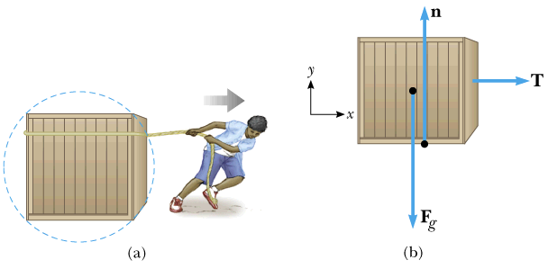
Free body diagram
Analyzing forces
Free body diagram
Tension in a rope = magnitude of the force that the rope exerts on object.

Slide 18
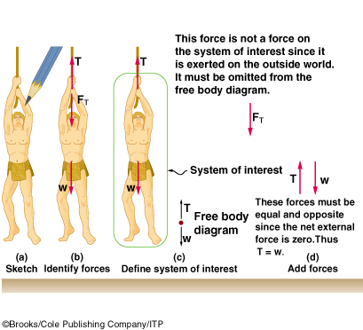
System of Interest

Slide 19
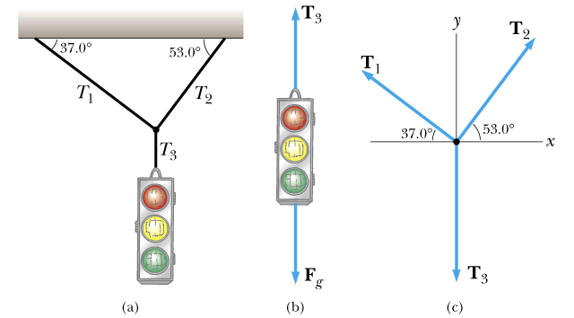
Example
A traffic light weighing hangs from a cable tied to two other cables fastened to a support as shown in the figure.

Slide 20
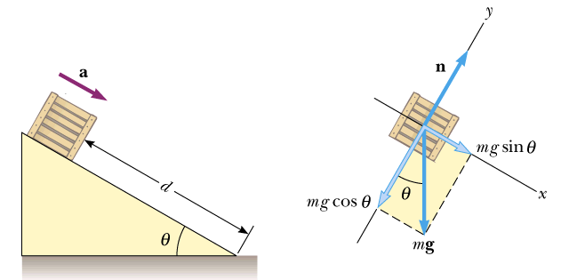
Example
A crate of mass m is placed on a frictionless plane of incline
Determine the acceleration of the crate.
α
α
α
α
α
α
α
α

Slide 21
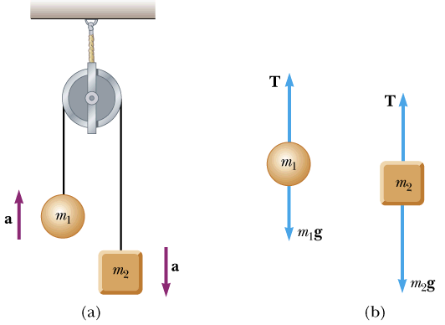
Example
Attwood’s machine.
Two objects of mass m₁ and m₂ are hung over a pulley.
Determine the magnitude of the acceleration of the two objects and the tension in the cord.

Slide 22
Free Body Diagram
BC
C
BA
W
B
A
W

Slide 23
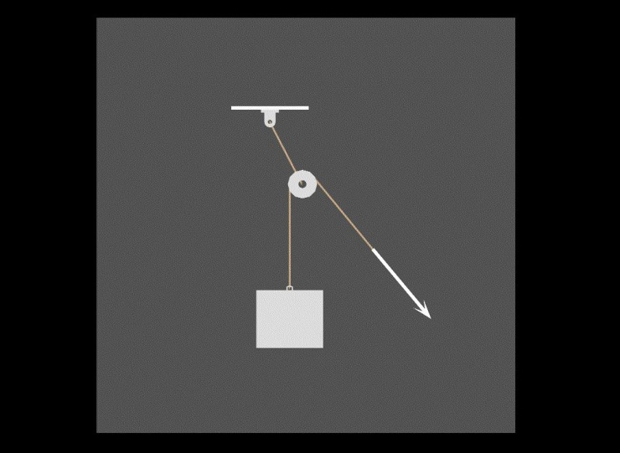
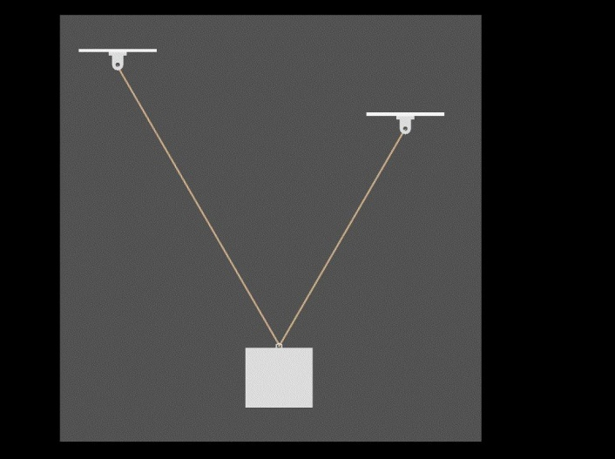
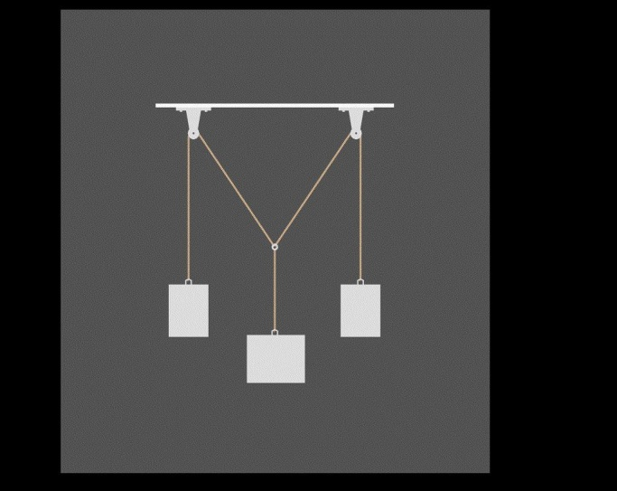
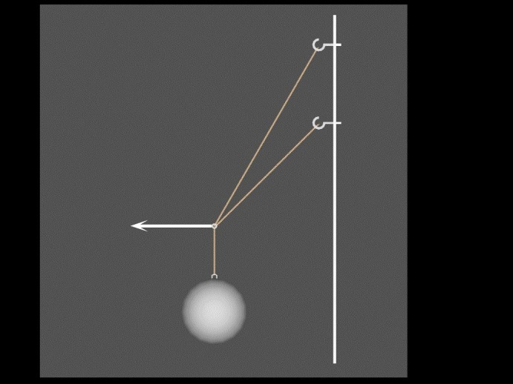
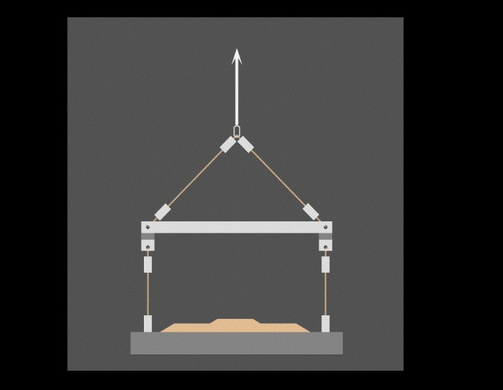

Slide 24
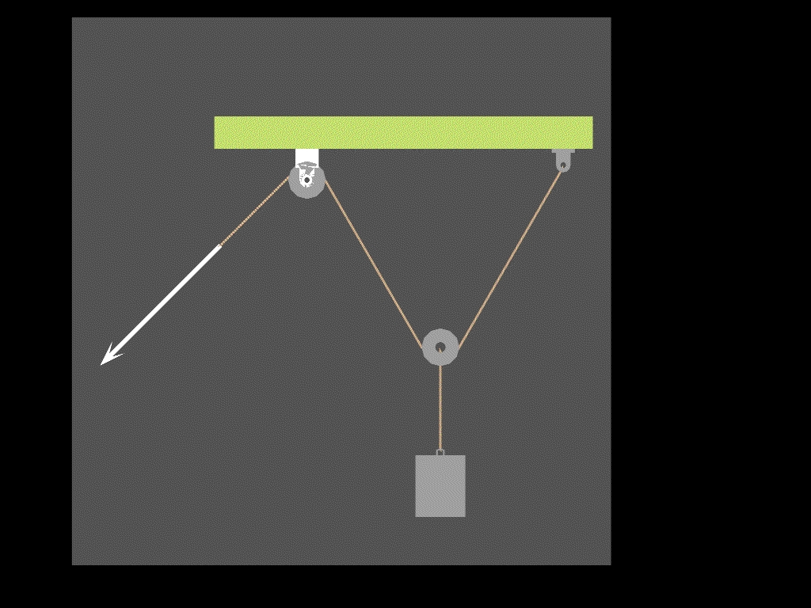
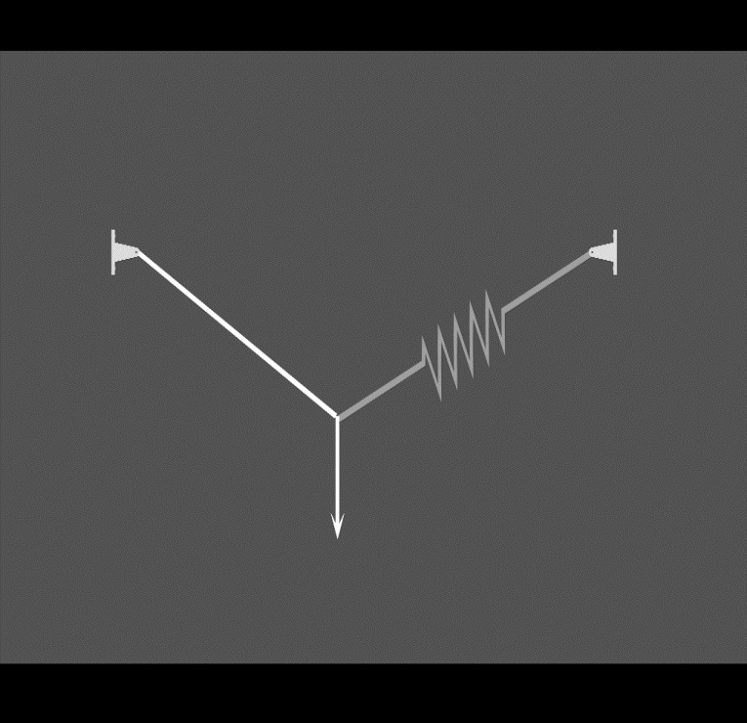

Slide 25
Question
Consider a person standing in an elevator that is accelerating upward. The upward normal force N exerted by the elevator floor on the person is
a) larger than
b) identical to
c) less than
the downward weight W of the person.
N
Free Body Diagram of the person:
mg
Person is accelerating upwards - net upwards force is non zero

Slide 26
Normal Force
A block of mass m rests on the floor of an elevator that is accelerating upward. What is the relationship between the force due to gravity and the normal force on the block?
(a) N > mg
(b) N = mg
(c)
a
N < mg
m

Slide 27
Solution
All forces are acting in the y direction, so use:
F_{total} = ma
N - mg = ma
N = ma + mg
therefore N > mg
N
m
a
mg

Slide 28
Understanding
You are driving a car up a hill with constant velocity. On a piece of paper, draw a Free Body Diagram (FBD) for the car. How many forces are acting on the car? 1 2 3 4 5
F_{N}
V
correct
True if accelerating also
F_{road on car}
W
weight/gravity (W) normal (F_{N}) engine/motor (F_{car_on_road}(action) ==> (reaction) F_{road on car})

Slide 29
Understanding
The net force on the same car is 1. Zero 2. Pointing up the hill 3. Pointing down the hill 4. Pointing vertically downward 5. Pointing vertically upward
F_{N}
V
correct
F_{road on car}
W
F_{road on car}
F_{N}
W
ΣF = ma = 0

Slide 30
Pulley I
What is the tension in the string?
A) T<W
B) T=W
C) W<T<2W
D) T=2W
W
W
T
Look at Free Body Diagram: T=W
Net Force = 0 = acceleration
W
W
Pull with
force = W
Same answer
W

Slide 31
Pulley II
What is the tension in the string?
A) T<W
B) T=W
C) W<T<2W
D) T=2W
a
2W
a
W
Look at Free Body Diagrams:
T
T
T<2W:
a
2W
W
W<T:
a
2W
W

Slide 32
Ropes & Strings
Can be used to pull from a distance.
Tension (T) at a certain position in a rope is the magnitude of the force acting across a cross-section of the rope at that position.
The force you would feel if you cut the rope and grabbed the ends.
An action-reaction pair.
T
cut
L
T
T = F_{R,L}
T
T = F_{L,R}
R
Tension doesn’t have a direction
When you hook up a wire to an object the direction is determined by geometry of the hook up

Slide 33
Ropes & Strings...
Consider a horizontal segment of rope having mass m:
Draw a free-body diagram (ignore gravity).
Using Newton’s 2nd law (in x direction): F_{NET} = T₂ - T₁ = ma
So if m = 0 (i.e. the rope is light) then T₁ = T₂
And if a = 0 then T₁ = T₂
Otherwise, T is a function of position
m
T₁
T₂
a
x

Slide 34
Ropes & Strings...
An ideal (massless) rope has constant tension along the rope.
If a rope has mass, the tension can vary along the rope
For example, a heavy rope hanging from the ceiling...
We will deal mostly with ideal massless ropes.
T
T
T = T_{g}
T = 0

Slide 35
Ropes & Strings...
What is force acting on mass – isolate the mass!!!
The direction of the force provided by a rope is along the direction of the rope:
(this is a massless rope)
T
Since a_{y} = 0 (box not moving),
m
T = mg
mg

Slide 36
Force and acceleration
A fish is being yanked upward out of the water using a fishing line that breaks when the tension reaches 180 N. The string snaps when the acceleration of the fish is observed to be is 12.2 m/s². What is the mass of the fish?
snap !
(a) 14.8 kg
(b) 18.4 kg
(c) 8.2 kg
a = 12.2 m/s²
m = ?

Slide 37
Solution:
T
Draw a Free Body Diagram!!
Use Newton’s 2nd law in the upward direction:
a = 12.2 m/s²
m = ?
F_{TOT} = ma
T - mg = ma
T = ma + mg = m(g+a)
mg

Slide 38
Pegs & Pulleys
Used to change the direction of forces
An ideal massless pulley or ideal smooth peg will change the direction of an applied force without altering the magnitude:
F₁
ideal peg
or pulley
| F₁ | = | F₂ |
F₂

Slide 39
Pegs & Pulleys
Used to change the direction of forces
An ideal massless pulley or ideal smooth peg will change the direction of an applied force without altering the magnitude:
F_{W,S} = mg
T
m
T = mg
mg

Slide 40
Scales:
Springs can be calibrated to tell us the applied force.
We can calibrate scales to read Newtons, or...
Fishing scales usually read weight in kg or lbs.
1 lb = 4.45 N
How many Newtons is 1 kg?
0
2
4
6
8

Slide 41
Force and acceleration
A block weighing 4 lbs is hung from a rope attached to a scale. The scale is then attached to a wall and reads 4 lbs. What will the scale read when it is instead attached to another block weighing 4 lbs?
?
m
m
m
(1)
(2)
(a) 0 lbs. (b) 4 lbs. (c) 8 lbs.

Slide 42
Solution:
Draw a Free Body Diagram of one of the blocks!!
T
Use Newton’s 2nd Law in the y direction:
m
T = mg
a = 0 since the blocks are stationary
mg
F_{TOT} = 0
T - mg = 0
T = mg = 4 lbs.

Slide 43
Solution:
The scale reads the tension in the rope, which is T = 4 lbs in both cases!
T
T
T
T
T
T
T
m
m
m

