Slide 1
Stoichiometry
November 10, 2011
SCH 4c

Slide 2
Review
What is Avagadro’s Number?
What is the mole?
How do we relate mol, mass, molar mass?

Slide 3
Introduction
Why do we balance chemical reactions?
Balanced chemical equations are needed to make calculations related to chemical reactions
Imagine you are making a salad.
What ingredients do you need?
One head of lettuce
Two Cucumbers
Five Radishes
How would we represent this as an equation?

Slide 4
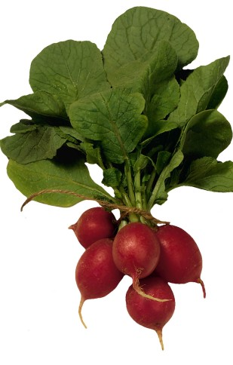
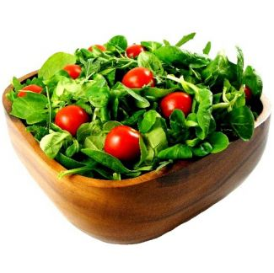
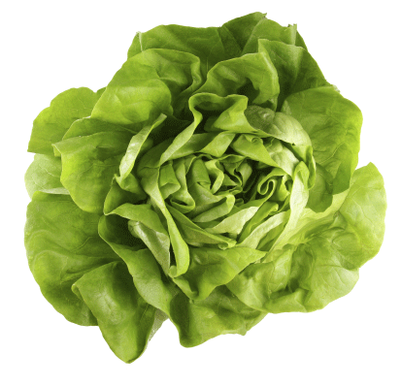
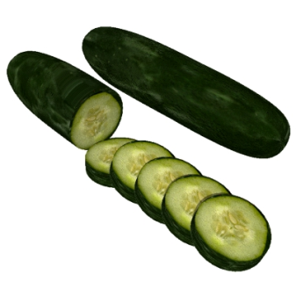
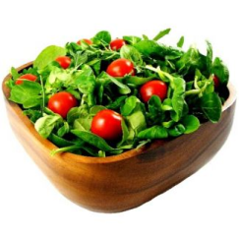
Salad Chemistry
What if we wanted two salads?
What if we had 3 heads of lettuce, six cucumbers, and 15 radishes?

Slide 5
Balanced Chemical Equation
What do coefficients tell us?
How many atoms and molecules participate in a reaction
1 atom C : 1 molecule O₂ : 1 molecule CO₂
1
1
1
1 atom
1 molecule
1 molecule
12 atom
12 molecules
12 molecules
6.022 x 10²³ atom
6.022 x 10²³ molecules
6.022 x 10²³ molecules
1 mole
1 mole
1 mole

Slide 6
Mole Ratios
2
2 molecules
1 molecule
1 molecule
2 mole
1 mole
1 mole
2 mole H₂ : 1 mole O₂ : 2 mole H₂O
Suppose you want to produce 20 moles of water. How many moles of oxygen do you need?
n_{oxygen} = moles given x moles of what you want
moles of what you have
= 20 H₂0 mol x 1 mole O₂ = 10 mol O₂
2 mole H₂0

Slide 7
How many molecules of NaCl are needed to react with one molecule of sulfuric acid?
How many molecules of NaCl are needed to react with 3 dozen molecules of sulfuric acid?
How many molecules of sodium sulfate are formed from 2 molecules of NaCl?
How many molecules of HCl are formed from 4 molecules of sulfuric acid?

Slide 8
How many molecules of NaCl are needed to make 6 million molecules of sodium sulfate?
How many moles of NaCl form 1 mole of sodium sulfate?
How many moles of HCl will be formed from 1 mole of sulfuric acid?
How many moles of HCl are formed from 0.5 molecules of sulfuric acid?
How many moles of sulfuric acid are needed to form 0.5 mole of sodium sulfate?

Slide 9
Homework
Question 2 of “Introduction to Stiochiometry Probems”
Practice Problems

